Slide 1


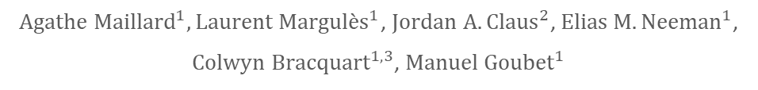
Étude des conformères de l'ortho-crésol par spectroscopie rotationnelle
¹ Univ. Lille, CNRS, UMR 8523 - PhLAM - Physique des Lasers Atomes et Molécules, F-59000 Lille, France
² Università di Bologna, Dipartimento di Chimica « Giacomo Ciamician » - Spettroscopia rotazionale e computazionale, Bologna, Italia
³LPCA, Laboratoire de Physico-Chimie de l’Atmosphère, Université du Littoral Côte d’Opale, UR4493, F-59140 Dunkerque, France
${Agathe Maillard}^{1},{Laurent Margulès}^{1}$, ${Jordan A. Claus}^{2}$,${ Elias M. Neeman}^{1}$,
${Colwyn Bracquart}^{1,3}$, ${Manuel Goubet}^{1}$

Slide 2
Crésol – Journées de Spectroscopie Moléculaire – Grenoble – 10-12 mars 2024
Introduction
General Context: Volatile Organic Compounds
Definition:
Molecules in the gaseous phase of the atmosphere

Slide 3
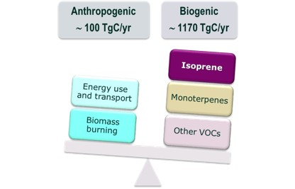
Crésol – Journées de Spectroscopie Moléculaire – Grenoble – 10-12 mars 2024
Introduction
General Context: Volatile Organic Compounds
Definition:
Molecules in the gaseous phase of the atmosphere
Sources:
Biogenic
Anthropogenic

Slide 4
Crésol – Journées de Spectroscopie Moléculaire – Grenoble – 10-12 mars 2024
Introduction
General Context: Volatile Organic Compounds
Definition:
Molecules in the gaseous phase of the atmosphere
Sources:
Biogenic
Anthropogenic
Main classes of VOCs studied:
Isoprene (44%)
Monoterpenes (11%)
Other reactive VOCs (22.5%)
Other non-reactive VOCs (22.5%)
Importance in the atmosphere:
Influences atmospheric chemistry
Impact on the carbon cycle

Slide 5


Crésol – Journées de Spectroscopie Moléculaire – Grenoble – 10-12 mars 2024
Introduction
General Context: Volatile Organic Compounds
Definition:
Molecules in the gaseous phase of the atmosphere
Sources:
Biogenic
Anthropogenic
Main classes of VOCs studied:
Isoprene (44%)
Monoterpenes (11%)
Other reactive VOCs (22.5%)
Other non-reactive VOCs (22.5%)
Importance in the atmosphere:
Influences atmospheric chemistry
Impact on the carbon cycle
Aérosols Organiques Secondaires
VOC
anthropogenic
biogenic

Slide 6
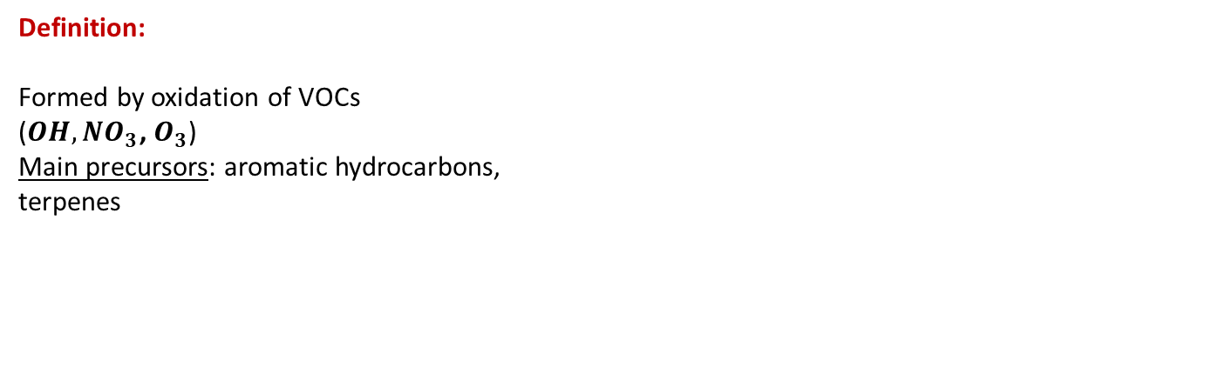
Crésol – Journées de Spectroscopie Moléculaire – Grenoble – 10-12 mars 2024
Introduction
General context: Secondary Organic Aerosols
Definition:
Formed by oxidation of VOCs
($OH, {NO}_{3}$, $O_{3}$)
Main precursors: aromatic hydrocarbons, terpenes
Guzman, M. I., & Eugene, A. J. (2021). Aqueous photochemistry of 2-oxocarboxylic acids: evidence, mechanisms, and atmospheric impact. Molecules, 26(17), 5278.

Slide 7
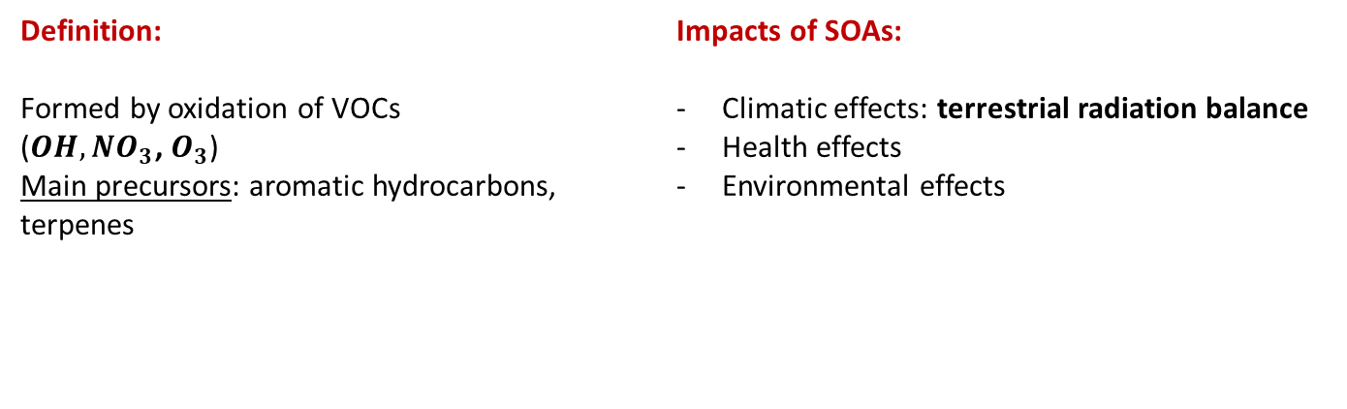
Crésol – Journées de Spectroscopie Moléculaire – Grenoble – 10-12 mars 2024
Introduction
General context: Secondary Organic Aerosols
Definition:
Formed by oxidation of VOCs
($OH, {NO}_{3}$, $O_{3}$)
Main precursors: aromatic hydrocarbons, terpenes
Impacts of SOAs:
Climatic effects: terrestrial radiation balance
Health effects
Environmental effects
Guzman, M. I., & Eugene, A. J. (2021). Aqueous photochemistry of 2-oxocarboxylic acids: evidence, mechanisms, and atmospheric impact. Molecules, 26(17), 5278.

Slide 8
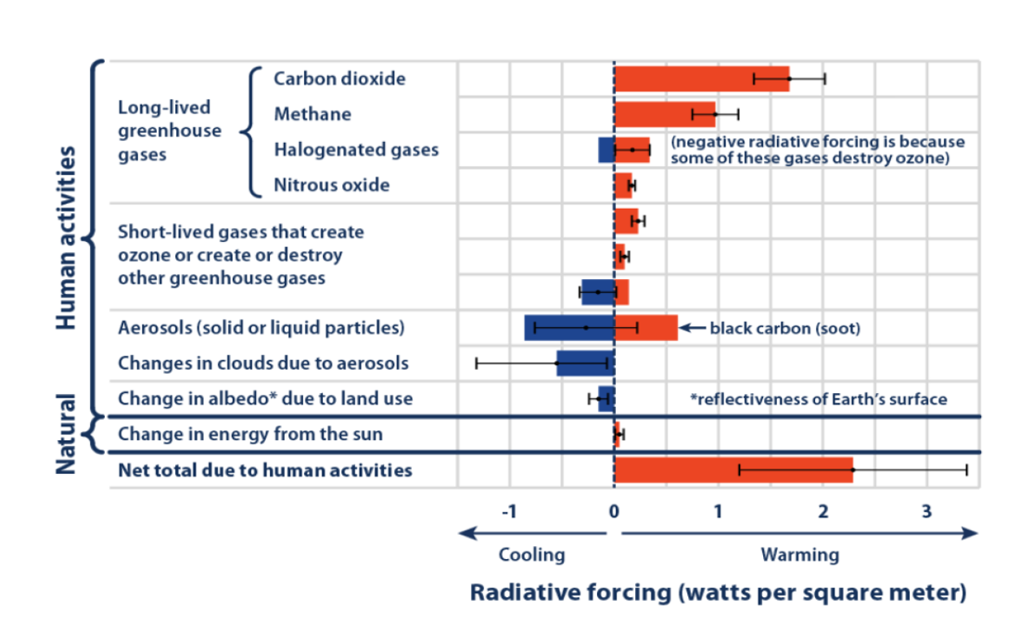
Crésol – Journées de Spectroscopie Moléculaire – Grenoble – 10-12 mars 2024
Introduction
General context: Secondary Organic Aerosols
Definition:
Formed by oxidation of VOCs
($OH, {NO}_{3}$, $O_{3}$)
Main precursors: aromatic hydrocarbons, terpenes
Impacts of SOAs:
Climatic effects: terrestrial radiation balance
Health effects
Environmental effects
Source IPCC, 2013 web update May 2014
Guzman, M. I., & Eugene, A. J. (2021). Aqueous photochemistry of 2-oxocarboxylic acids: evidence, mechanisms, and atmospheric impact. Molecules, 26(17), 5278.

Slide 9
Crésol – Journées de Spectroscopie Moléculaire – Grenoble – 10-12 mars 2024
Introduction
General context: Secondary Organic Aerosols
Definition:
Formed by oxidation of VOCs
($OH, {NO}_{3}$, $O_{3}$)
Main precursors: aromatic hydrocarbons, terpenes
Impacts of SOAs:
Climatic effects: terrestrial radiation balance
Health effects
Environmental effects
Source IPCC, 2013 web update May 2014
Guzman, M. I., & Eugene, A. J. (2021). Aqueous photochemistry of 2-oxocarboxylic acids: evidence, mechanisms, and atmospheric impact. Molecules, 26(17), 5278.

Slide 10
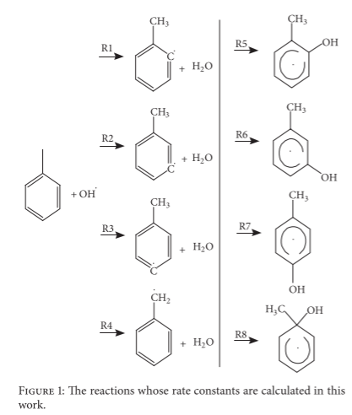
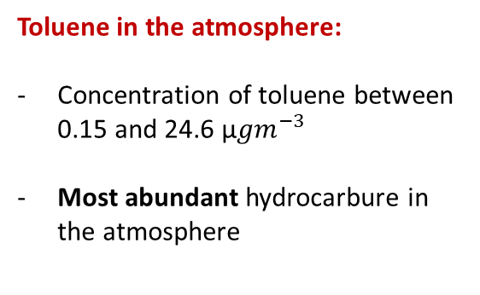
Crésol – Journées de Spectroscopie Moléculaire – Grenoble – 10-12 mars 2024
Introduction
Why study ortho-cresol?
Toluene in the atmosphere:
Concentration of toluene between 0.15 and 24.6 µ${gm}^{−3}$
Most abundant hydrocarbure in the atmosphere
Zhang, R. M., Truhlar, D. G., & Xu, X. (2019). Kinetics of the Toluene Reaction with OH Radical, Research, 2019, 5373785.

Slide 11
Crésol – Journées de Spectroscopie Moléculaire – Grenoble – 10-12 mars 2024
Introduction
Why study ortho-cresol?
Toluene in the atmosphere:
Concentration of toluene between 0.15 and 24.6 µ${gm}^{−3}$
Most abundant hydrocarbure in the atmosphere
Reaction:
Cresols (m-, o-, and p-cresol) are by-products of the oxidation of toluene with OH radicals.
Zhang, R. M., Truhlar, D. G., & Xu, X. (2019). Kinetics of the Toluene Reaction with OH Radical, Research, 2019, 5373785.

Slide 12


Crésol – Journées de Spectroscopie Moléculaire – Grenoble – 10-12 mars 2024
Introduction
Why study ortho-cresol?
Toluene in the atmosphere:
Concentration of toluene between 0.15 and 24.6 µ${gm}^{−3}$
Most abundant hydrocarbure in the atmosphere
Reaction:
Cresols (m-, o-, and p-cresol) are by-products of the oxidation of toluene with OH radicals.
Dangerous:
- Health hazard
Zhang, R. M., Truhlar, D. G., & Xu, X. (2019). Kinetics of the Toluene Reaction with OH Radical, Research, 2019, 5373785.

Slide 13
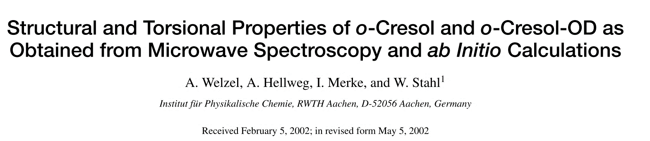
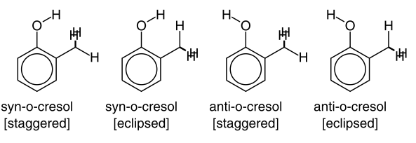
Crésol – Journées de Spectroscopie Moléculaire – Grenoble – 10-12 mars 2024
Method:
Experimental: FTMW from 3 to 40 GHz
Ab-initio calculations: Gaussian 94 ab-initio package + MP2
1. Ortho-cresol
Welzel, A., Hellweg, A., Merke, I., & Stahl, W. (2002). Structural and torsional properties of o-cresol and o-cresol-OD as obtained from microwave spectroscopy and ab initio calculations. Journal of Molecular Spectroscopy, 215(1), 58-65.

Slide 14
Crésol – Journées de Spectroscopie Moléculaire – Grenoble – 10-12 mars 2024
Method:
Experimental: FTMW from 3 to 40 GHz
Ab-initio calculations: Gaussian 94 ab-initio package + MP2
1. Ortho-cresol
Results:
Rotational constants determined
Sextic centrifugal distortion constants determined
Welzel, A., Hellweg, A., Merke, I., & Stahl, W. (2002). Structural and torsional properties of o-cresol and o-cresol-OD as obtained from microwave spectroscopy and ab initio calculations. Journal of Molecular Spectroscopy, 215(1), 58-65.

Slide 15
Crésol – Journées de Spectroscopie Moléculaire – Grenoble – 10-12 mars 2024
Method:
Experimental: FTMW from 3 to 40 GHz
Ab-initio calculations: Gaussian 94 ab-initio package + MP2
1. Ortho-cresol
Our goal:
Extend the frequency range of measurements
- Further determination of centrifugal distortion constants
Results:
Rotational constants determined
Sextic centrifugal distortion constants determined
Welzel, A., Hellweg, A., Merke, I., & Stahl, W. (2002). Structural and torsional properties of o-cresol and o-cresol-OD as obtained from microwave spectroscopy and ab initio calculations. Journal of Molecular Spectroscopy, 215(1), 58-65.

Slide 16
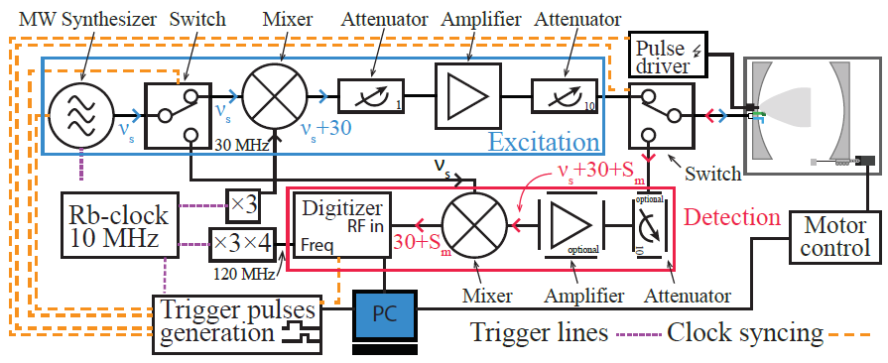
Crésol – Journées de Spectroscopie Moléculaire – Grenoble – 10-12 mars 2024
1. Ortho-cresol
Method employed:
Experimental:
Fourier transform microwave pulse spectrometers (2-20 GHz)
Credits: Noureddin Osseiran

Slide 17
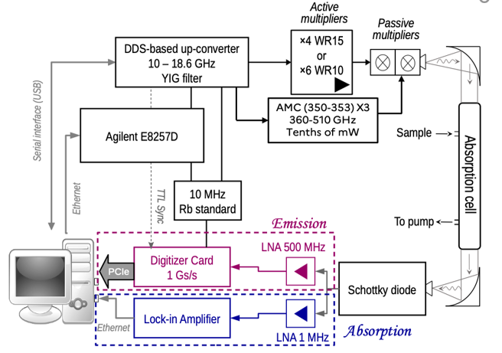
Crésol – Journées de Spectroscopie Moléculaire – Grenoble – 10-12 mars 2024
1. Ortho-cresol
Method employed:
Experimental:
Fourier transform microwave pulse spectrometers (2-20 GHz)
Credits: Noureddin Osseiran
The terahertz absorption spectrometer in Lille
(75-1400 GHz)
Credits: Luyao Zou

Slide 18
Crésol – Journées de Spectroscopie Moléculaire – Grenoble – 10-12 mars 2024
1. Ortho-cresol
Method employed:
Experimental:
Fourier transform microwave pulse spectrometers (2-20 GHz)
Credits: Noureddin Osseiran
The terahertz absorption spectrometer in Lille
(75-1400 GHz)
Credits: Luyao Zou
- Calculations: equilibrium structure
Analysis: using SPFIT/SPCAT

Slide 19
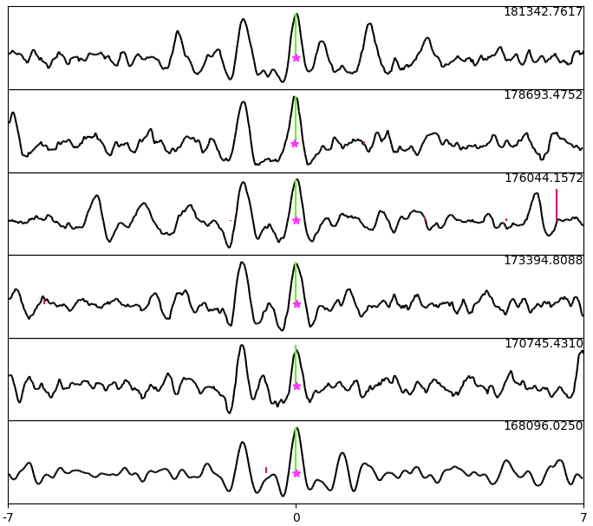

Crésol – Journées de Spectroscopie Moléculaire – Grenoble – 10-12 mars 2024
1. Ortho-cresol
Our premilinary results (semi-rigid) : tunneling splitting
Transitions from J= 59 ${\text{K}}_{a}=4$
to J= 64 ${\text{K}}_{a}=4$

Slide 20
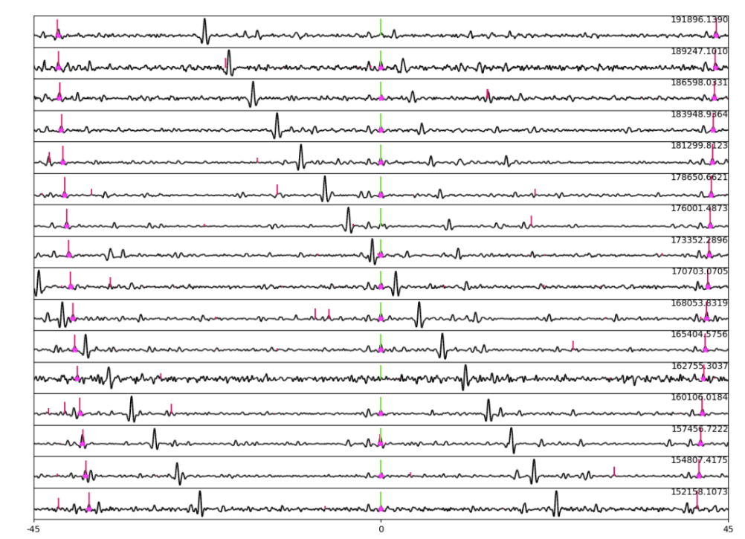

Crésol – Journées de Spectroscopie Moléculaire – Grenoble – 10-12 mars 2024
1. Ortho-cresol
Our premilinary results (semi-rigid) : tunneling splitting
Transitions from J= 59 ${\text{K}}_{a}=4$
to J= 64 ${\text{K}}_{a}=4$
Transitions from J= 52 ${\text{K}}_{a}=5$
to J= 67 ${\text{K}}_{a}=5$

Slide 21


Crésol – Journées de Spectroscopie Moléculaire – Grenoble – 10-12 mars 2024
1. Ortho-cresol
Our premilinary results (semi-rigid) : tunneling splitting
$V_{3_anti}=$4.4 ${kJ.mol}^{−1}$
$V_{3_syn}=$7.9 ${kJ.mol}^{−1}$
Transitions from J= 59 ${\text{K}}_{a}=4$
to J= 64 ${\text{K}}_{a}=4$
Transitions from J= 52 ${\text{K}}_{a}=5$
to J= 67 ${\text{K}}_{a}=5$

Slide 22
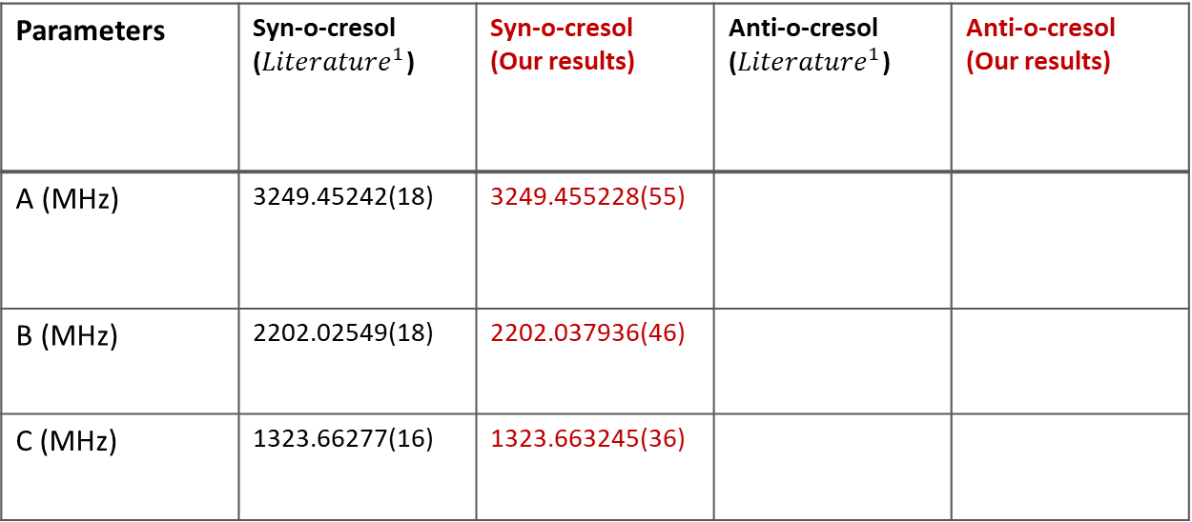
Crésol – Journées de Spectroscopie Moléculaire – Grenoble – 10-12 mars 2024
1. Ortho-cresol
Our premilinary results :
Parameters | Syn-o-cresol (${Literature}^{1}$) | Syn-o-cresol (Our results) | Anti-o-cresol (${Literature}^{1}$) | Anti-o-cresol (Our results)
A (MHz) | 3249.45242(18) | 3249.455228(55)
B (MHz) | 2202.02549(18) | 2202.037936(46)
C (MHz) | 1323.66277(16) | 1323.663245(36)
$${\begin{aligned}\text{Welzel}\text{, }\text{A}\text{., }\text{Hellweg}\text{, }\text{A}\text{., }\text{Merke}\text{, }\text{I}\text{., & }\text{Stahl}\text{, }\text{W}\text{. (2002). }\text{Structural} \text{and} \text{torsional} \text{properties} \\ \text{of} \text{o}\text{−}\text{cresol} \text{and} \text{o}\text{−}\text{cresol}\text{−}\text{OD} \text{as} \text{obtained} \text{from} \text{microwave} \text{spectroscopy} \text{and} \text{ab} \text{initio} \text{calculations}\text{. }\text{Journal} \text{of} \text{Molecular} \text{Spectroscopy}\text{, }\text{215}\text{(1), 58−65.}\end{aligned}}^{1}$$

Slide 23
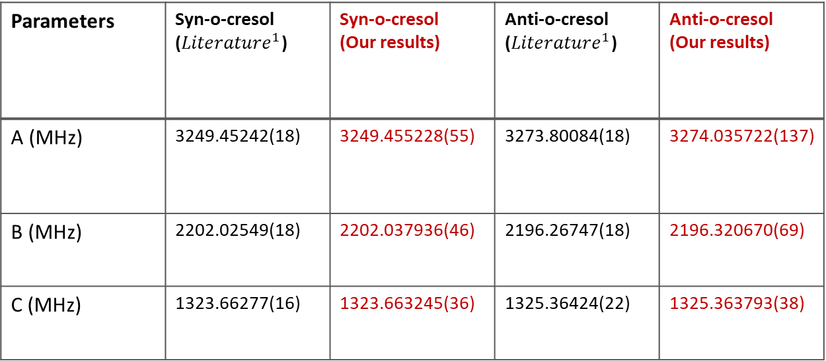
Crésol – Journées de Spectroscopie Moléculaire – Grenoble – 10-12 mars 2024
1. Ortho-cresol
Our premilinary results :
Parameters | Syn-o-cresol (${Literature}^{1}$) | Syn-o-cresol (Our results) | Anti-o-cresol (${Literature}^{1}$) | Anti-o-cresol (Our results)
A (MHz) | 3249.45242(18) | 3249.455228(55) | 3273.80084(18) | 3274.035722(137)
B (MHz) | 2202.02549(18) | 2202.037936(46) | 2196.26747(18) | 2196.320670(69)
C (MHz) | 1323.66277(16) | 1323.663245(36) | 1325.36424(22) | 1325.363793(38)
$${\begin{aligned}\text{Welzel}\text{, }\text{A}\text{., }\text{Hellweg}\text{, }\text{A}\text{., }\text{Merke}\text{, }\text{I}\text{., & }\text{Stahl}\text{, }\text{W}\text{. (2002). }\text{Structural} \text{and} \text{torsional} \text{properties} \\ \text{of} \text{o}\text{−}\text{cresol} \text{and} \text{o}\text{−}\text{cresol}\text{−}\text{OD} \text{as} \text{obtained} \text{from} \text{microwave} \text{spectroscopy} \text{and} \text{ab} \text{initio} \text{calculations}\text{. }\text{Journal} \text{of} \text{Molecular} \text{Spectroscopy}\text{, }\text{215}\text{(1), 58−65.}\end{aligned}}^{1}$$

Slide 24
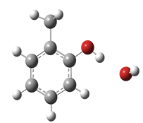
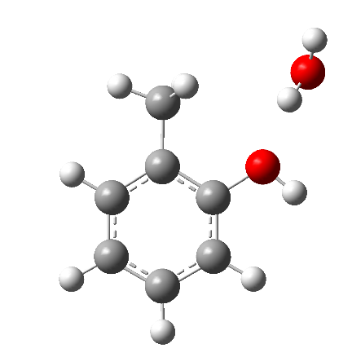
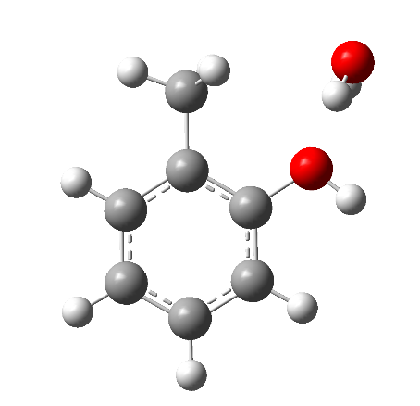
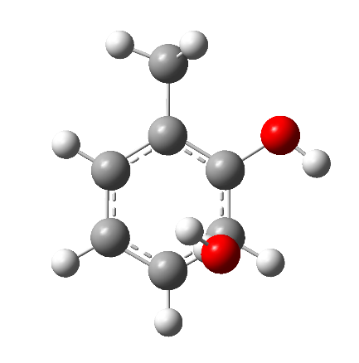
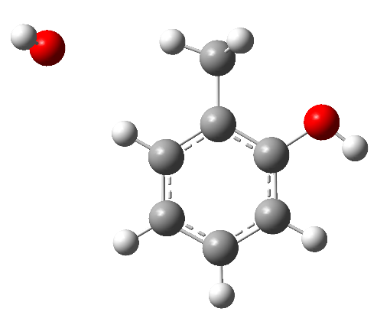
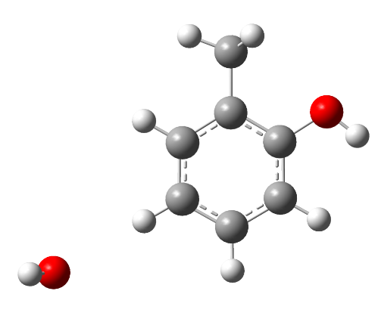
Crésol – Journées de Spectroscopie Moléculaire – Grenoble – 10-12 mars 2024
2. Monohydrated ortho-cresol
1
2
3
Quantum computational calculations (B98aVTZ):
4
5
6

Slide 25






Crésol – Journées de Spectroscopie Moléculaire – Grenoble – 10-12 mars 2024
2. Monohydrated ortho-cresol
1
2
3
Quantum computational calculations (B98aVTZ):
$${0 kJ.mol}^{−1}$$
$${9.9 kJ.mol}^{−1}$$
$${10.5 kJ.mol}^{−1}$$
4
5
6
$${11.8 kJ.mol}^{−1}$$
$${15.9 kJ.mol}^{−1}$$
$${16.6 kJ.mol}^{−1}$$

Slide 26
Crésol – Journées de Spectroscopie Moléculaire – Grenoble – 10-12 mars 2024
2. Monohydrated ortho-cresol
1
2
3
Quantum computational calculations (B98aVTZ):
$${0 kJ.mol}^{−1}$$
$${9.9 kJ.mol}^{−1}$$
$${10.5 kJ.mol}^{−1}$$
4
5
6
$${11.8 kJ.mol}^{−1}$$
$${15.9 kJ.mol}^{−1}$$
$${16.6 kJ.mol}^{−1}$$

Slide 27




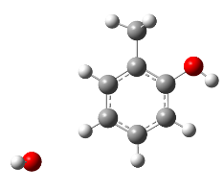
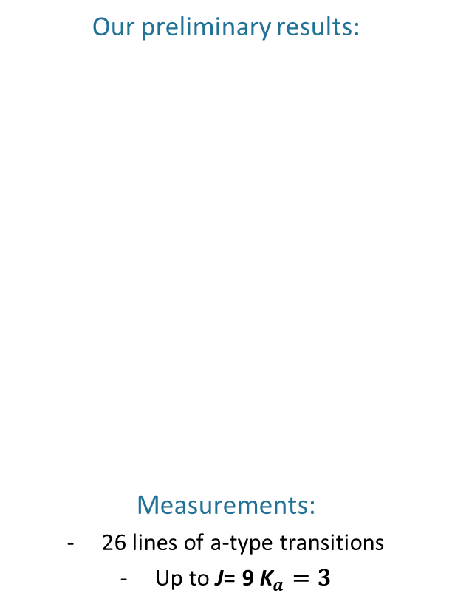
Crésol – Journées de Spectroscopie Moléculaire – Grenoble – 10-12 mars 2024
2. Monohydrated ortho-cresol
 | Experimental results | Quantum computational calculations
Par. |  | 1 | 2 | 3 | 4 | 5 | 6
A(MHz) | 2279.82522 (193) | 2294.0159 | 2843.1308 | 2643.9948 | 1688.5447 | 2197.4222 | 2943.398
B (MHz) | 1052.177236 (111) | 1046.9139 | 918.1743 | 953.54405 | 1218.9974 | 922.53805 | 700.97057
C (MHz) | 725.592337 (67) | 724.47675 | 731.6682 | 769.18254 | 997.90227 | 654.32743 | 569.61425
Our preliminary results:
Measurements:
26 lines of a-type transitions
Up to J= 9 ${\text{K}}_{a}=3$

Slide 28
Crésol – Journées de Spectroscopie Moléculaire – Grenoble – 10-12 mars 2024
2. Monohydrated ortho-cresol
 | Experimental results | Quantum computational calculations
Par. |  | 1 | 2 | 3 | 4 | 5 | 6
A(MHz) | 2279.82522 (193) | 2294.0159 | 2843.1308 | 2643.9948 | 1688.5447 | 2197.4222 | 2943.398
B (MHz) | 1052.177236 (111) | 1046.9139 | 918.1743 | 953.54405 | 1218.9974 | 922.53805 | 700.97057
C (MHz) | 725.592337 (67) | 724.47675 | 731.6682 | 769.18254 | 997.90227 | 654.32743 | 569.61425
Our preliminary results:
Measurements:
26 lines of a-type transitions
Up to J= 9 ${\text{K}}_{a}=3$

Slide 29
Crésol – Journées de Spectroscopie Moléculaire – Grenoble – 10-12 mars 2024
2. Monohydrated ortho-cresol
 | Experimental results | Quantum computational calculations
Par. |  | 1 | 2 | 3 | 4 | 5 | 6
A(MHz) | 2279.82522 (193) | 2294.0159 | 2843.1308 | 2643.9948 | 1688.5447 | 2197.4222 | 2943.398
B (MHz) | 1052.177236 (111) | 1046.9139 | 918.1743 | 953.54405 | 1218.9974 | 922.53805 | 700.97057
C (MHz) | 725.592337 (67) | 724.47675 | 731.6682 | 769.18254 | 997.90227 | 654.32743 | 569.61425
Our preliminary results:
Measurements:
26 lines of a-type transitions
Up to J= 9 ${\text{K}}_{a}=3$

Slide 30
Crésol – Journées de Spectroscopie Moléculaire – Grenoble – 10-12 mars 2024
Conclusion
Ortho-cresol:
Measurements from 150 to 377 GHz
3484 transtions assigned for the syn-o-cresol
1163 transitions assigned for the anti-o-cresol
Parameters determined up the octic centrifugal distortion
Switching to XIAM to finish up the analysis

Slide 31
Crésol – Journées de Spectroscopie Moléculaire – Grenoble – 10-12 mars 2024
Conclusion
Ortho-cresol:
Measurements from 150 to 377 GHz
3484 transtions assigned for the syn-o-cresol
1163 transitions assigned for the anti-o-cresol
Parameters determined up the octic centrifugal distortion
Switching to XIAM to finish up the analysis
Monohydrated ortho-cresol :
Measurements from 6 to 14 GHz
26 transitions assigned
A, B and C constants determined
Pursue measurements
Determine the centrifugal distortion terms
Switching to XIAM to continue the analysis

Slide 32
Crésol – Journées de Spectroscopie Moléculaire – Grenoble – 10-12 mars 2024
Conclusion
Ortho-cresol:
Measurements from 150 to 377 GHz
3484 transtions assigned for the syn-o-cresol
1163 transitions assigned for the anti-o-cresol
Parameters determined up the octic centrifugal distortion
Switching to XIAM to finish up the analysis
Monohydrated ortho-cresol :
Measurements from 6 to 14 GHz
26 transitions assigned
A, B and C constants determined
Pursue measurements
Determine the centrifugal distortion terms
Switching to XIAM to continue the analysis
Metha-cresol:
Measurements from 150 to 377 GHz
Analyzed the spectra

Slide 33




Thanks for your attention
Acknowledgments:
Manuel Goubet
Laurent Margulès
Elias Neeman
Jordan Claus
Colwyn Bracquart

Slide 34



Titre (Calibri Bold 32 pt)
Légende
00/00/0000
Nom du support - Évènement - Lieu

