Slide 1
Dark-fringe interferometry for absorption molecular spectroscopy
Malo Briend, Lucile Rutkowski
Université de Rennes, CNRS, Institut de Physique de Rennes, France

Slide 2
Absorption spectroscopy in Mid-IR in supersonic jet
Photolysis Laser
Bellow
( )
Fourier transform spectrometer
Near IR
fs laser
DFG
Cavity mirror
Uniform supersonic flow
Vacuum chamber
de Laval nozzle

Slide 3
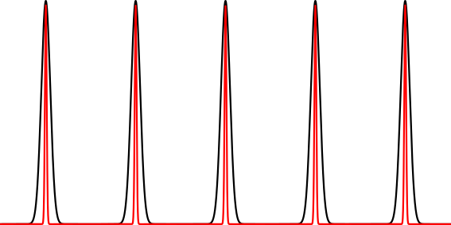
Sensitivity in molecular absorption spectroscopy
Search for sensitive experimental system :
- Detection of traces/ low density gases
Cavity modes
Comb modes
Single-pass cell: ~ 50 cm
Multipass cell: ~ 50 m
Optical cavity: ~ 5 km
Challenging to work in a noisy environment + lose broadband property of combs

Slide 4
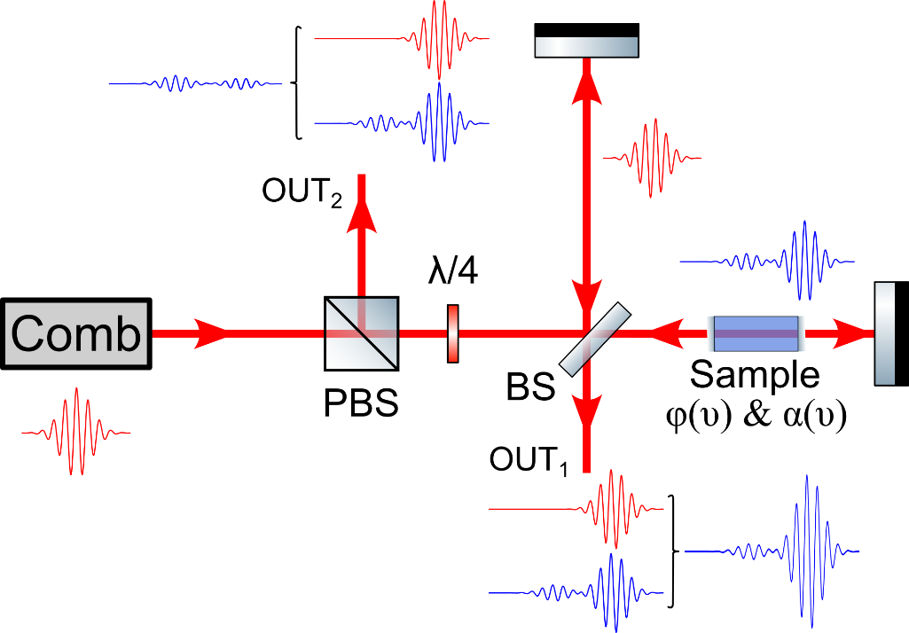
Dark-fringe interferometry
Static Michelson interferometer
Constructive interference at OUT₁ & destructive at OUT₂
Phase opposition at OUT₂
Beamsplitter 50/50 at 45° angle
Suppression of central burst
PBS: polarizing beamsplitter
BS: beamsplitter
λ/4: quarter wave plate
ϕ(ν), α(ν): dispersion and absorption terms

Slide 5
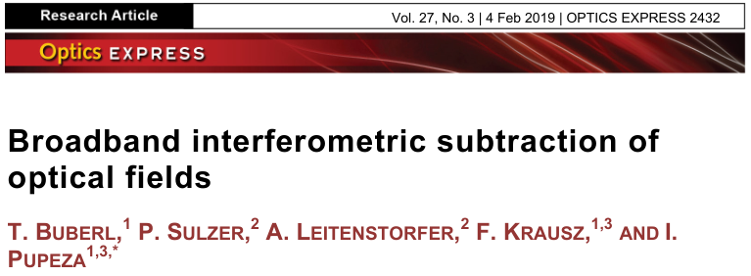
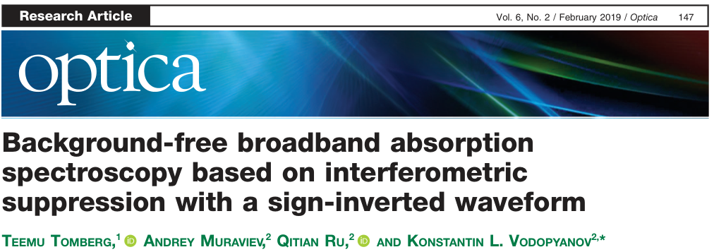
Dark-fringe interferometry using combs
A few publications
- T. Buber et al 2019 Opt. Express 27 2432-2443
Mach-Zehnder-like interferometer coupled with Er:fiber laser.
Spectroscopy of CH₄.
Optical spectrum analyzer
K. Fujiwara et al 2024 Opt. Lett. 49 3898-3901
Michelson interferometer with Cr:ZnS laser.
Spectroscopy of CH₄.
Monochromator spectrometer SOL Instruments
- T. Tomberg et al 2019 Optica 6 147-151
Michelson interferometer.
Spectroscopy of CO, C₂H₆, C₂H₄, CH₄ and NO₂.
Dual-comb spectroscopy in the mid-infrared.

Slide 6
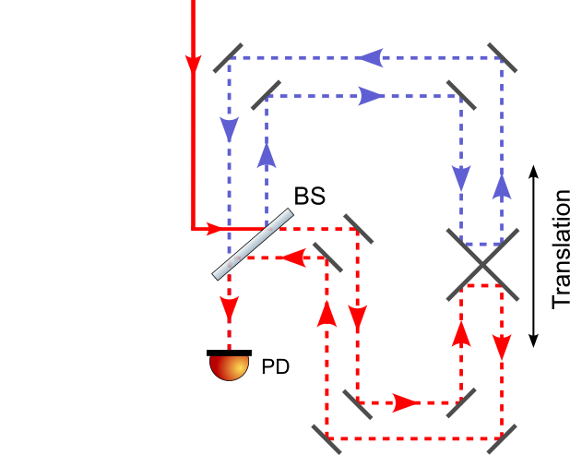
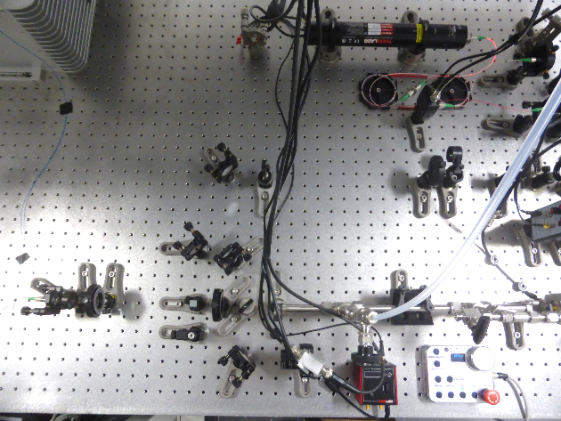
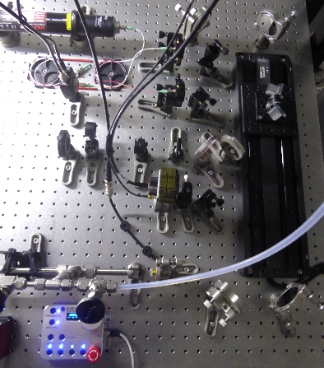
Experimental setup
Er:fiber laser source: 100 mW avg power/ 1500-1620 nm/ f_{rep}= 100MHz
Detection with homemade Fourier Transform Spectrometer (FTS)
Twice folded Michelson interferometer
Resolution = 500 MHz
Adjustable gain from 1 to 10⁴ on photodiode

Slide 7
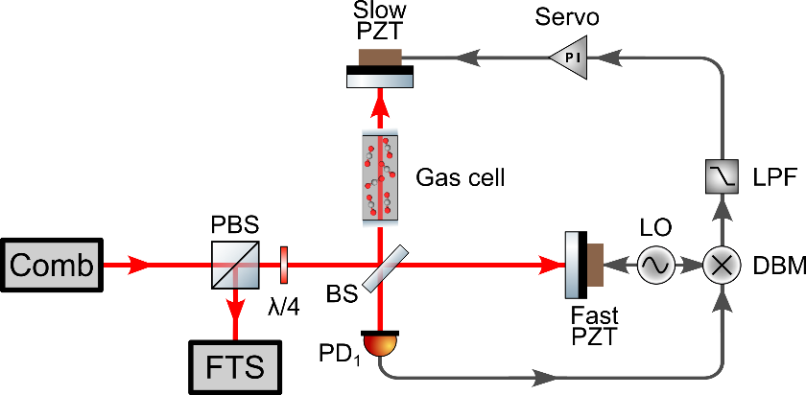
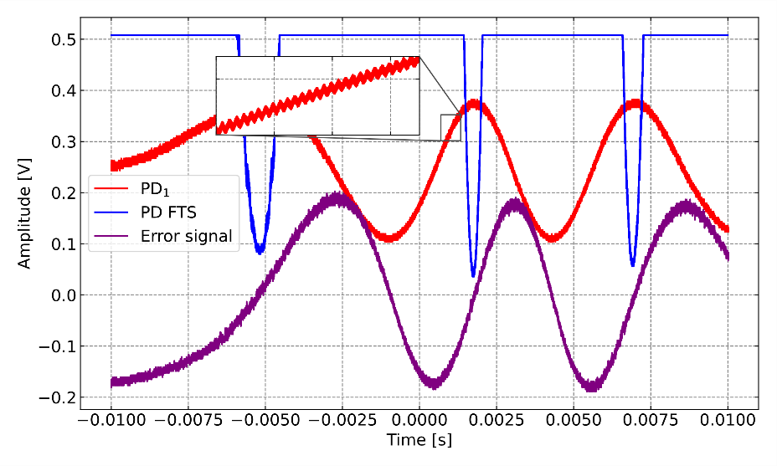
Zero-path difference locking loop
Dither lock method:
- 80 kHz modulation ramp to a fast PZT
Servo controller gain (PI corner: 100 Hz) feed to a slow PZT to keep zero-path difference
Easy to implement and sturdy lock during 45 min at least.
PBS: polarizing beamsplitter FTS: Fourier transform spectrometer
BS: beamsplitter PD: photodiode
DBM: double balanced mixer PZT: piezoelectric transducer
LO: local oscillator LPF: low-pass filter

Slide 8
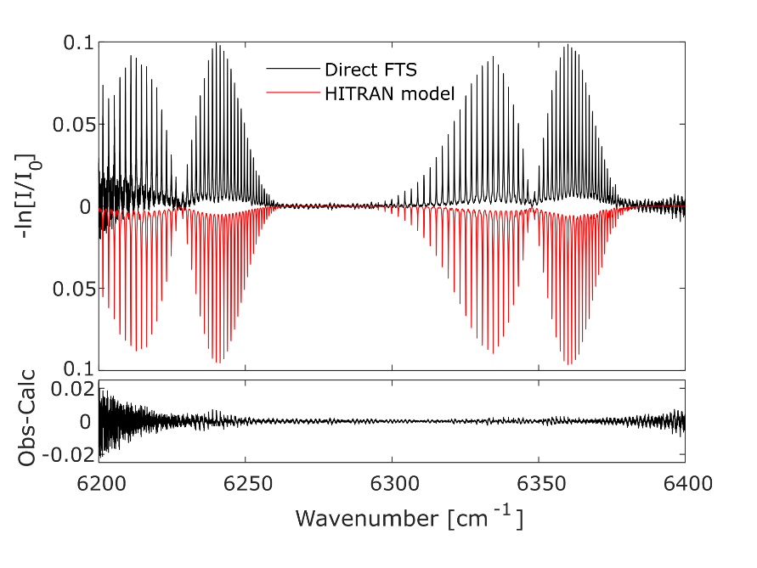
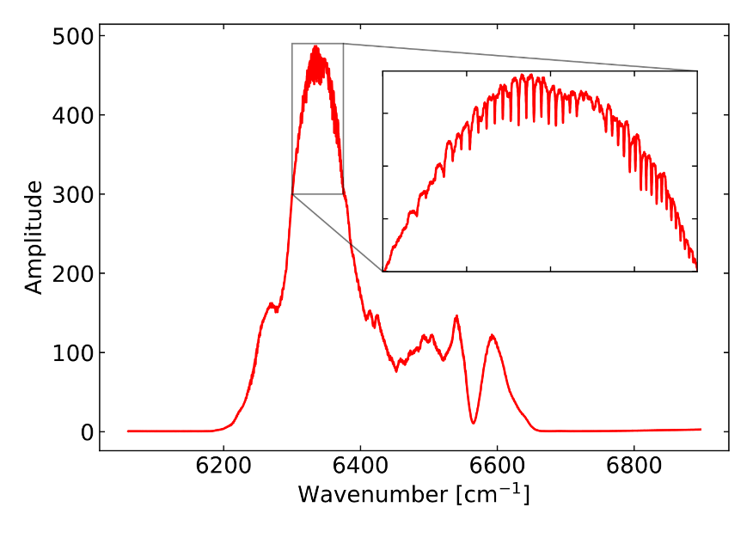
Direct CO₂ spectroscopy
Absorption spectroscopy of CO₂ between 1500 – 1620 nm in direct configuration (Beer-Lambert)
78% CO₂ at 1 atm in a 40 cm cell
Average of 100 scans (1 scan = 2 sec). 500 MHz resolution / 60 cm OPD

Slide 9
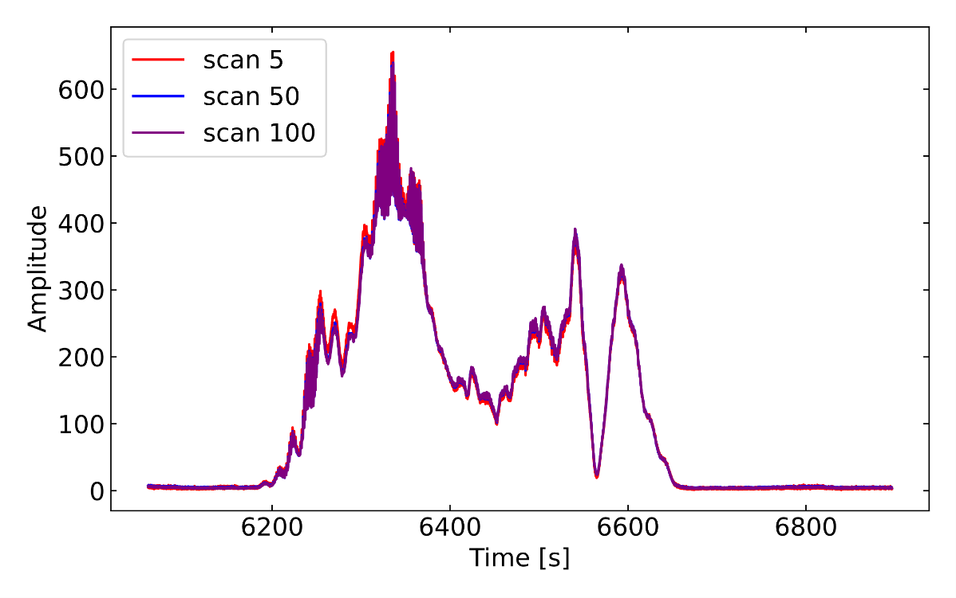
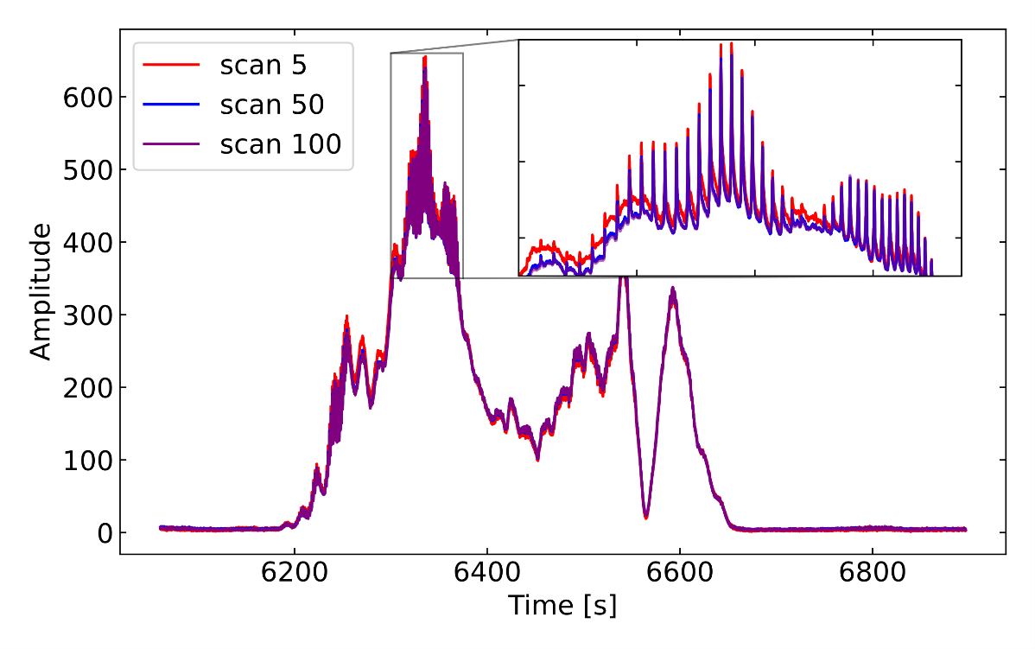
Dark-fringe CO₂ spectroscopy
Gain x100
Contribution of the central burst
Stable spectrum during 100 scans
Lines point upwards

Slide 10
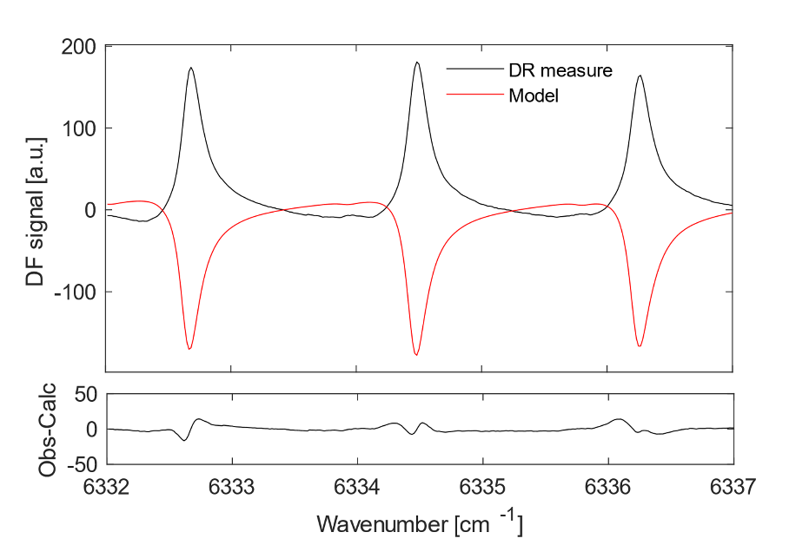
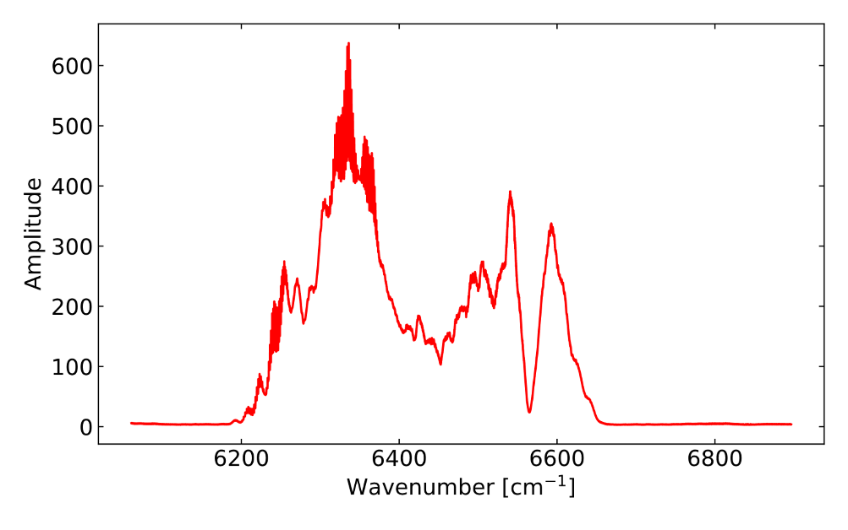
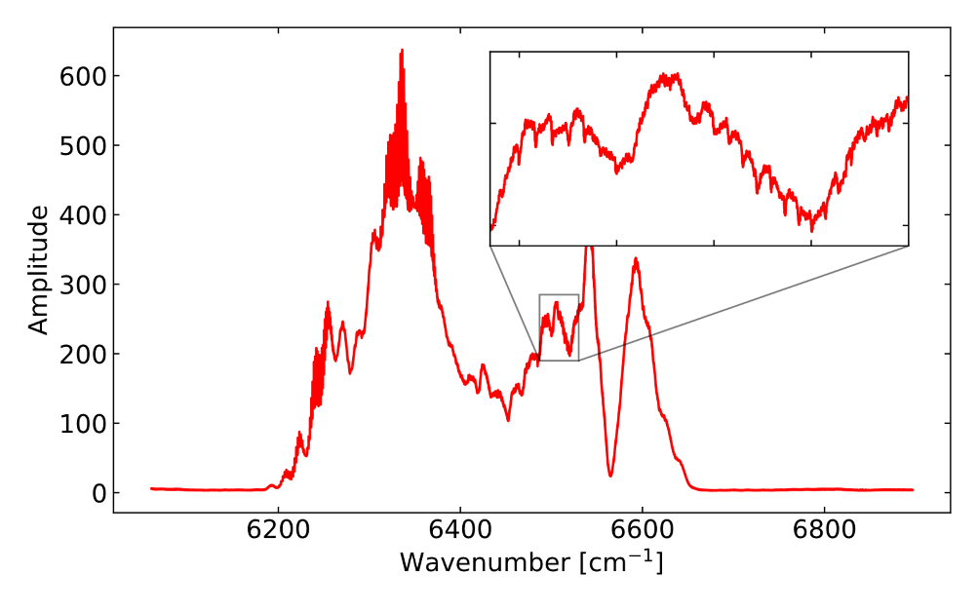
Dark-fringe CO₂ spectroscopy
Average of 100 scans
Model: $A\left(α+φ\right)+B(α^{2}+φ^{2})$

Slide 11
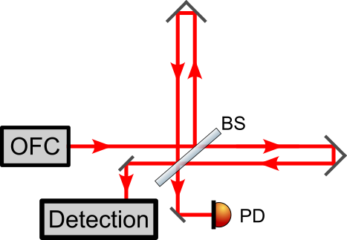
Outlook and perspectives
Current status of the setup:
Challenge to do a perfect destructive interference
Improve dispersion control with compensating plate
Etalon with polarization optics
Easy implementation and sturdy lock
No spectral filtering of the comb
Use of full dynamic range of photodiode
Statistical studies: variance d’Allan-Werle
Acknowledgment:
Hugo Danet (M2 student)
Ewen Gallou
Jean-Charles Potier
Jonathan Courbe
Jonathan Thiévin
Olivier Moustier
+ DPM members

Slide 12
