Slide 1




Fourier transform cavity ring-down spectroscopy using an optical frequency comb source
Romain Dubroeucq*, Dominik Charczun⁺, Piotr Masłowski⁺, Lucile Rutkowski*
* Univ Rennes, CNRS, IPR (Institut de Physique de Rennes)-UMR 6251, F-35000 Rennes, France
⁺ Institute of Physics, Faculty of Physics, Astronomy and Informatics, Nicolaus Copernicus University, Grudziadzka 5, 87-100 Torun, Poland

Slide 2
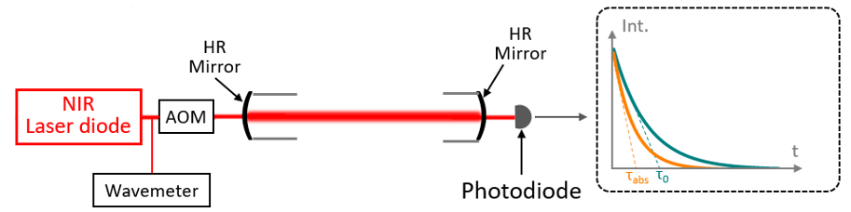
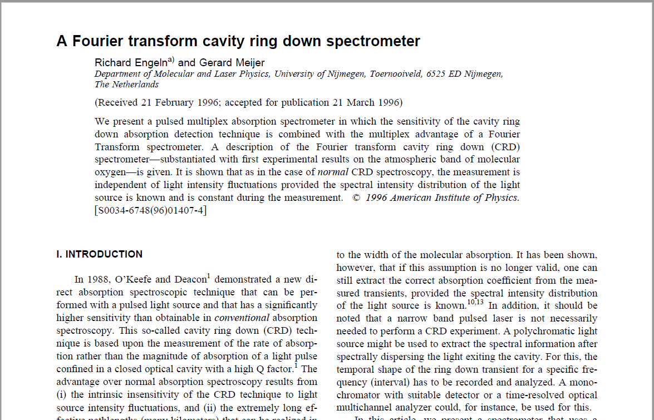
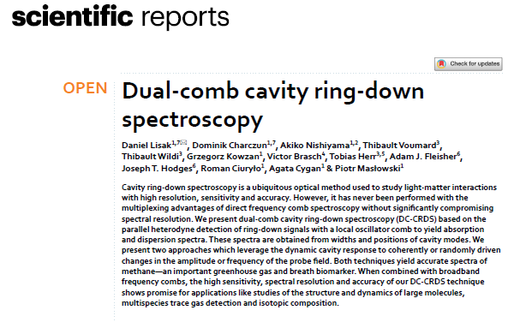
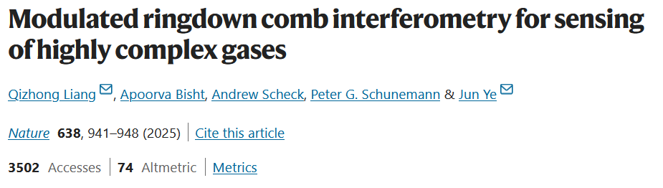
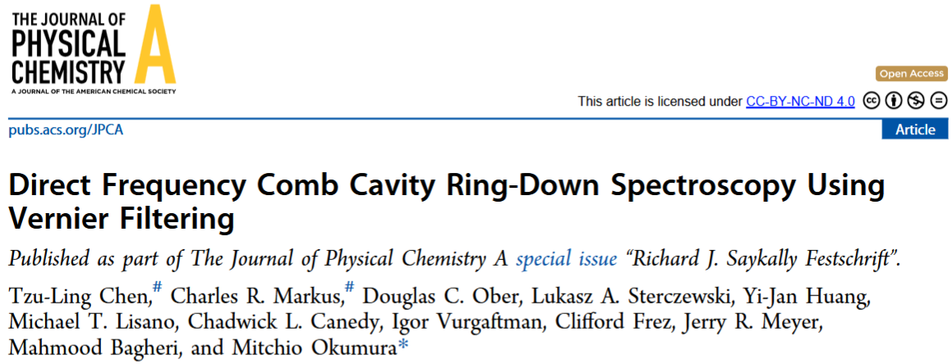
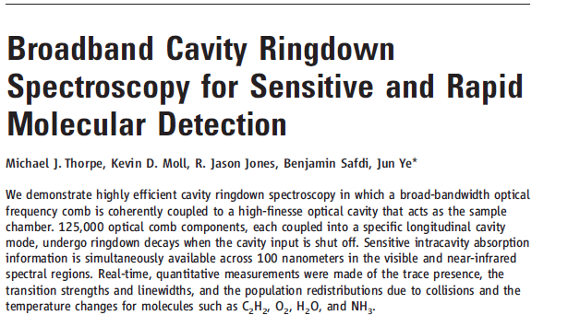
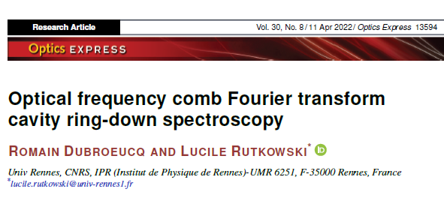
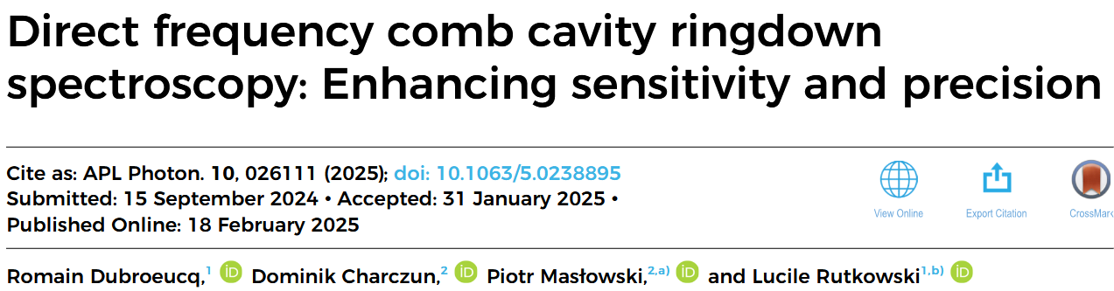
Cavity ring-down spectroscopy
Romain Dubroeucq, JSM2025 – 10 mars 2025
CRDS based on cw diode lasers
  High sensitivity
  Calibration free
  Simple and robust absorption spectrometer
Multiplexed CRDS?
1996-2006
2022
2025

Slide 3
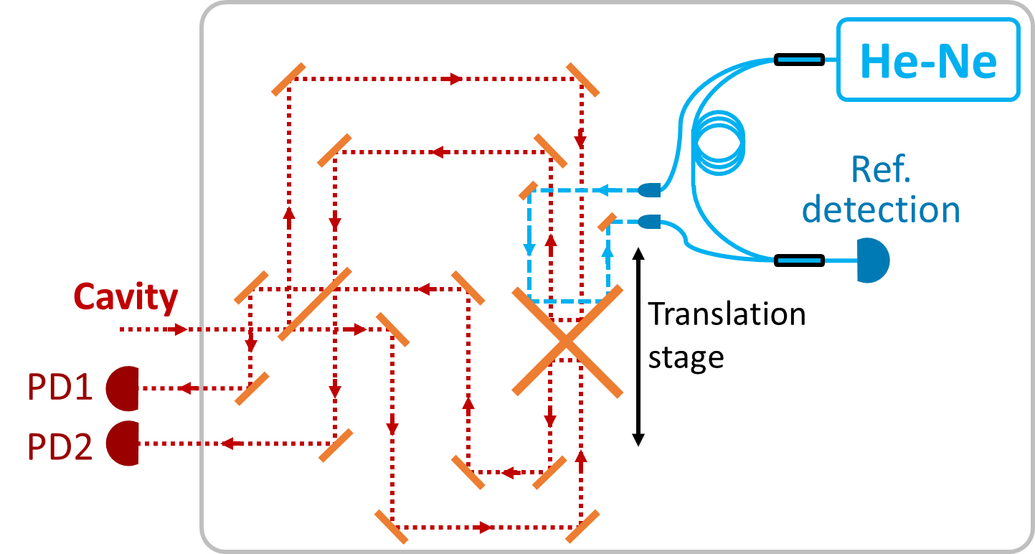
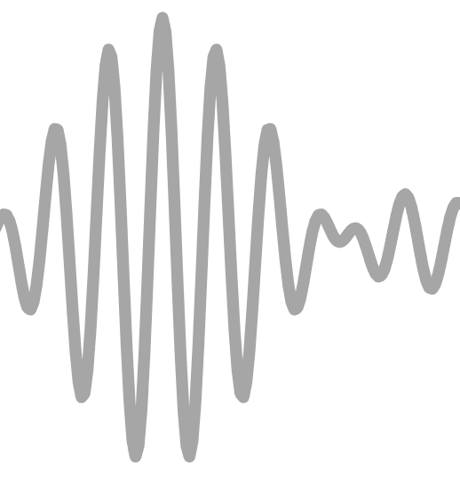
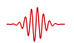
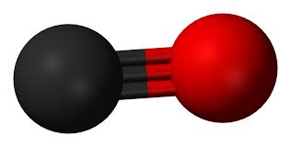
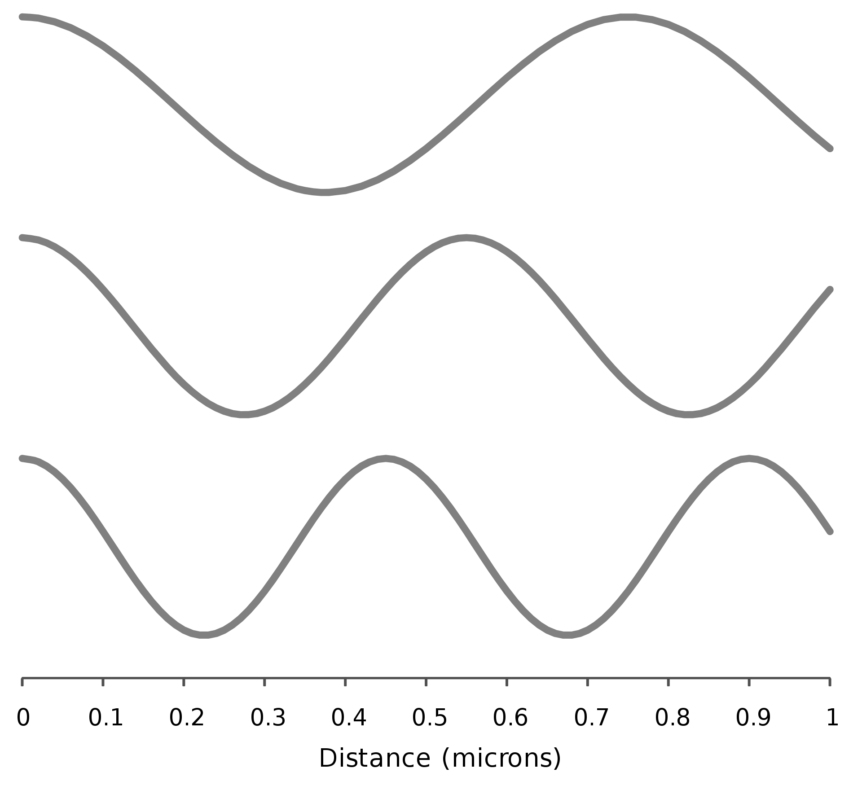
Romain Dubroeucq, JSM2025 – 10 mars 2025
Experimental principle
Optical frequency comb
Ring-down cavity
Fourier transform spectrometer
DAQ, CH1
( )
τ_{RD} = 12 µs
DAQ, CH2
AOM
c
o
Ar
cw Ref
Ref.
CH1
DDG
CH2
DAQ trig
Comb
Interferograms
Ref.
DDG threshold
Optical path difference
R. Dubroeucq and L. Rutkowski, Opt. Express, 30 (8), 13594 (2022)
R. Dubroeucq, D. Charczun, P. Masłowski and Lucile Rutkowski, APL Photonics 10 (2), 026111 (2025)

Slide 4
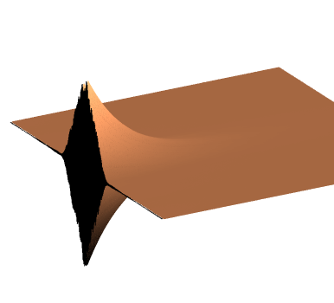
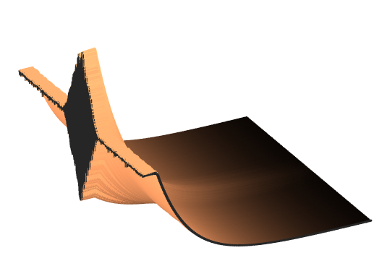

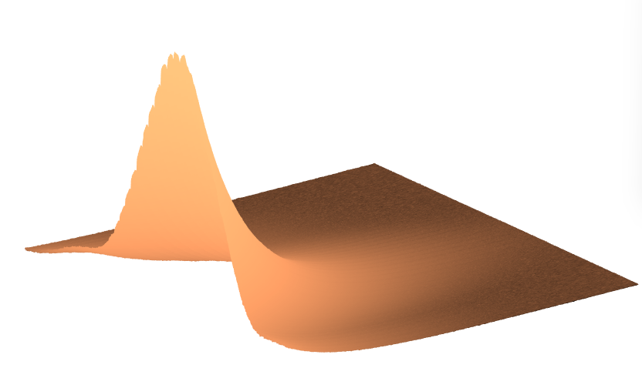


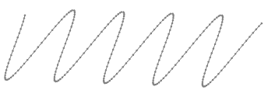
Post-processing data treatment
Romain Dubroeucq, JSM2025 – 10 mars 2025
DAQ CH1
CH1 - balanced CH2
Ring-down spectrum
Abs(FFT)
Noise cancellation
FFT
Intensity
Intensity
Intensity
Time
Time
Time
3
2
δOPD
Frequency
OPD
OPD
1
Ref.
R. Dubroeucq and L. Rutkowski, Opt. Express, 30 (8), 13594 (2022)
R. Dubroeucq, D. Charczun, P. Masłowski and L. Rutkowski, APL Photonics 10 (2), 026111 (2025)

Slide 5
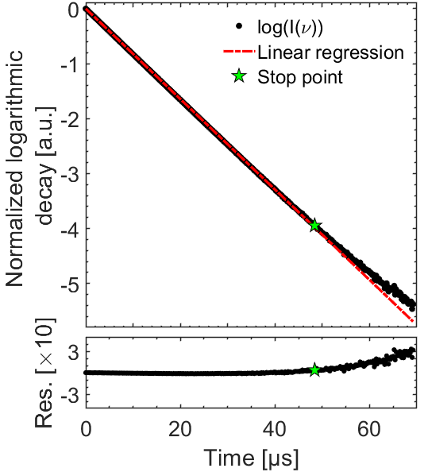
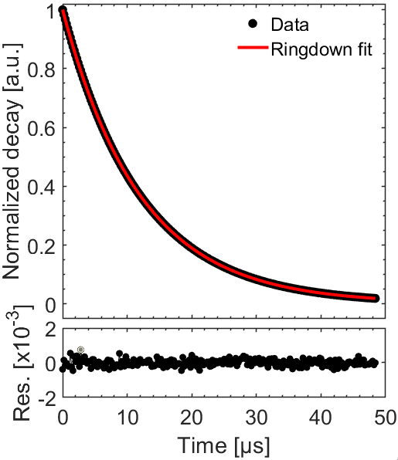

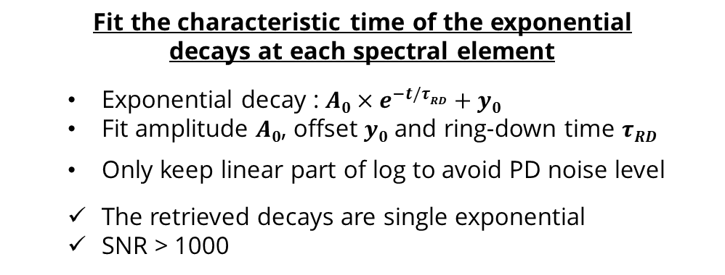
Measured ring-down events
Romain Dubroeucq, JSM2025 – 10 mars 2025
Intensity
Time
$τRD$ = 12.7 µs
Frequency
Fit the characteristic time of the exponential
decays at each spectral element
  Exponential decay : ${A0×e}^{−t/τRD}+y0$
  Fit amplitude $A0$, offset $y0$ and ring-down time $τRD$
  Only keep linear part of log to avoid PD noise level
  The retrieved decays are single exponential
  SNR > 1000
R. Dubroeucq, D. Charczun, P. Masłowski and L. Rutkowski, APL Photonics 10 (2), 026111 (2025)

Slide 6
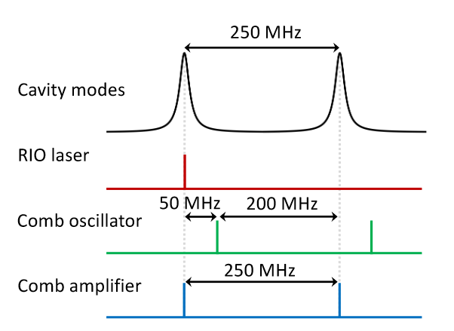
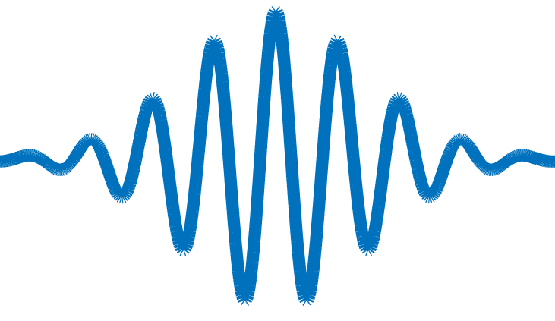

Experimental setup
Romain Dubroeucq, JSM2025 – 10 mars 2025
Phase Det.
Trigger
Digital delay generator
4 f_{rep} – 980 MHz
Er:fiber comb
Amp.
AOM
CRDS cavity
F ~ 20,000
f_{ceo}
Osc.
PZT
λ/2
PBS
λ/4
( )
H maser
Beatnote
lock
FTS
cw laser
EOM
Slit
Comb and cavity locking decoupled using an intermediate cw laser
The AOM shutoff does not affect the lock
Stabilization of the cavity length
➔ Averaging possible
Closed cavity and calibrated gas sample
Pound-Drever-Hall locking electronics
Comb source:
f_{rep} ~ 250 MHz (matched to cavity FSR)
f_{ceo} RF locked to a H maser
Oscillator optically locked to RIO cw laser
Amp shifted by 200 MHz by AOM
CW reference: @ 1.565 µm
Locked to cavity using PDH
R. Dubroeucq, D. Charczun, P. Masłowski and L. Rutkowski, APL Photonics 10 (2), 026111 (2025)

Slide 7
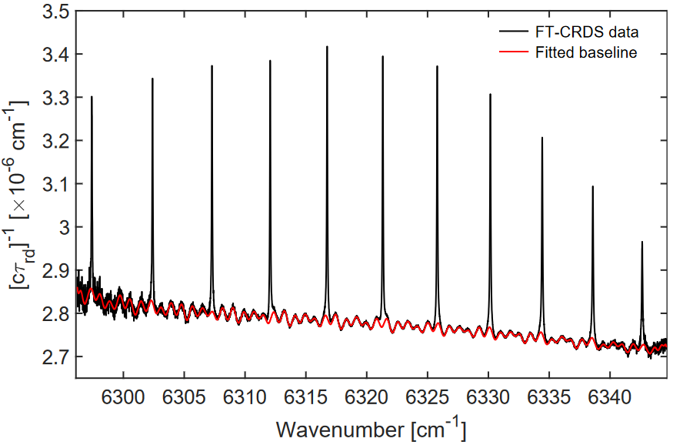
Spectroscopy of CO in Ar
Romain Dubroeucq, JSM2025 – 10 mars 2025
Mixture 250 ppm CO in Ar:
Total pressure = 534 Torr, [CO] ~ 250 ppm
Ambient temperature
Resolution 251 MHz
Averaging of 15 spectra, 80 min acquisition
[cτ_{rd}(ν)]⁻¹ = [cτ₀(ν)]⁻¹ + α(ν)
Baseline subtraction
R. Dubroeucq, D. Charczun, P. Masłowski and L. Rutkowski, APL Photonics 10 (2), 026111 (2025)

Slide 8
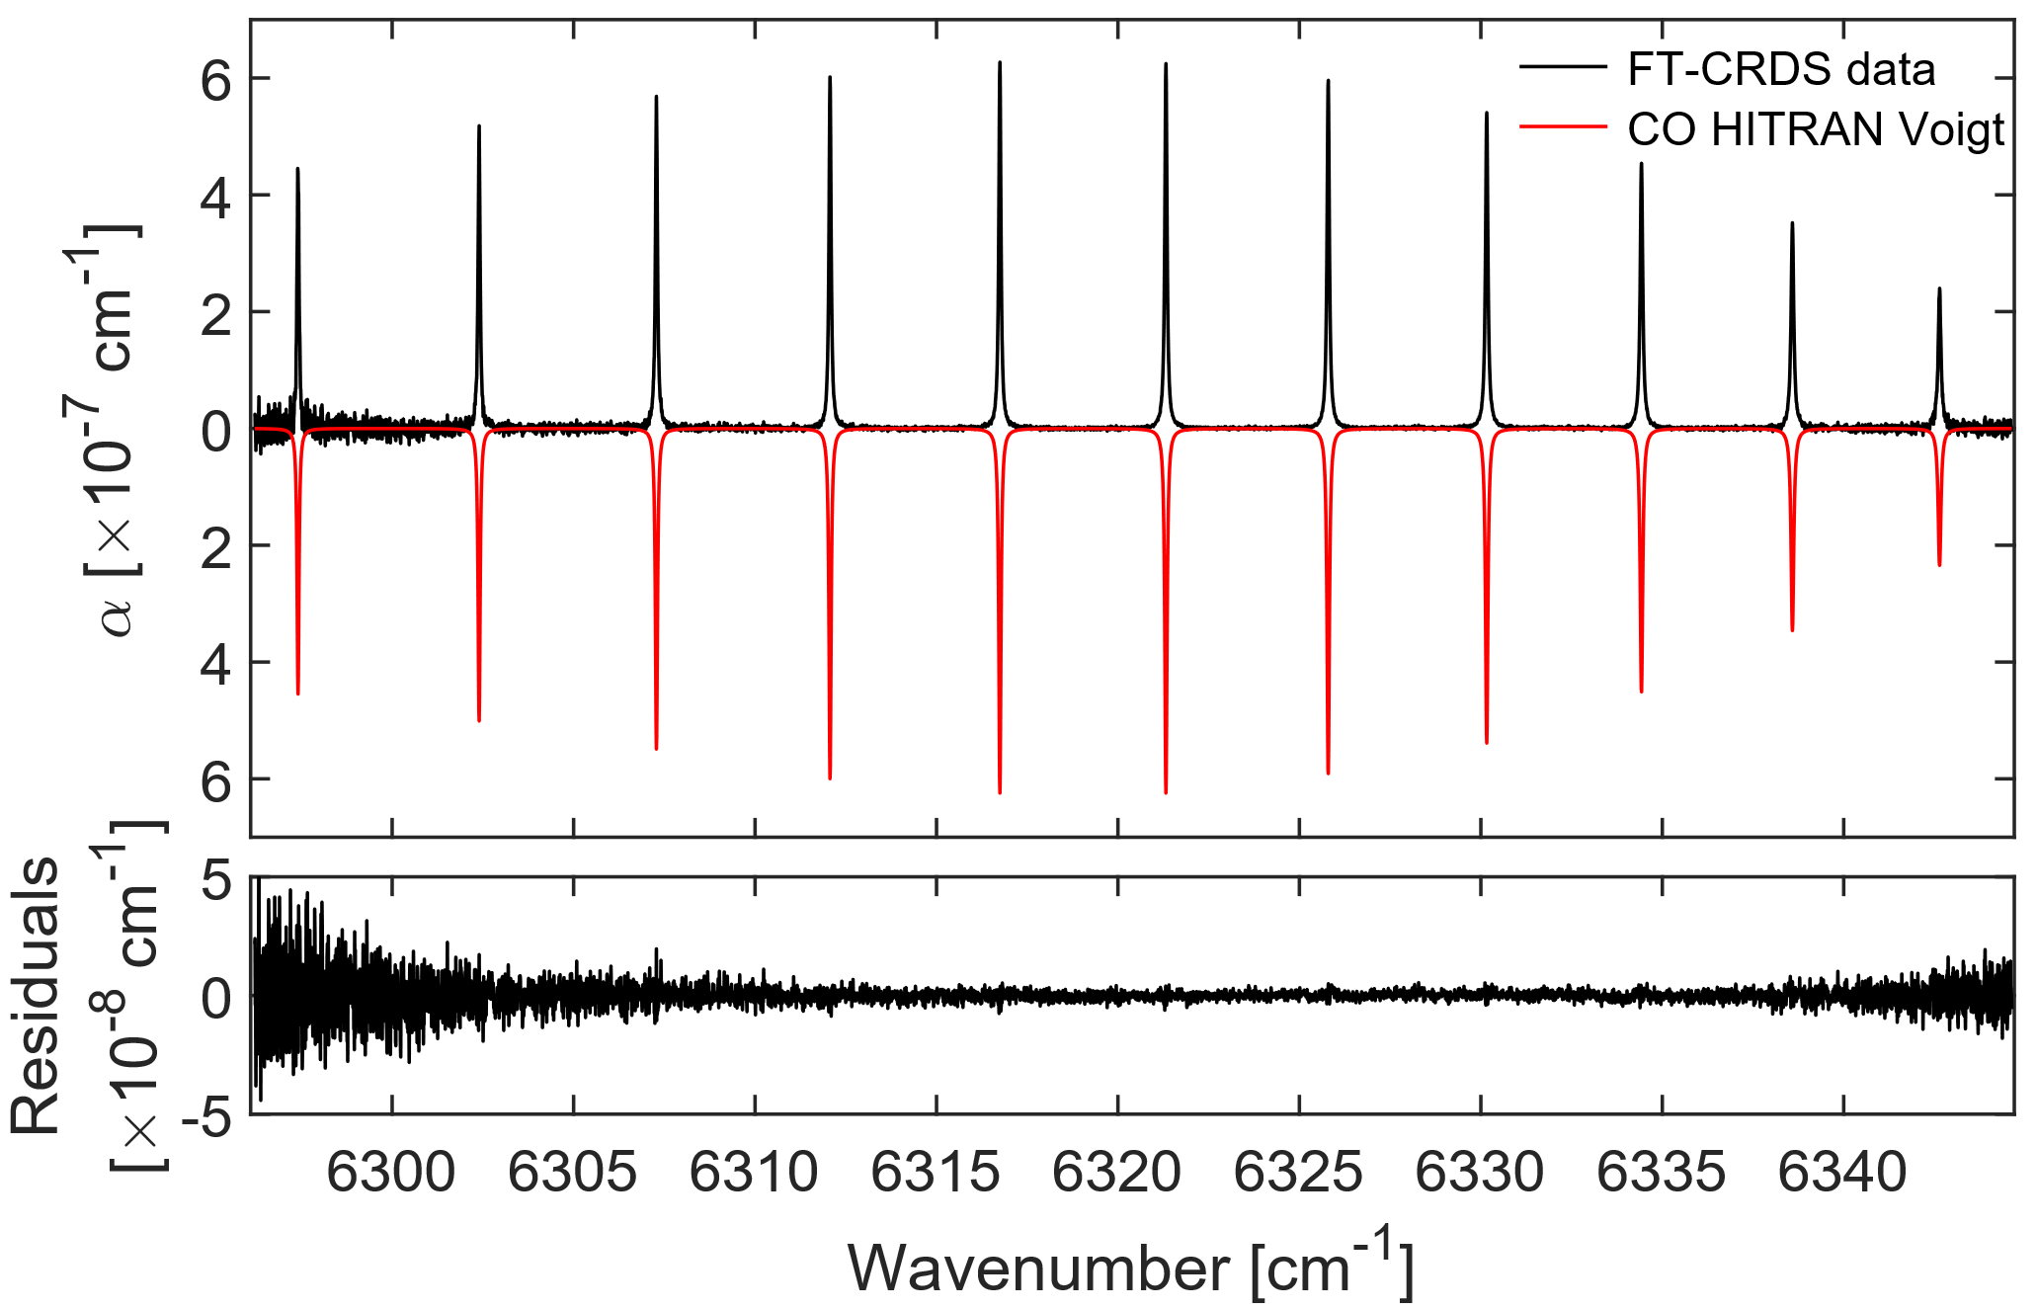
Spectroscopy of CO in Ar
Romain Dubroeucq, JSM2025 – 10 mars 2025
Mixture 250 ppm CO in Ar:
Total pressure = 534 Torr, [CO] ~ 250 ppm
Ambient temperature
Resolution 251 MHz
Averaging of 15 spectra, 80 min acquisition
NEA = 1.1 × 10⁻⁹ cm⁻¹
Figure of merit : 9.6 × 10⁻¹⁰ cm⁻¹ Hz^{-1/2} per spectral element
R. Dubroeucq, D. Charczun, P. Masłowski and L. Rutkowski, APL Photonics 10 (2), 026111 (2025)

Slide 9
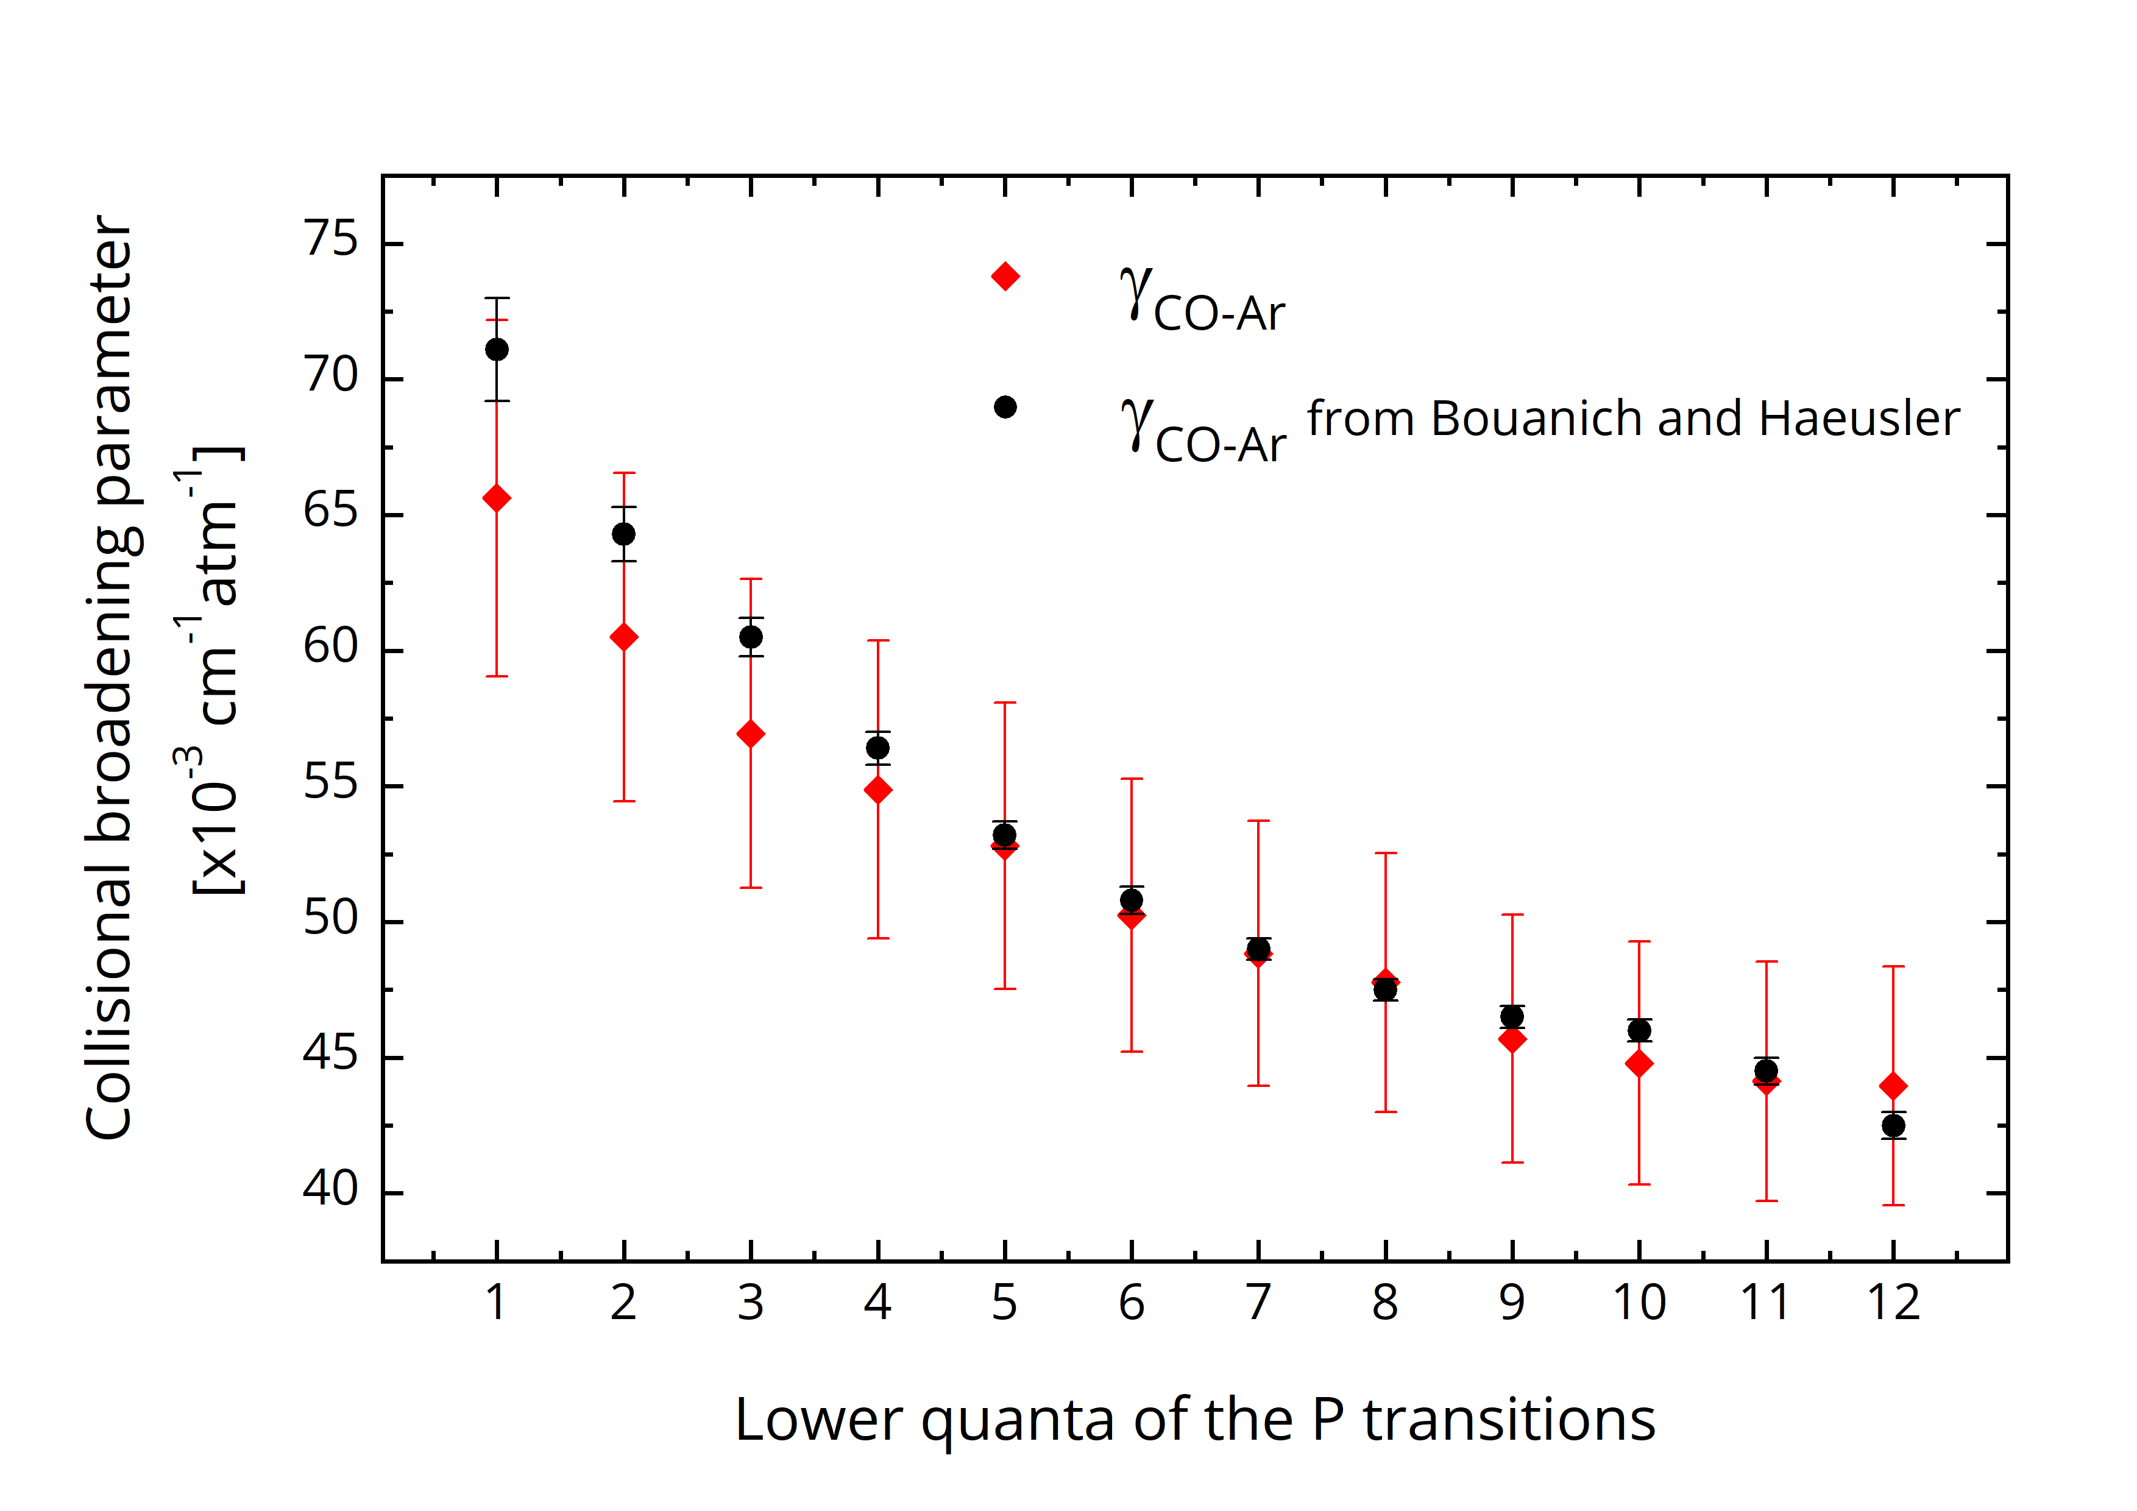
Romain Dubroeucq, JSM2025 – 10 mars 2025
Spectroscopy of CO in Ar
CO-Ar pressure broadening parameters :
this work
J.-P. Bouanich and C. Haeusler, JQSRT 12 (4), 695-702 (1972)
R. Dubroeucq, D. Charczun, P. Masłowski and L. Rutkowski, APL Photonics 10 (2), 026111 (2025)

Slide 10
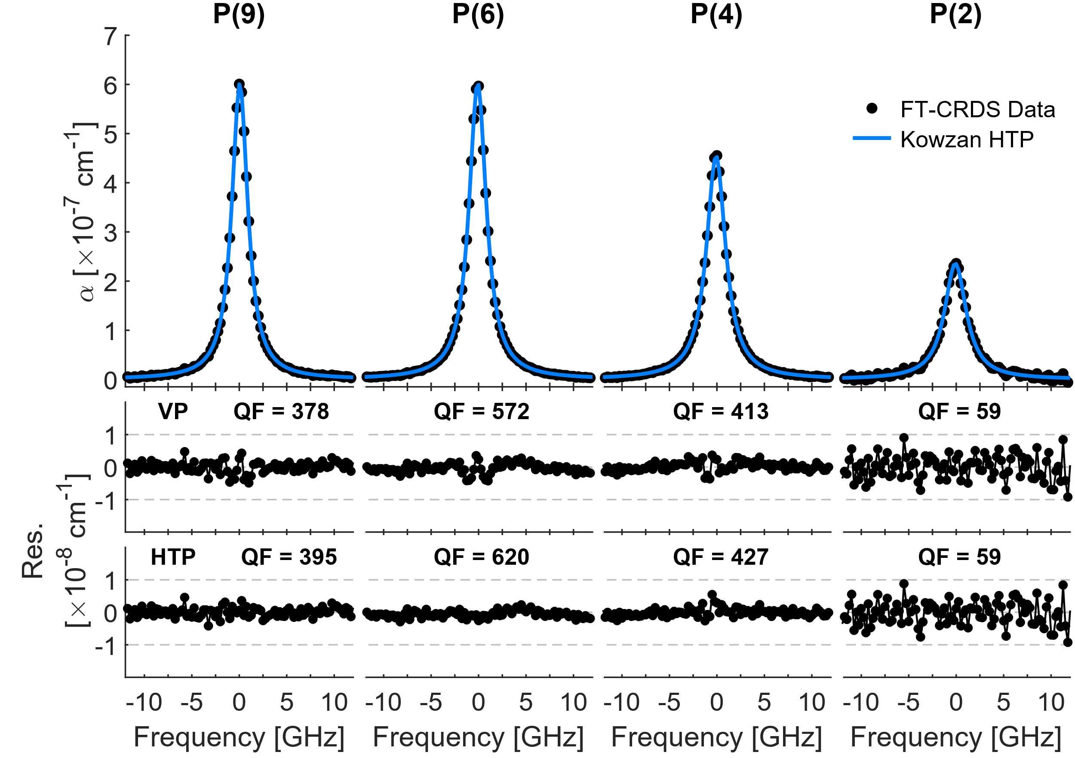
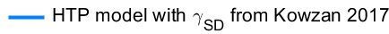
Beyond Voigt
Romain Dubroeucq, JSM2025 – 10 mars 2025
Line profile investigation:
Voigt Profile:
line intensity from HITRAN 2020
Fit the first order collisional broadening coefficient, concentration and temperature
[CO] = 244.8(21) ppm ; T= 295.2(15) K
Hartman-Tran Profile:
line intensity from HITRAN 2020
Collisional broadening parameters from Kowzan et al., JQSRT, 191, 46 (2017).
Fit CO concentration and temperature
[CO] = 242.8(15) ppm ; T = 292.6(9) K
R. Dubroeucq, D. Charczun, P. Masłowski and L. Rutkowski, APL Photonics 10 (2), 026111 (2025)

Slide 11
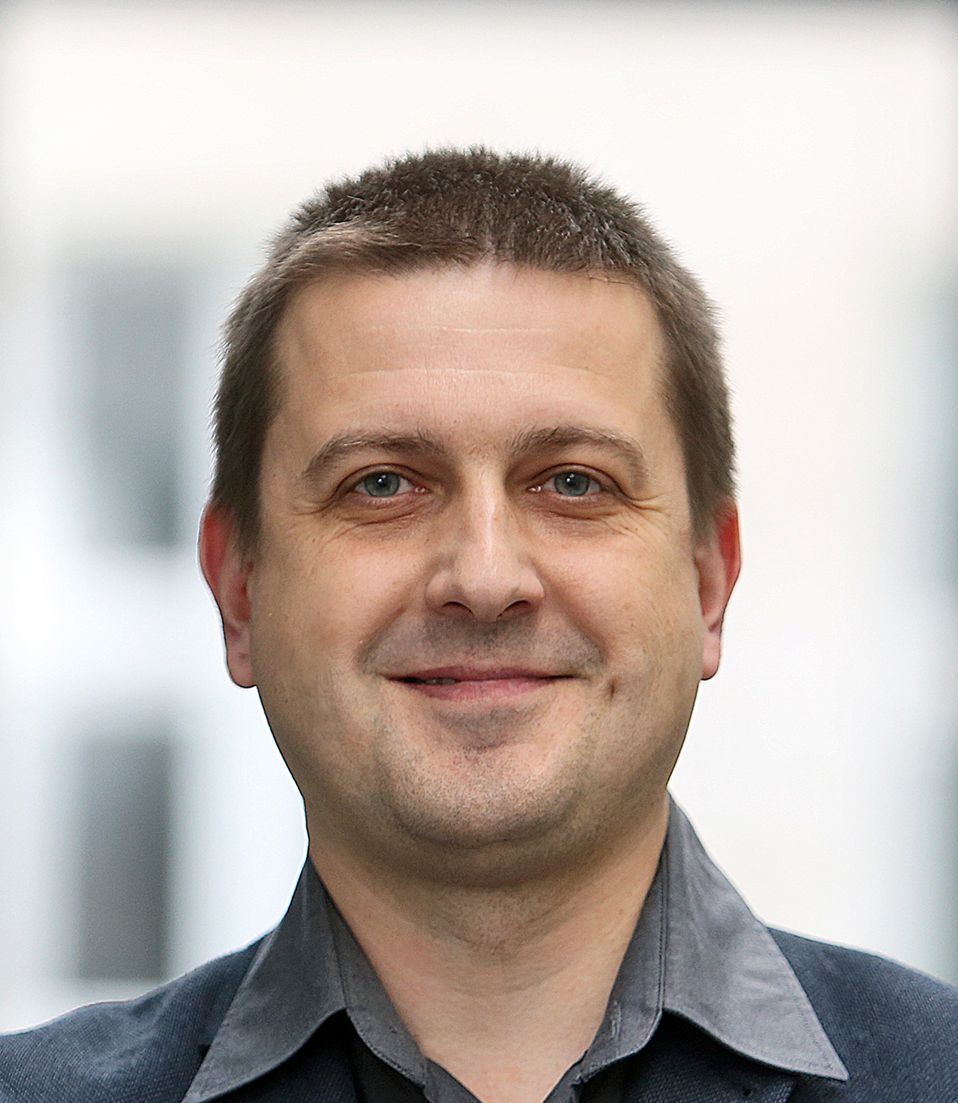
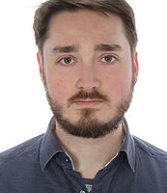




Conclusion FT-CRDS
Romain Dubroeucq, JSM2025 – 10 mars 2025
Parallel acquisition of multiple ring-down :
Time-resolved FTS to detect the cavity decays
High SNR using FTS balancing
Compatible with 20’000 finesse cavity
Spectrum calibration-free in absorption
Absorption sensitivity 1.1 × 10⁻⁹ cm⁻¹
FoM 9.6 × 10⁻¹⁰ cm⁻¹ Hz^{-1/2} per spectral element
Precision spectroscopy of CO in Ar :
High precision absorption retrieval
Line profiles beyond Voigt
Piotr Masłowski & Dominik Charczun
Funding sources
Poster session : DCS for greenhouse gases remote sensing

Slide 12
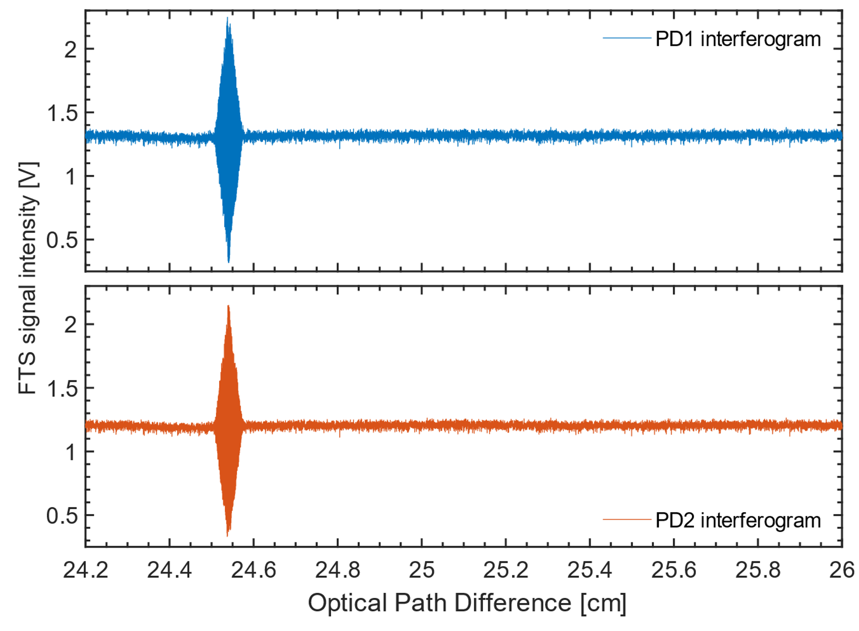
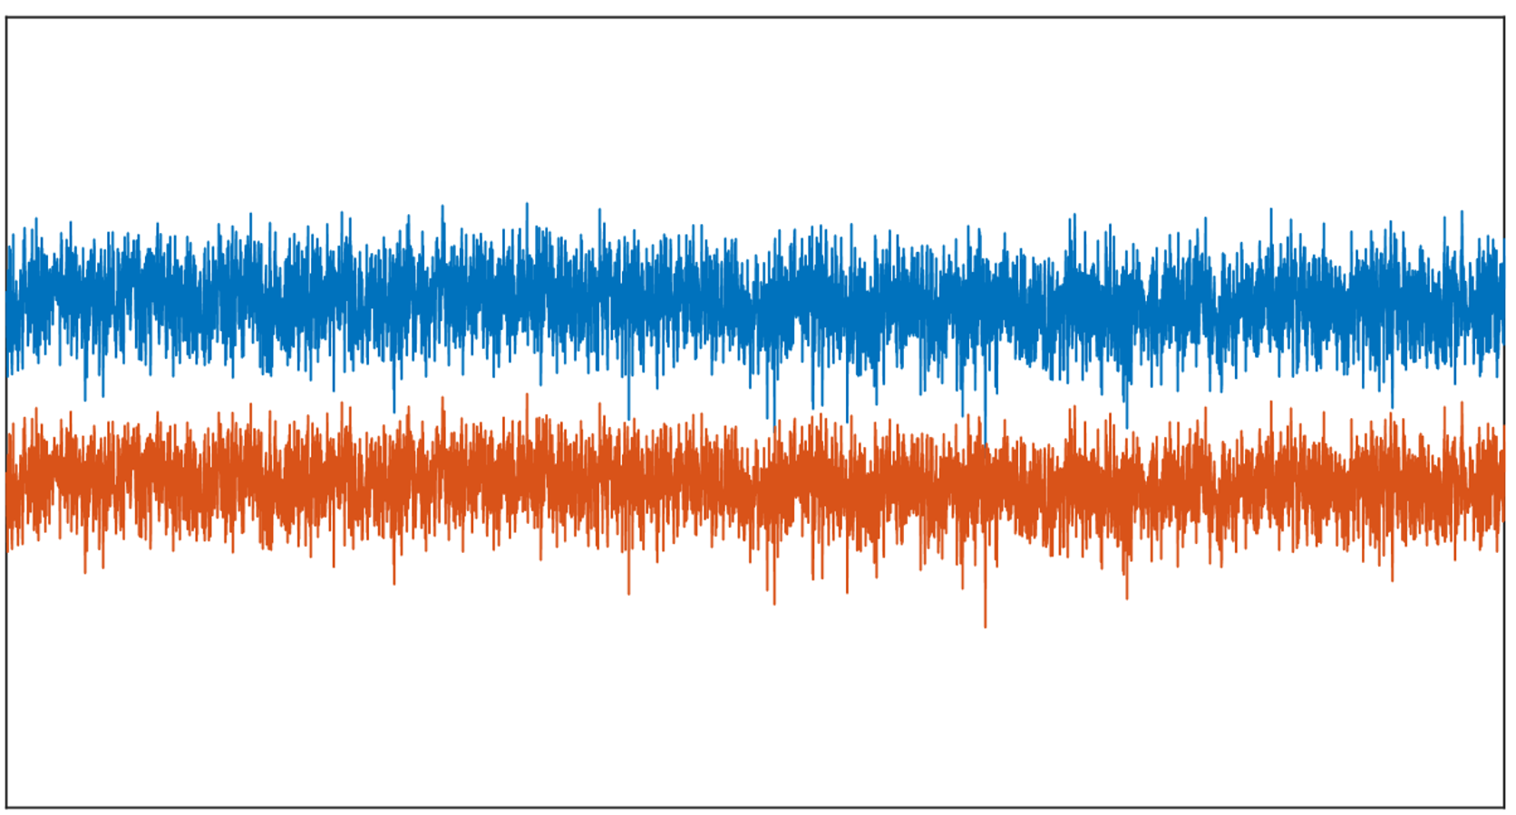
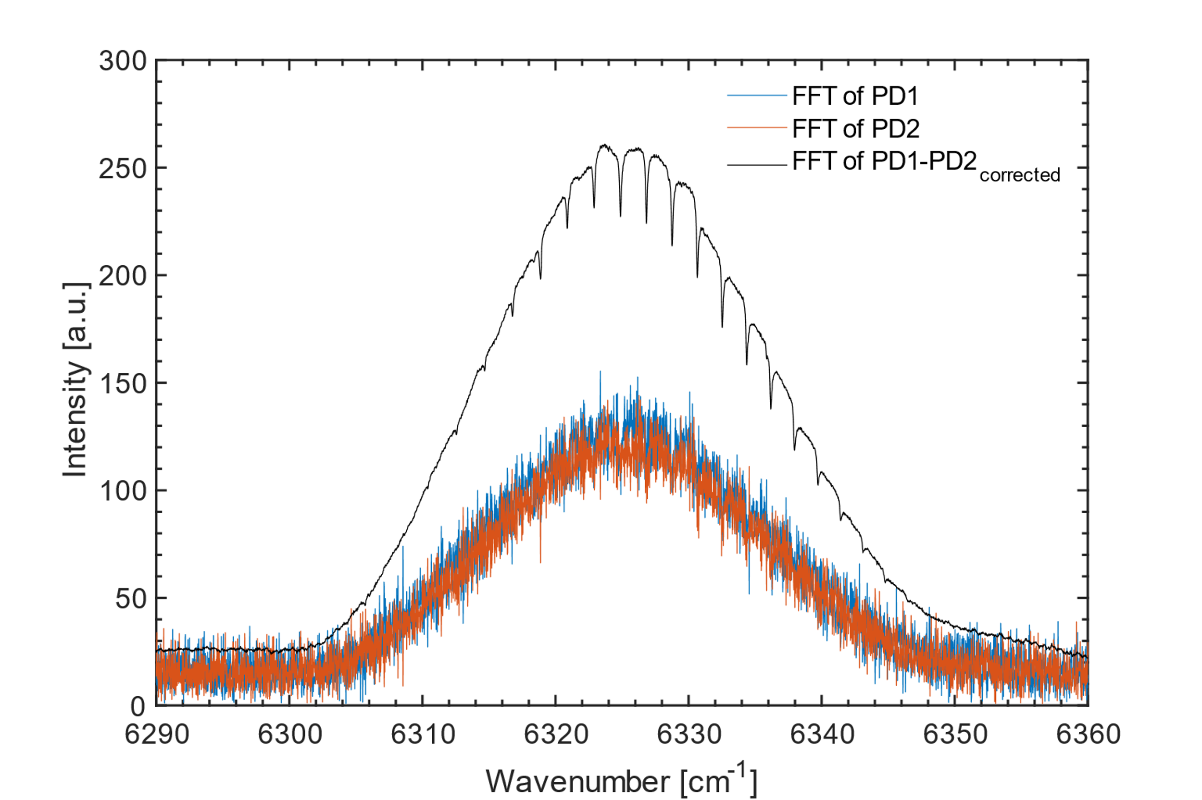
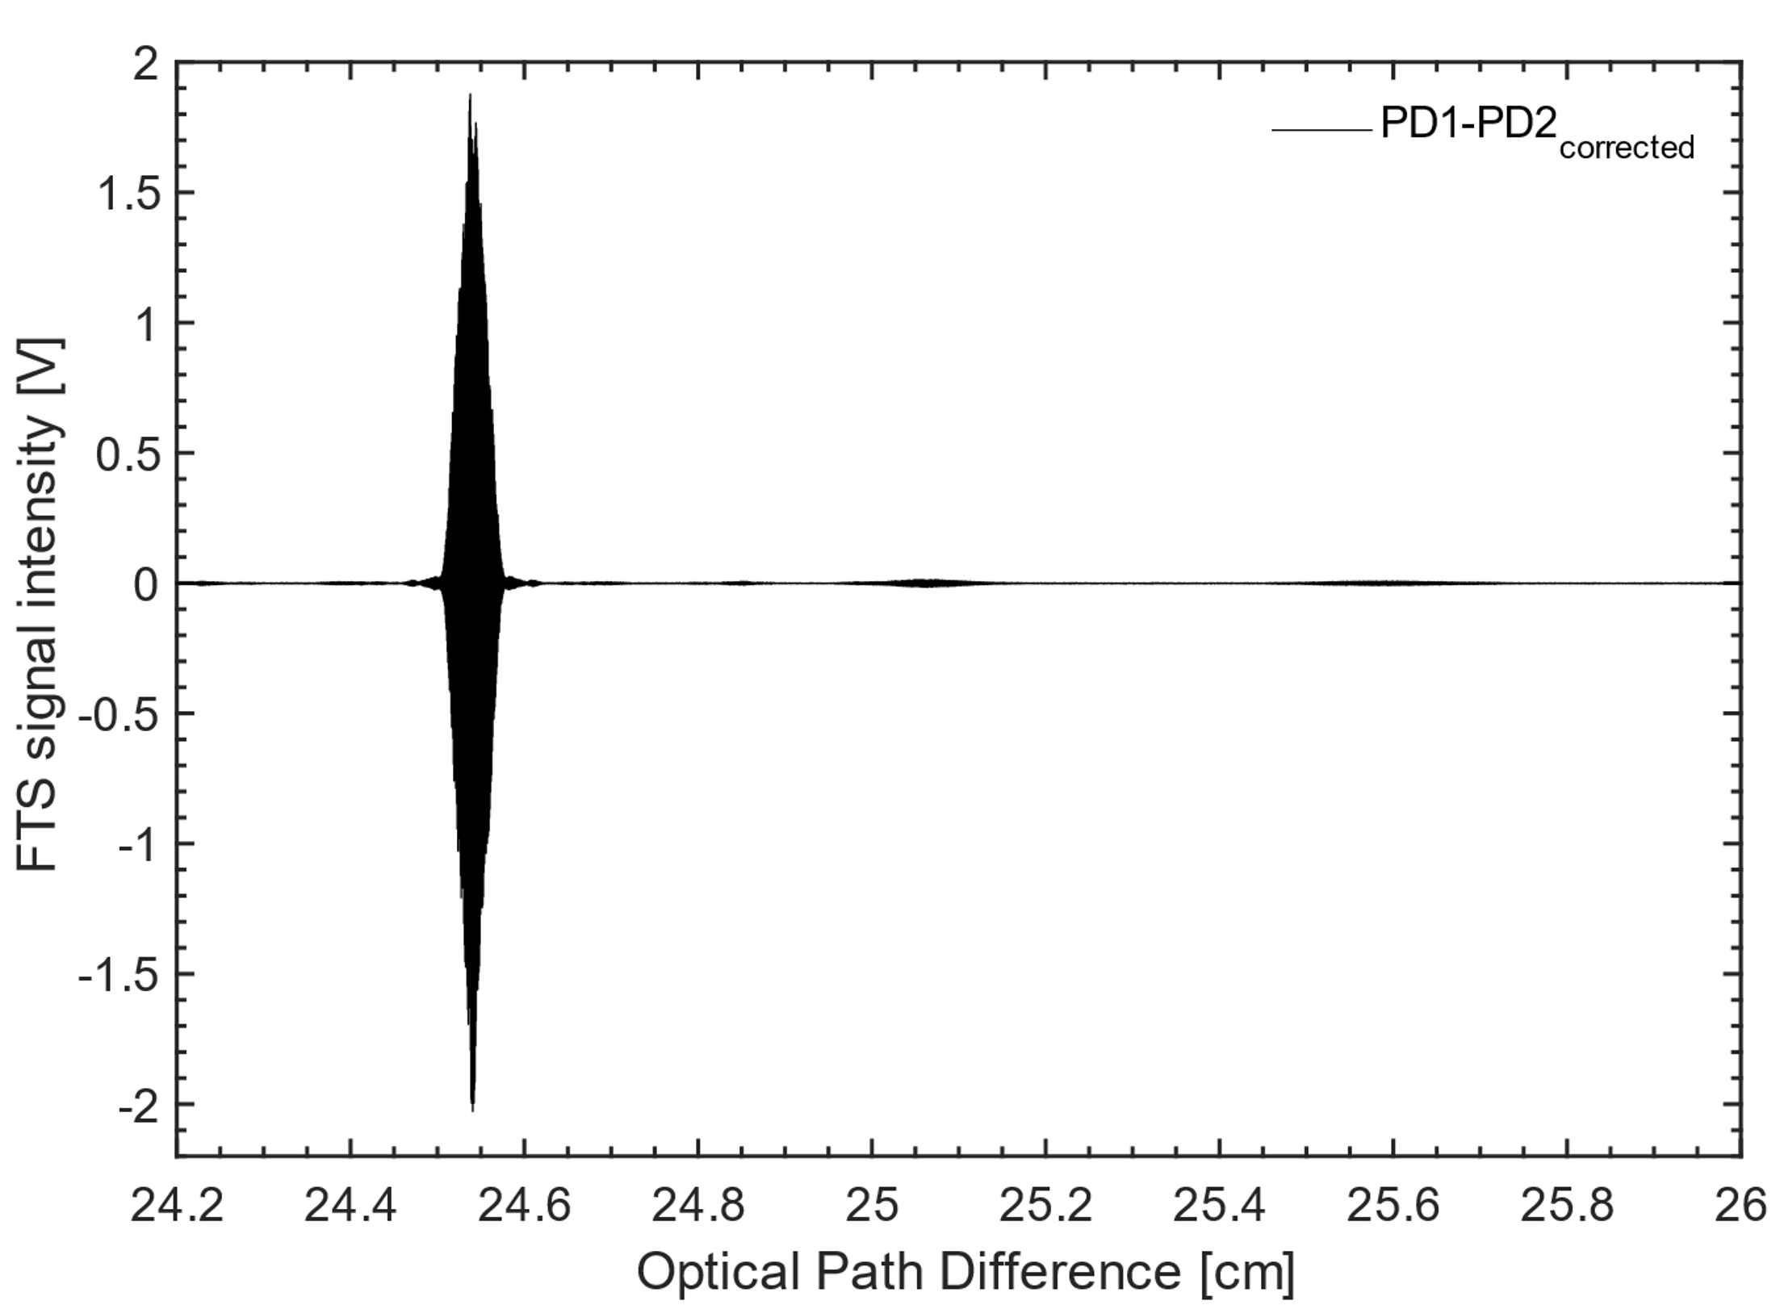
Balancing procedure
Romain Dubroeucq, JSM2025 – 10 mars 2025
Gain difference
SNR ×33
CH1
CH2
Balancing mechanism :
Photodiodes difference correction
Substraction of the two interferograms

Slide 13
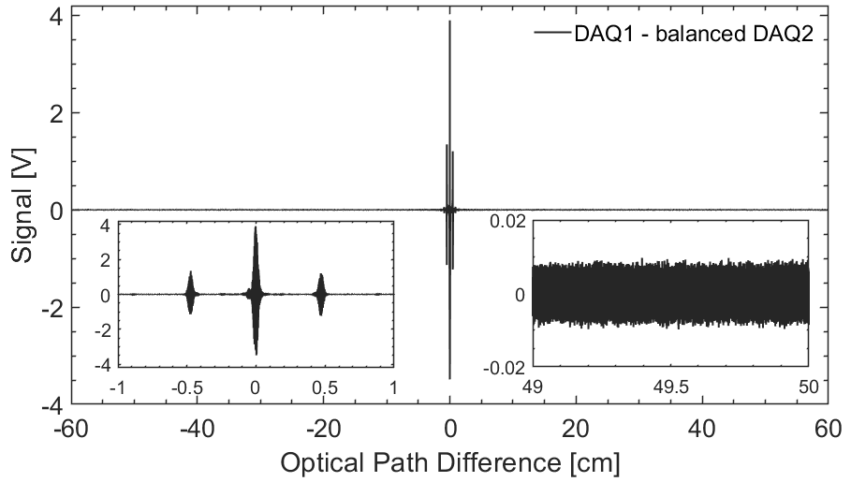
Balanced interferogram
Romain Dubroeucq, JSM2025 – 10 mars 2025

