Slide 1
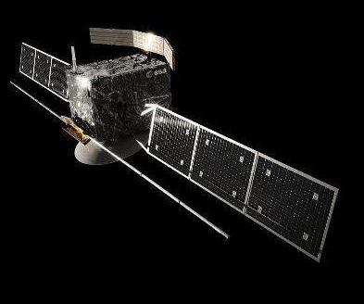
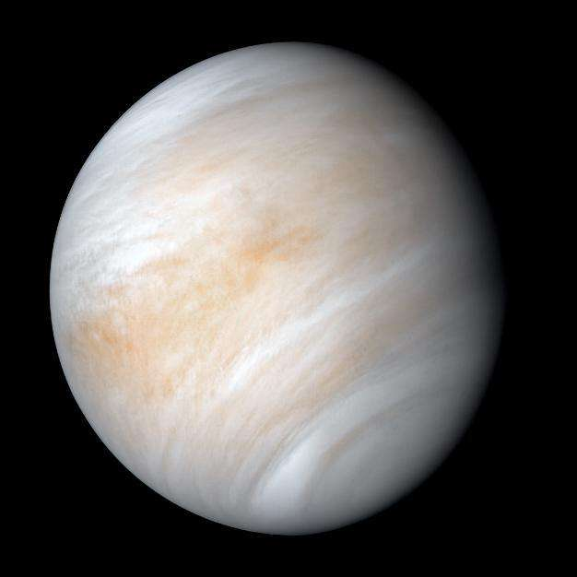
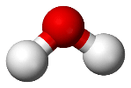
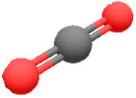
New
H₂O – CO₂
parameters
© ESA/NASA/JAXA
New experimental and calculated linelists for H₂O – CO₂ collision system: the impact on atmospheric water vapor retrievals
É. Ducreux, B. Grouiez, S. Robert, M. Lepère, B. Vispoel, R. R. Gamache, L. Régalia
ROYAL BELGIAN INSTITUTE FOR SPACE AERONOMY
Monday 10th March 2025

Slide 2
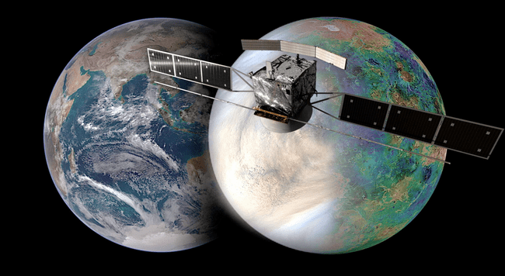
Context: EnVision mission
A new mission to Venus
© ESA/NASA
Radars and spectrometers onboard
To study the evolution of the planet and its volcanic activity

Slide 3
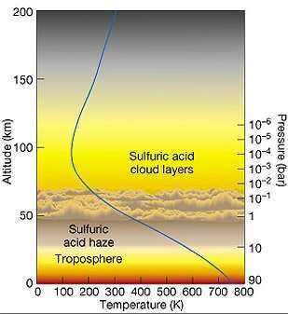
Venus and its atmosphere
Taylor et al., Space Sci. Rev (2018)
At the surface: 93 bar and 737 K
© Pearson Edu.
Molecular species | Amount in the lower atmosphere
Carbon dioxide | 96 %
Nitrogen | 3.5 %
Sulfur dioxide | 150 ppm
Argon | 70 ppm
Carbon monoxide | 40 ppm
Water vapor | 30 ppm
Neon | 5 ppm
Carbonyl sulfide | 4 ppm
H₂O will be greatly disturbed by the surrounding CO₂
=> Need of appropriate spectroscopic parameters

Slide 4
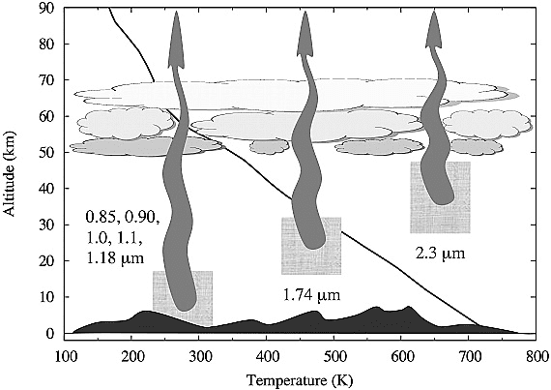
VenSpec-H instrument details
Need to look through the clouds
Infrared
Only during the night
Only through ‘Atmospheric transparency windows’
2.34 µm → from 30 km to 45 km
Spectral resolution = 0.5 cm⁻¹
1.74 µm → from 20 km to 30 km
Spectral resolution = 0.6 cm⁻¹
1.18 µm → from 0 km to 15 km
Spectral resolution = 0.9 cm⁻¹
Bézard and De Bergh, JGR (2007)

Slide 5
Laboratory measurements
In the lab:
P, T fixed
Spectroscopic parameters ?
In the atmosphere:
Spectroscopic parameters fixed
P, T, molecular abundance ?

Slide 6
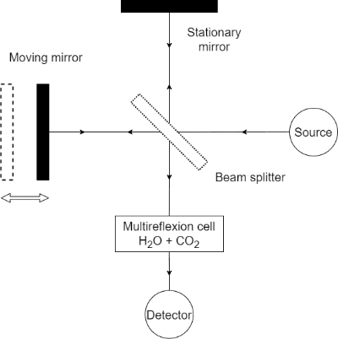
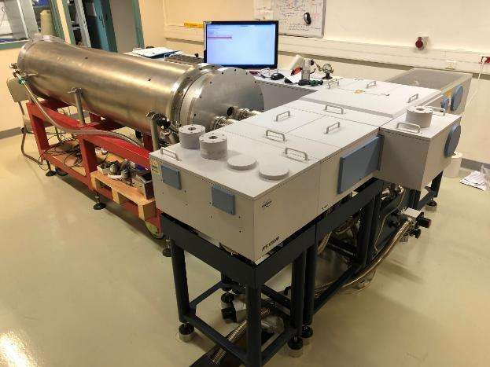
Instrumental setup
High resolution Fourier Transform IR Spectrometer + 2-m multireflexion cell
Bruker IFS 125 HR
Spectral range: 700-33000 cm⁻¹
MPD : 3.72 m
Resolution : 0.0024 cm⁻¹
Beamsplitters: KBr, CaF₂
Quartz vis
Detectors : HgCdTe, InSb

Slide 7
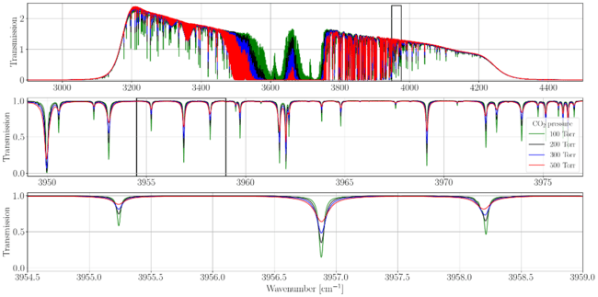
Recorded spectra at 2.7 µm
Régalia et al., JQSRT (2019)
Ducreux et al., JQSRT (2024)
Path length: 8 m - Iris aperture: 0.85 mm - At room temperature ~292 K
Spectral resolution: from 0.016 to 0.022 cm⁻¹
P(H₂O) = 1.5 Torr + several P(CO₂) = 100, 200, 300, 500 Torr.

Slide 8
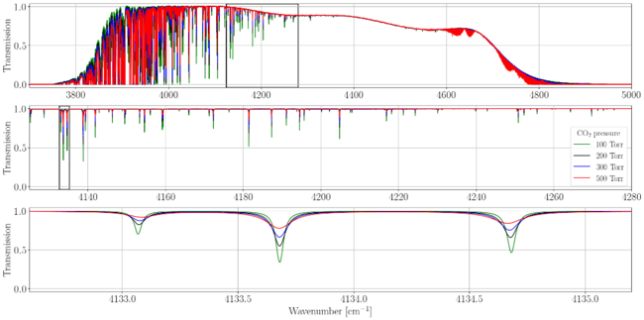
Recorded spectra at 2.34 µm
Ducreux et al., JQSRT (2025)
In preparation
Path length: 64 m - Iris aperture: 0.85 mm - At room temperature ~297 K
Spectral resolution: 0.01 cm⁻¹
P(H₂O) = 1.0 Torr + several P(CO₂) = 100, 200, 300, 500 Torr.

Slide 9
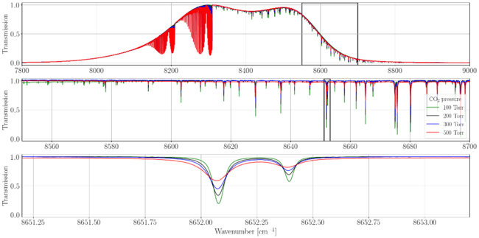
Recorded spectra at 1.18 µm
Ducreux et al., JQSRT (2025)
In preparation
Path length: 104 m - Iris aperture: 1.00 mm - At room temperature ~295 K
Spectral resolution: 0.02 cm⁻¹
P(H₂O) = 1.0 Torr + several P(CO₂) = 100, 200, 300, 500 Torr.

Slide 10
Multispectrum fitting procedure
Ngo et al., Ph. Trans. R. Soc. (2012)
Ngo et al., JQSRT (2013)
Residuals with W-shape using the Voigt profile
Narrowing of the water line
Profiles | Parameters
Voigt | Γ₀, Δ₀
quadratic Speed-Dependent Voigt | Γ₀, Δ₀, Γ₂, Δ₂
Considering finer effects
MSF (Lyulin, Atmo. Oc. Opt. 2015): beyond-Voigt line profiles

Slide 11
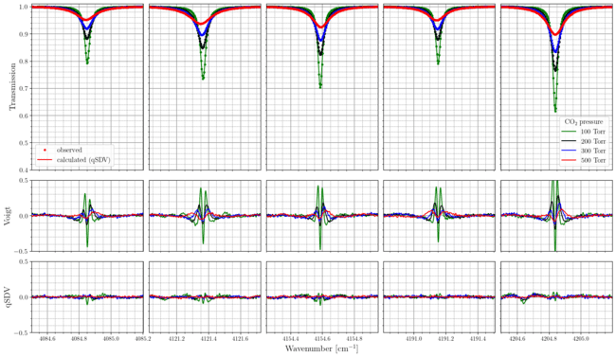
Profiles comparison at 2.34 µm
Ducreux et al., JQSRT (2025)
In preparation

Slide 12
CO₂-collisional parameters calculations
Robert & Bonamy, J Phys (1979) - Ma et al., JQSRT (2007)
New calculations in Venusian atmospheric windows for many transitions:
Refine the H₂O-CO₂ interaction potential
Semi-classic Complex Robert-Bonamy-Ma (CRBM) calculations
Bastien Vispoel
Invited talk
Tuesday 14h00
List of CO₂-collisional parameters for H₂O
to simulate Venus atmosphere

Slide 13
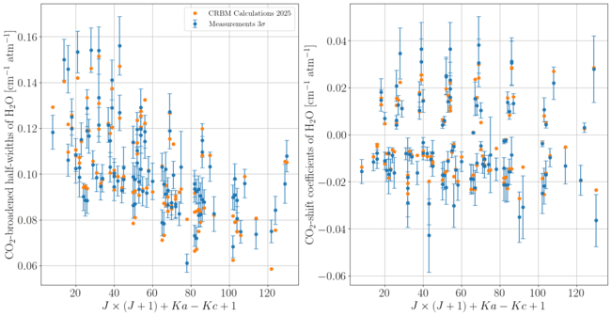
Calculations comparison
Ducreux et al., JQSRT (2025)
In preparation
Γ
Δ
APD = 1.3 % - STD = 7.4 %
Abs. mean dev. = 0.0037 cm⁻¹.atm⁻¹

Slide 14
Atmospheric retrievals and radiative transfer

Slide 15
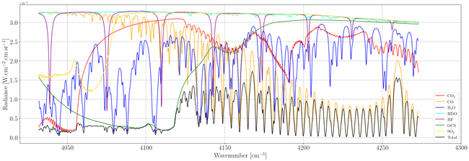
Radiative transfer model – Asimut
Vandaele et al. (2006)
Simulation of Venus atmospheric spectra from lists of calculated parameters in Voigt profile
Retrieval of the water vapor amount in the atmosphere from a spectrum
Around 2.34 µm
Estimate the error made using air-collisional instead of CO₂-collisional parameters

Slide 16
Venus atmospheric spectra simulation
1.18 µm
0 - 15 km
P = 93 bar
T = 740 K
30 ppm H₂O

Slide 17
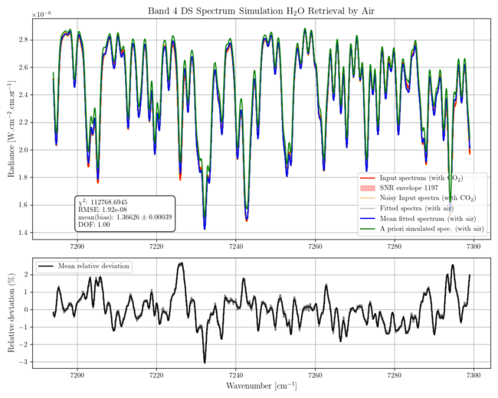
Venus atmospheric spectra retrievals
1.38 µm
65 - 80 km
P = 1e-02 bar
T = 220 K
5 ppm H₂O

Slide 18
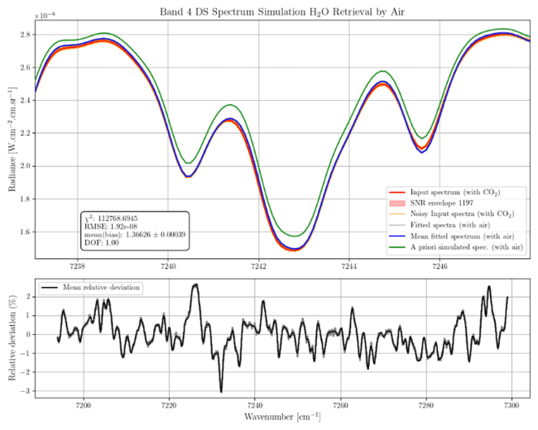
Venus atmospheric spectra retrievals
1.38 µm
65 - 80 km
P = 1e-02 bar
T = 220 K
5 ppm H₂O

Slide 19
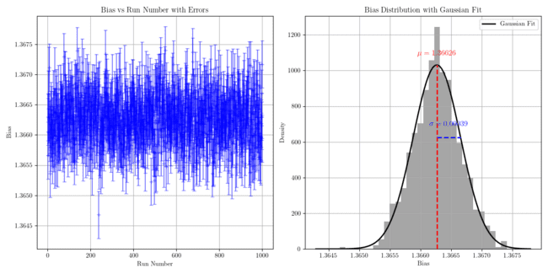
Venus atmospheric spectra retrievals
Bias = 36.63 ± 0.04 %

Slide 20
Conclusions

Slide 21
Conclusions
New measurements of H₂O-CO₂ collisional parameters
New calculations in Venus atmospheric transparency windows
Lead to significant biases in water vapor retrieved in the mesosphere
Need further investigations for the troposphere
Two papers in preparation to share both lists of line-shape parameters
To come: HDO-CO₂ collisional parameters

Slide 22
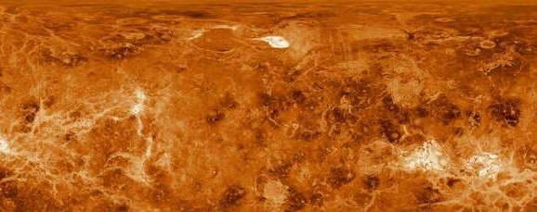
thank you! Questions?
emile.ducreux@univ-reims.fr

Slide 23
Annexes

Slide 24
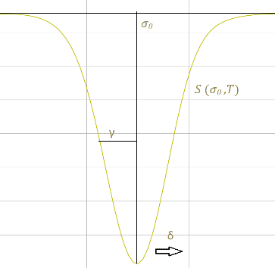
Absorption spectrum
Beer-Lambert Law:
$$I\left(σ\right)=I_{0}∙exp⁡\left[−N\left(P,T\right).L.S\left(σ_{0},T\right).Φ\left(σ−σ_{0},P,T\right)\right]$$
Line parameters:
Position σ₀, Intensity S,
Half-width γ, Shift δ
Laboratory measurements to atmospheric spectra study

Slide 25
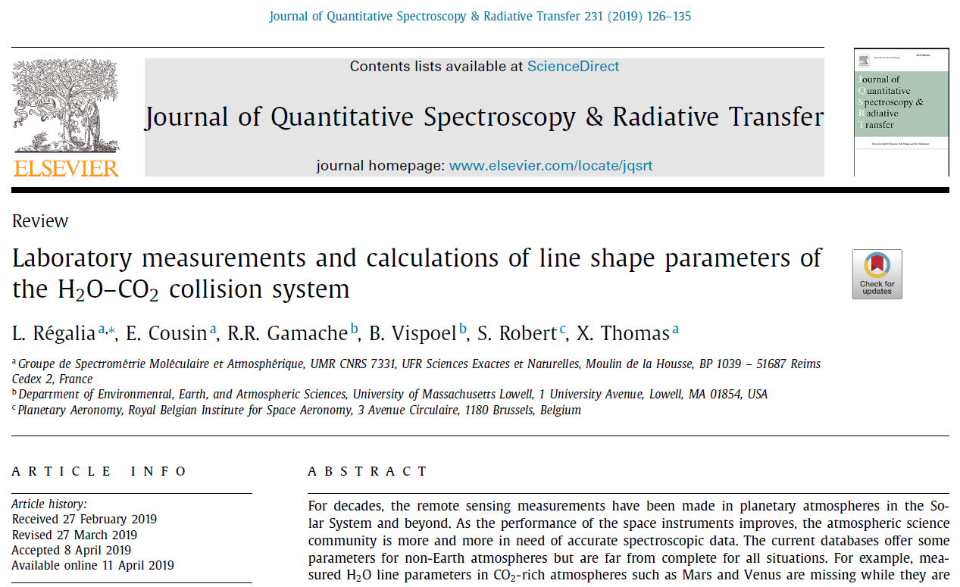
Previous work
Régalia et al., JQSRT (2019)
To insert a slide in this lay-out:
click right
Select “Layout”
Select “BIRA-IASB Left banner”
At 2.7 µm with the previous FTIR spectrometer

Slide 26
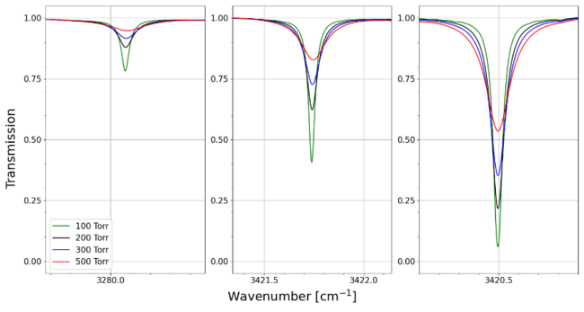
Multispectrum fitting procedure
MFT (Plateaux et al. 2001): Voigt profile and pressure fitting
MSF (Lyulin et al. 2015): beyond-Voigt line profiles
Too weak
Good
Saturated

Slide 27
Multispectrum fitting procedure
Ngo et al., Ph. Trans. R. Soc. (2012)
Ngo et al. , JQSRT (2013)
Residuals with W-shape using the Voigt profile
Narrowing of the water line
Profiles | Parameters
Voigt | Γ₀, Δ₀
Rautian | Γ₀, Δ₀, ν_{VC}
quadratic Speed-Dependent Voigt | Γ₀, Δ₀, Γ₂, Δ₂
quadratic Speed-Dependent Rautian | Γ₀, Δ₀, Γ₂, Δ₂, ν_{VC}
Considering finer effects
Limit cases of the Hartmann-Tran profile
MSF (Lyulin, Atmo. Oc. Opt. 2015): beyond-Voigt line profiles

Slide 28
Water vapour adsorption
Loos et al., JQSRT (2017)
Ducreux et al., JQSRT (2024)
H₂O adsorption in the stainless steel cell → H₂¹⁶O partial pressure correction
Intensities fixed at HITRAN2020 values with uncertainty < 1 %
MFT (Plateaux et al., JQSRT 2001): Voigt profile and pressure fitting
Fitted pressures always under measured ones.
Before
After

Slide 29
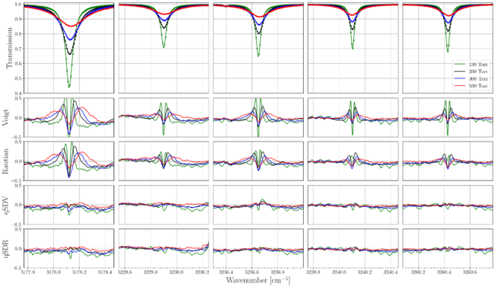
Profiles comparison at 2.7 µm
Ducreux et al., JQSRT (2024)

Slide 30
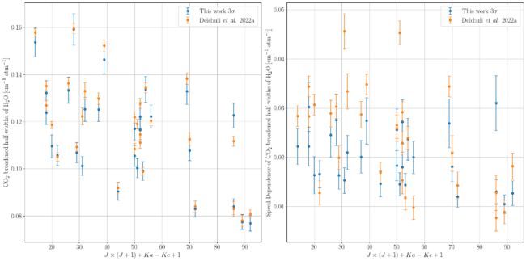
Literature comparison qSDV
Deichuli et al., AOO (2022a)
Γ
Γ₂
APD = 2.9 % - STD = 5.6 %
APD = 25.2 % - STD = 59.6 %

Slide 31
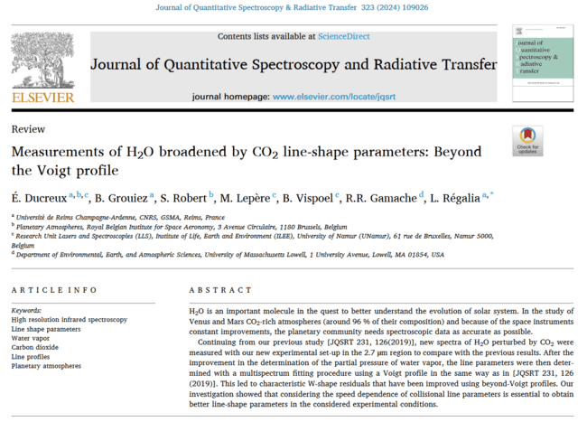

Slide 32
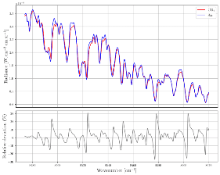
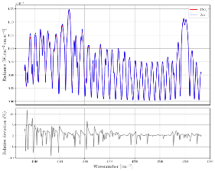
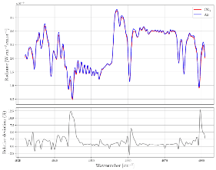
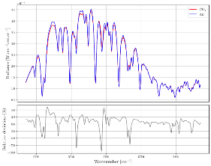
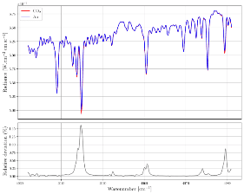
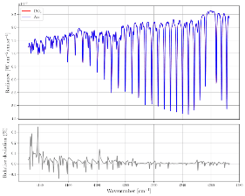
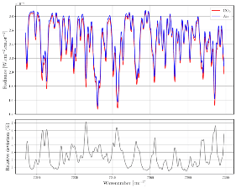
Venus atmospheric spectra simulation
Several atmospheric transparency windows of Venus
Comparison between air- and CO₂- collisional simulated spectra

Slide 33
Venus atmospheric spectra simulation
RETRIEVAL METHOD
Simulation of Venus atmospheric spectrum using CO₂-collisional parameters
Random noise added for a statistic sample of 1000 spectra
H₂O retrieval on the 1000 noisy spectra using CO₂-collisional parameters
H₂O retrieval on the 1000 noisy spectra using air-collisional parameters
Bias using air-collisional parameters

Slide 34
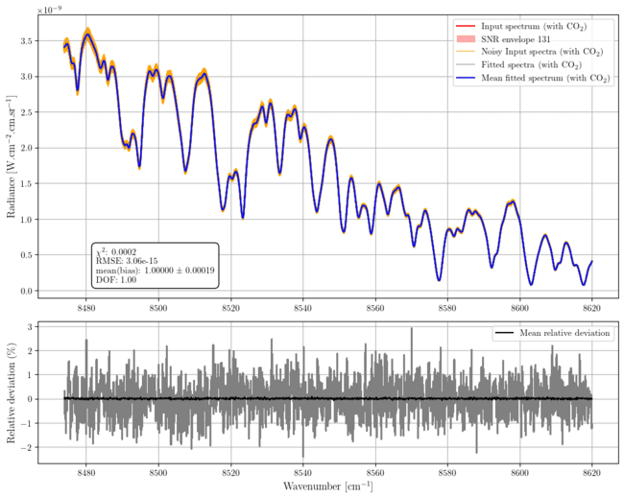
Venus atmospheric spectra retrievals
1.18 µm
0 - 15 km

Slide 35
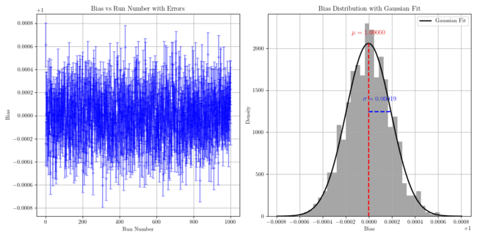
Venus atmospheric spectra retrievals
Bias = 0.00 ± 0.02 %

Slide 36
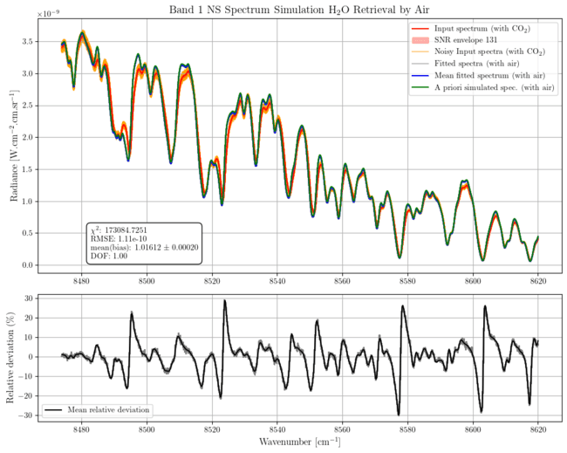
Venus atmospheric spectra retrievals
1.18 µm
0 - 15 km
P = 93 bar
T = 740 K

Slide 37
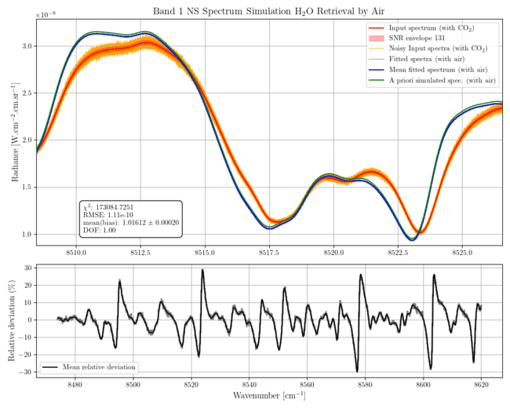
Venus atmospheric spectra retrievals
1.18 µm
0 - 15 km
P = 93 bar
T = 740 K

Slide 38
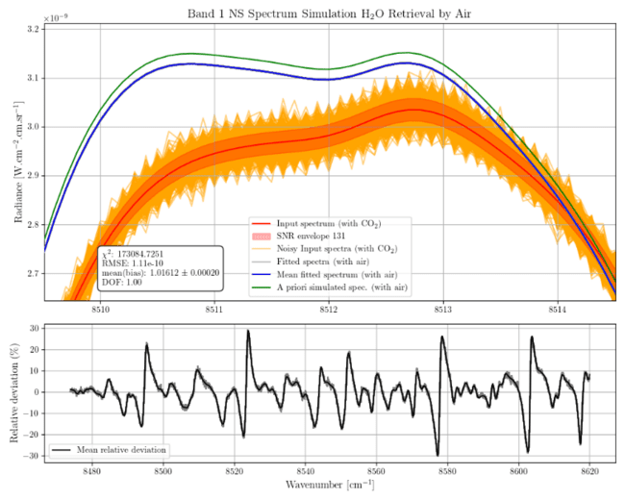
Venus atmospheric spectra retrievals
1.18 µm
0 - 15 km
P = 93 bar
T = 740 K

Slide 39
Venus atmospheric spectra retrievals
1.18 µm
0 - 15 km
P = 93 bar
T = 740 K

Slide 40
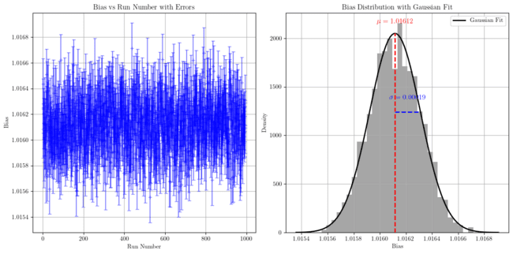
Venus atmospheric spectra retrievals
Bias = 1.61 ± 0.02 %

Slide 41
Venus atmospheric spectra retrievals
Spectral region | Planet side | Probed altitude range | Bias ± error
1.18 µm | Nightside | 0 – 15 km | 1.61 ± 0.02 %
1.74 µm | Nightside | 20 – 30 km | -0.28 ± 0.03 %
2.34 µm | Nightside | 30 – 45 km | 1.10 ± 0.16 %
2.34 µm | Dayside | 65 – 80 km | 11.34 ± 0.23 %
1.38 µm | Dayside | 65 – 80 km | 36.63 ± 0.04 %

Slide 42
H₂O retrievals on Venus simulated spectra
No dependence VS SNR

Slide 43
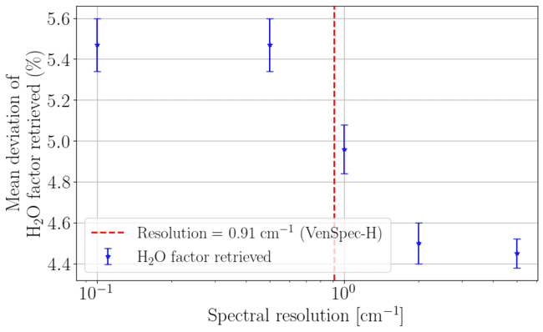
H₂O retrievals on Venus simulated spectra
Dependence VS spectral resolution at 1.17 µm

Slide 44
H₂O retrievals on Venus simulated spectra
And about the old observations?

