Slide 1
Millimeter Wave Fourier Transform Spectroscopy of Laser Photolysis Products
Ning Chen, Brian Hays, Eugene Alekseev, Roman Motiyenko, Laurent Margulès, Stephane Bailleux
Univ. Lille, CNRS, UMR 8523 - PhLAM - Physique des Lasers Atomes et Molécules, F-59000 Lille, France
JSM2025-Grenoble 12/03/2025

Slide 2
Context: Criegee Intermediates in Atmospheric Chemistry
Reactive carbonyl oxides (R₂COO) formed in the ozonolysis of alkenes
First proposition by R. Criegee in 1949 and fist observation in 2008 due to their high reactivity
CPER-ECRIN
biradical
zwitterionic
Large dipole moment!
M. Nakajim et al. J. Chem. Phys. 139, 10, 101103 (2013)
Notes:
reactive carbonyl oxides formed in the ozonolysis of alkenes
These chemicals may react with sulfur dioxide and nitrogen oxides in the Earth's atmosphere, and are implicated in the formation of aerosols, which are an important factor in controlling global climate
More related to the atmosptheric chemistry
440071,70 MHz
438994,85

Slide 3
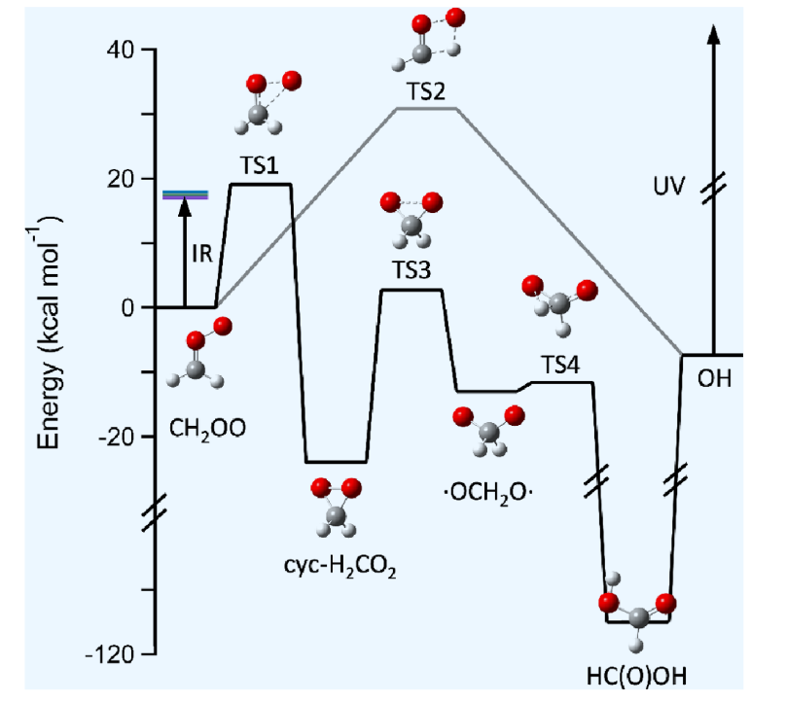
Context: Criegee Intermediates in Atmospheric Chemistry
CPER-ECRIN
CI*
Stabilized CI
unimolecular decomposition
Significant source of OH
bimolecular reactions with H₂O, (H₂O)₂, NO₂, SO₂, carboxylic acids, carbonyl compounds…
Qian et al., J. Phys. Chem. Letters 15, 23,6222‑29 (2024)
Notes:
reactive carbonyl oxides formed in the ozonolysis of alkenes
https://lweb.cfa.harvard.edu/amp/mccarthygroup/research_reactive-oxygen.html
These chemicals may react with sulfur dioxide and nitrogen oxides in the Earth's atmosphere, and are implicated in the formation of aerosols, which are an important factor in controlling global climate
More related to the atmosptheric chemistry
440071,70 MHz
438994,85

Slide 4
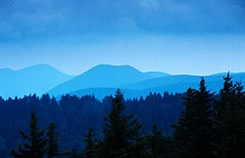
Context: Criegee Intermediates in Atmospheric Chemistry
Blue ridge mountains in US
Responsible for
production of OH, especially under conditions of poor light (nights, winter)
-> tropospheric oxidation cycle
production of acids and aerosols, which affect climate change and the formation of acid rain
Notes:
which contributes to the blue haze (~400 nm)

Slide 5
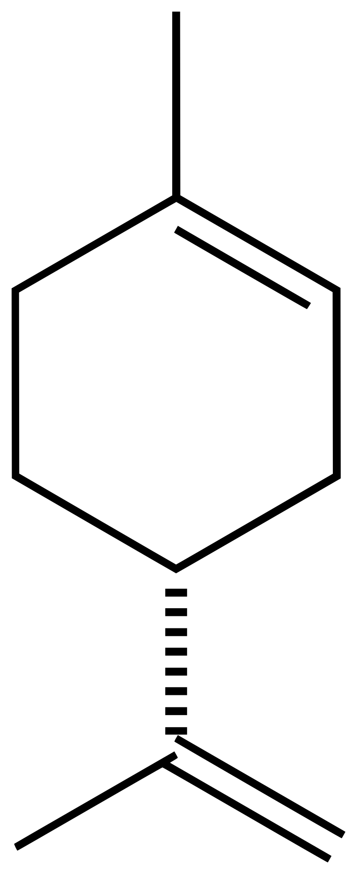
Context: Criegee Intermediates in Atmospheric Chemistry
Blue ridge mountains in US
Responsible for
production of OH, especially under conditions of poor light (nights, winter)
-> tropospheric oxidation cycle
production of acids and aerosols, which affect climate change and the formation of acid rain
SO₂,NO₂, carbonyl compounds…
CIs
O₃
…
Nuclearate & growth
Limonene
Secondary organic aerosols (SOA)
-> blue haze (~400 nm)
Pinene
VOC, like Monoterpenes (C₁₀H₁₆)
Notes:
which contributes to the blue haze (~400 nm)

Slide 6
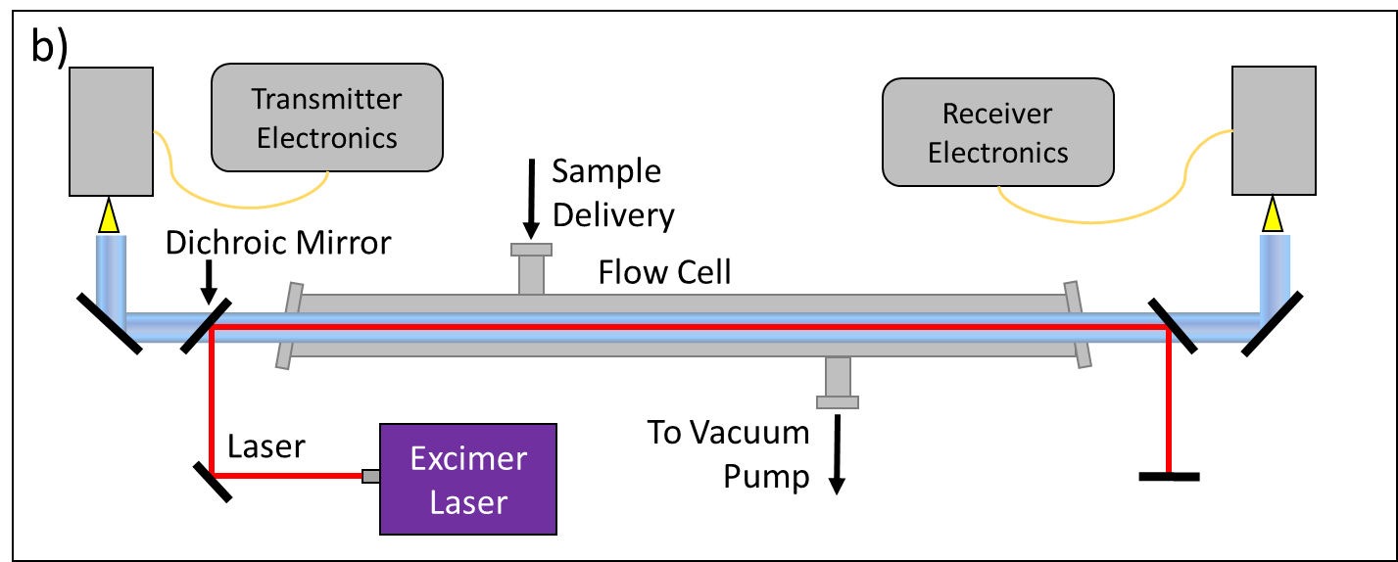
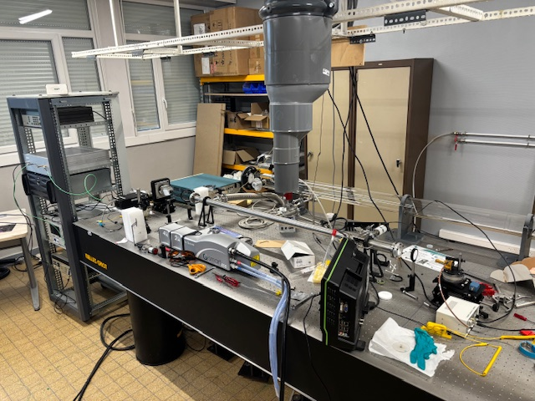
Construction of a new apparatus in Lille
f = 50-500 GHz
P = ~20-80 µbar, RT
Nd:YAG
laser
266 nm
D-P Zaleski et al. J. Phys. Chem. Lett. 8, 24, 6180‑88 (2017)
Room temperature flow-cell reactor + Pulsed laser photolysis (10 Hz) + mmW spectrometer
Pulsed laser photolysis to initiate reactions
Spectral study of rotational energy levels of intermediate molecules
Study of kinetics in the reactor (non-destructive analytical technique)
Notes:
In the millimeter spectroscopy, we send a pulse of radiation and detect the emission radaition, FID signal in time domain, by doing Fourier transform, we get the spectrum in frequency domaon. This is how we do measueremnt
NMR (nuclear magnetic resonance) spec electron spin
Rotational transition, Faster

Slide 7
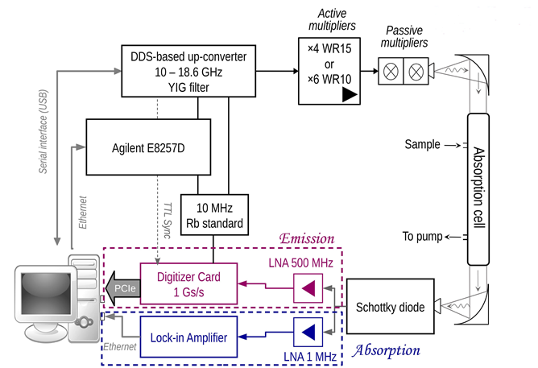
Fast Lille Absorption emiSsion High-resolution (FLASH) spectrometer (50-500 GHz)
DDS-based up-converter: Enhances spectroscopic recording speed thanks to fast frequency switching.
Data acquisition protocol
card average × computer average
Laser photolysis
Luyao Zou et al. Review of Scientific Instruments 91, 6 (2020)
Notes:
The first stage of averaging was the “card average” that runs N1 chirped pulse cycles without interruption, and the time domain data were stacked in the ADC card’s memory
After each card average cycle, the collected data were transferred from the ADC card to the computer via a PCI express bus (4 GB/s). The computer summed the data of all chirps and stored the data array in the computer’s memory

Slide 8
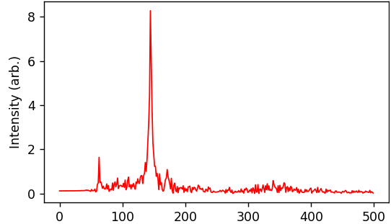
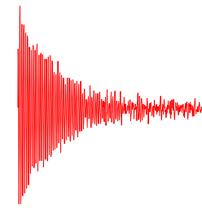
Multiple-pulse Emission Spectroscopy
Single pulse mode of the mmW Fourier Transform Spectroscopy
Free Induction Decay
(FID)
Frequency Spectrum
Excitation pulse
FFT
Time
Frequency
Repeat the cycle and record signals in the digitizer, averaging them to increase S/N ratio
Théo Guillaume, Brian M. Hays et al. J. Chem. Phys. 160, 20, 204201 (2024)
Notes:
In the millimeter spectroscopy, we send a pulse of radiation and detect the emission radaition, FID signal in time domain, by doing Fourier transform, we get the spectrum in frequency domaon. This is how we do measueremnt
NMR (nuclear magnetic resonance) spec electron spin
Rotational transition, Faster

Slide 9
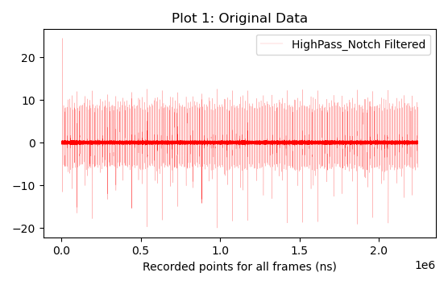
Multiple-pulse Emission Spectroscopy
Laser fire (ns, 10 Hz), Trigger
Sinle cycle (10 µs)
…
…
Time
Cut 1 = n cycles
Cut 2
Cut m
Accumulation of the n signal in each cut to increase the signal-to-noise ratio
Monitoring the kinetic evolution of the studied molecules after the laser firing
Allowing the identification and substraction the reflection signal
Théo Guillaume, Brian M. Hays et al. J. Chem. Phys. 160, 20, 204201 (2024)
Notes:
In the millimeter spectroscopy, we send a pulse of radiation and detect the emission radaition, FID signal in time domain, by doing Fourier transform, we get the spectrum in frequency domaon. This is how we do measueremnt
NMR (nuclear magnetic resonance) spec electron spin
Rotational transition, Faster

Slide 10
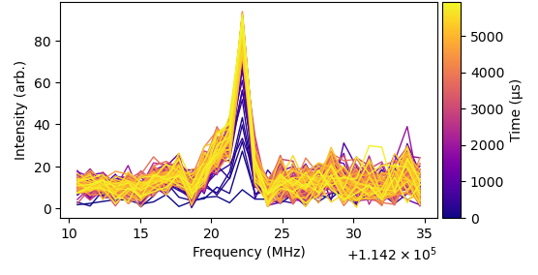
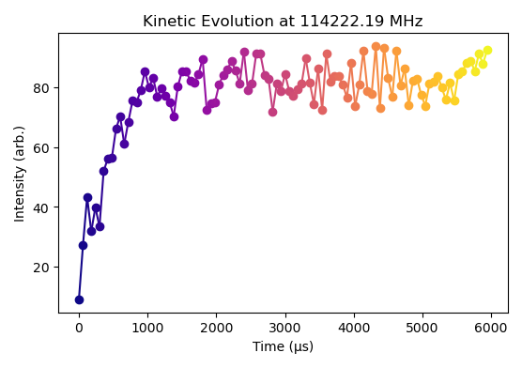
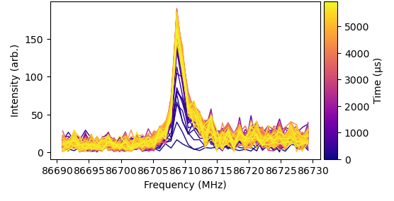
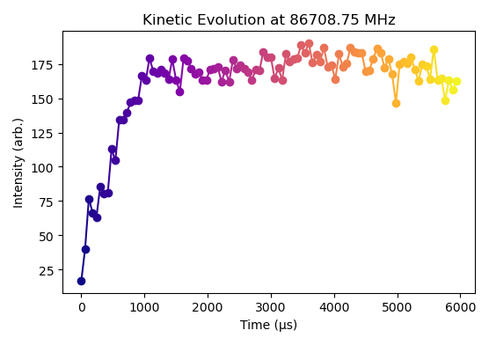
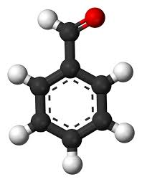
Preliminary photolysis tests
Laser fire
CO (v=1, J=1-0)
C₆H₅ + H + CO
hv
C₆H₅CHO
HCO ( N_{Ka,Kc,J,F} =
1_{0,1,2.5,1.5}-0_{0,0,1.5,0.5})
C₆H₅ + HCO
Notes:
The color gradiance shows the time revolution after the laser fires
Monitoring in the time domain

Slide 11
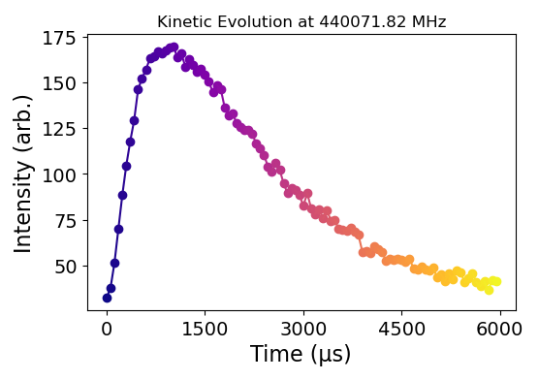
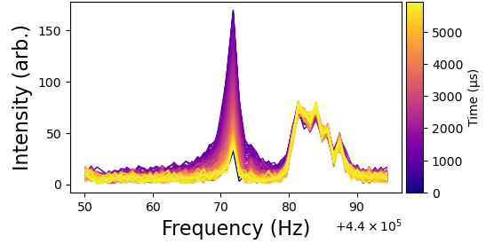
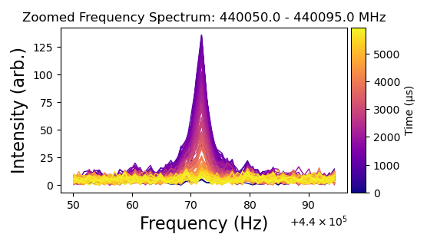
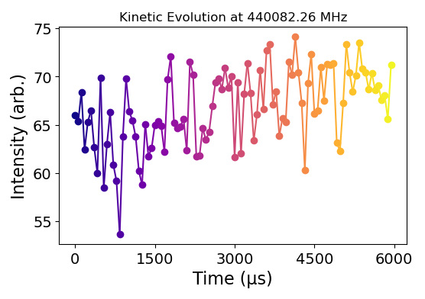
Preliminary results of the simplest Criegee intermediate
CH₂I₂
CH₂OO
hv
O₂
J_{Ka,Kc} = 20_{0,20} – 19_{0,19}
CH₂OO
J_{Ka,Kc} = 20_{0,20} – 19_{0,19}
CH₂OO
Substraction by the first 10 cycles

Slide 12
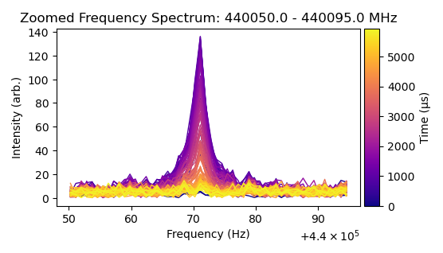
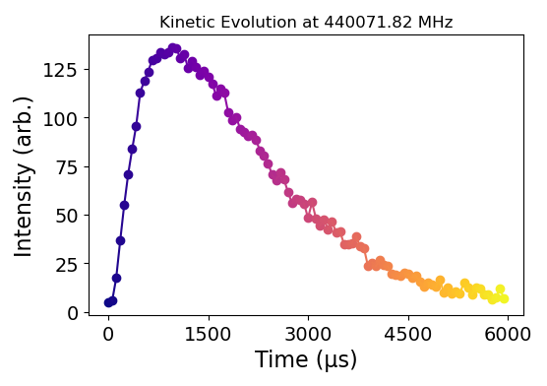
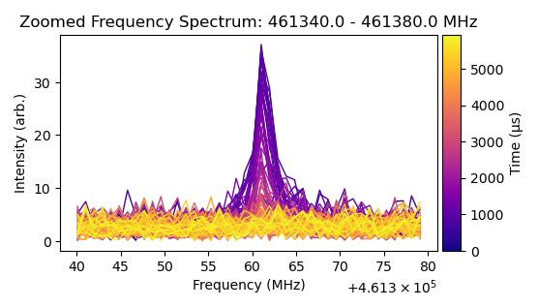
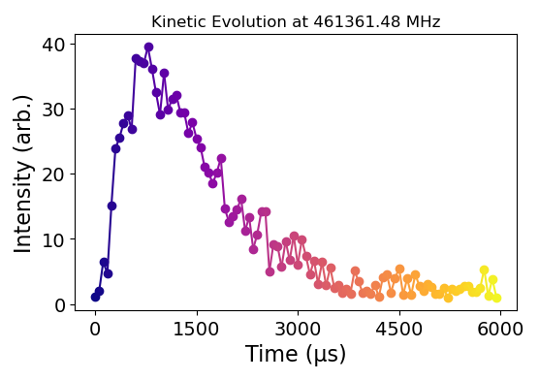
Preliminary results of the simplest Criegee intermediate
CH₂I₂
CH₂OO
CH₂OO
CH₂OO
J_{Ka,Kc} = 20_{0,20} – 19_{0,19}
hv
O₂
Decay:
reactions (with CH₂OO, I, CH₂I, …)
wall loss
Laser fire
J_{Ka,Kc} = 21_{0,21} – 20_{0,20}
CH₂OO
CH₂OO
Daly et al. J. Mol. Spec. 297, 16‑20 (2014)
Notes:
These chemicals may react with sulfur dioxide and nitrogen oxides in the Earth's atmosphere, and are implicated in the formation of aerosols, which are an important factor in controlling global climate
More related to the atmosptheric chemistry
440071,70 MHz
438994,85

Slide 13
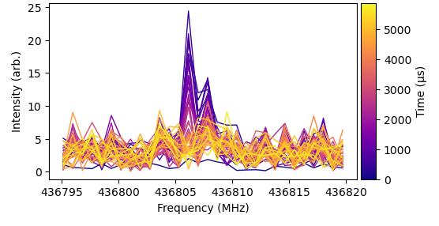
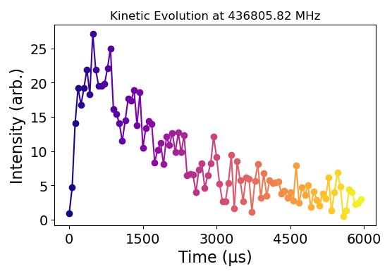
Preliminary results of the simplest Criegee intermediate
CH₂I₂
CH₂I
CH₂OO
CH₂OO
CH₂OO
J_{Ka,Kc} = 20_{0,20} – 19_{0,19}
hv
O₂
N_{Ka,Kc,J,I} = 25_{0,25,25,1}
– 24_{0,24,24,1}
CH₂I
CH₂I
Notes:
These chemicals may react with sulfur dioxide and nitrogen oxides in the Earth's atmosphere, and are implicated in the formation of aerosols, which are an important factor in controlling global climate
More related to the atmosptheric chemistry
440071,70 MHz
438994,85

Slide 14
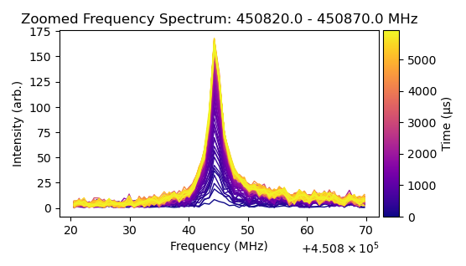
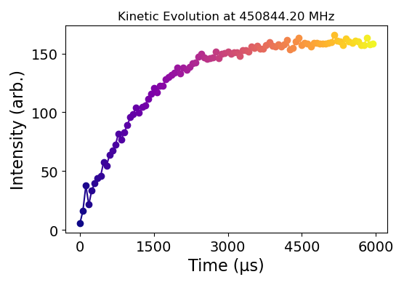
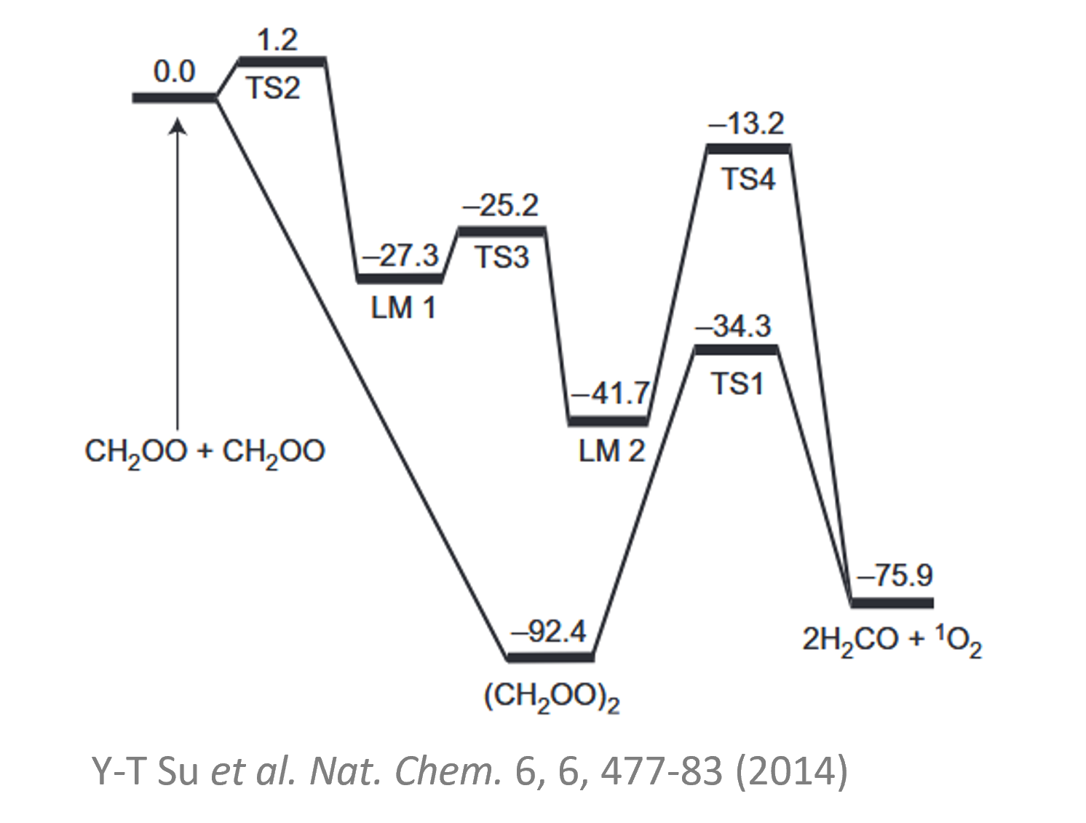
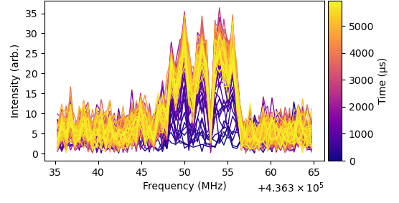
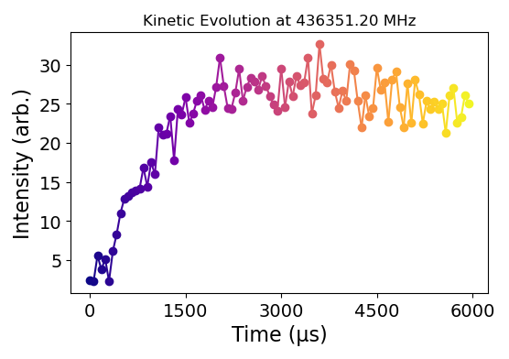
Preliminary results of the simplest Criegee intermediate
Decay of CH₂OO ?
Observation
of H₂CO and
IO radical
No observation of HCO and HCOOH, which have been reported (ex. T-Y Chen, PCCP(2020))
J_{Ka,Kc} = 6_{1,5} – 5_{1,4}
H₂CO
H₂CO
J = 21.5 – 20.5
IO
IO
Notes:
These chemicals may react with sulfur dioxide and nitrogen oxides in the Earth's atmosphere, and are implicated in the formation of aerosols, which are an important factor in controlling global climate
More related to the atmosptheric chemistry
440071,70 MHz
438994,85

Slide 15
Summary and future work
In the photolysis experiments of CH₂I₂:
Successfully observed the Criegee intermediate CH₂OO and other products, including two radicals (CH₂I and IO).
Clearly monitored the kinetic evolution of the detected molecules in the reaction cell.
In the photolysis experiments of PhCHO:
Observed rotational signals of CO (ground state) and CO (v=1), with v=1 being more visible.
Clearly observed rotational signals of HCO (ground state).
In the low frequency range, several rotational transitions possibly associated with HCO (v) were detected.

Slide 16
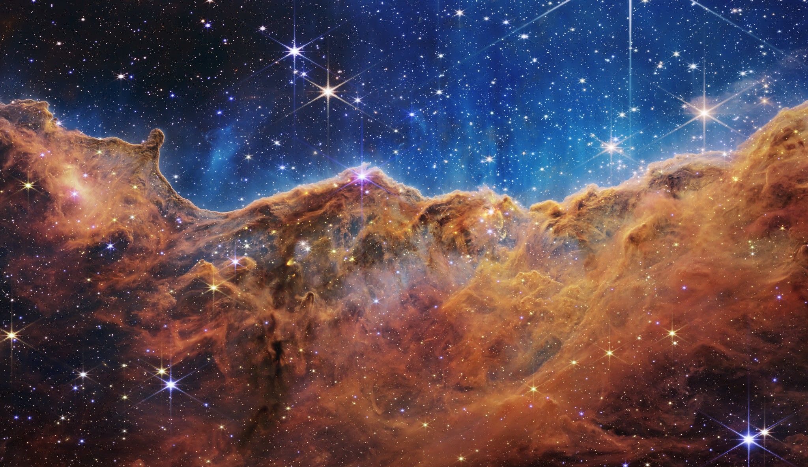
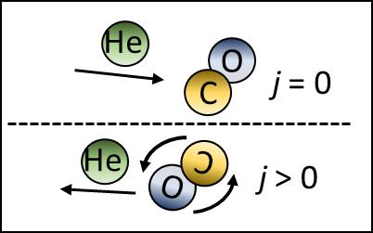
Summary and future work
Extending the spectra of Criegee Intermediates with functional groups
Vibrational states of radicals
C. Cabezas et al. Inte. Rev. Phys. Chem. 39. 349-382. (2020)
L. Chen et al. Atmos. Chem. Phys., 19, 4075–4091 (2019)
ANR JCJC Project: 2D CORTICO
Spectra of radicals with large amplitude motion
Pressure broadening and inelastic collision parameters of unstable molecules to compare against ab initio calculations
Build a buffer gas cooling cell to match the temperature of the ISM
Develop pulsed Fourier transform spectroscopic techniques to decipher collisional data
Credit: NASA, ESA, CSA, and STScI

Slide 17
Acknowledgements
Laurent Margulès
Manuel Goubet
Brian Hays
Roman Motiyenko
Eugene Alekseev
Stephane Bailleux
Arnaud Mussot
Fundings:

Slide 18
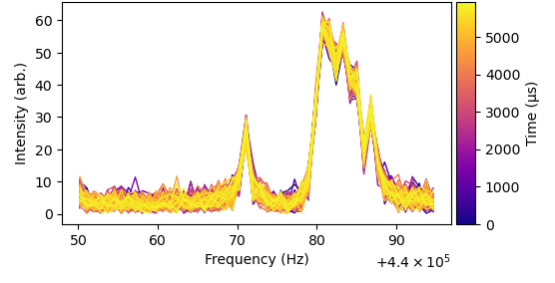
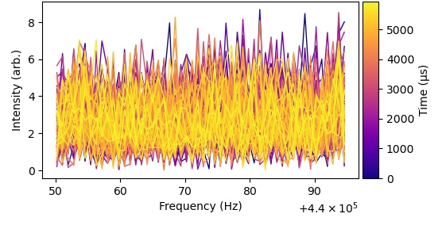
No O₂
No precursor

