Slide 1


Laser desorption on water microdroplets for gas phase characterization of biomolecules and its water aggregates
Alberto Macario, Ayoub Badri, Manal Al Sahmarani, Charles Desfrançois, Frédéric Lecomte, Bruno Manil, Nicolas Nieuwjaer
Laboratoire de Physique des Lasers (LPL) – UMR 7538 du CNRS, Université Sorbonne Paris Nord, Villetaneuse, France
alberto.macariofarto@sorbonne-paris-nord.fr
Me2-1 - Alberto Macario Farto Journées de Spectroscopie Moléculaire Grenoble, 12 mars 2025

Slide 2
Summary

  Gas-phase characterization
    Rotational Spectroscopy
    Action Spectroscopy: IRMPD
  Biomolecules and its water aggregates
  Laser desorption of water microdroplets
    Pulsed Droplet Beam Laser Desorption Source
  Perspectives and future experimental setup
Me2-1 - Alberto Macario Farto Journées de Spectroscopie Moléculaire Grenoble, 12 mars 2025

Slide 3
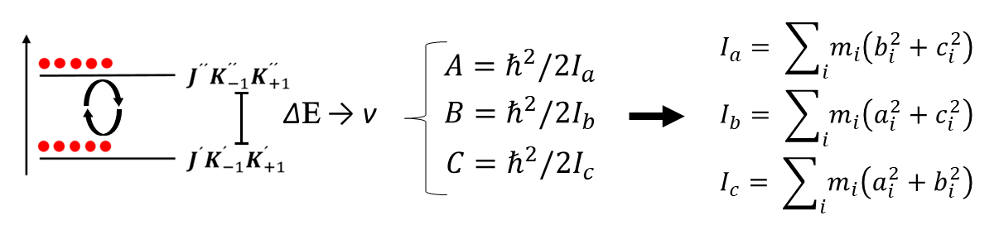
Gas-phase characterization

Rotational spectroscopy
Limitations
  General applicability (μ ≠ 0)
  High Selectivity
  Isomers, conformers and isotopologues, vibrationally excited states, radicals, ions
  Direct and accurate molecular structure
  Vaporization
  Isolation, lower temperature
  Characterization
  Molecular structure, Complexes, Dynamics, Conformational landscape and relative stability, intra- and inter molecular interactions
  μ = 0
High-resolution FT Rotational spectroscopy
Me2-1 - Alberto Macario Farto Journées de Spectroscopie Moléculaire Grenoble, 12 mars 2025

Slide 4
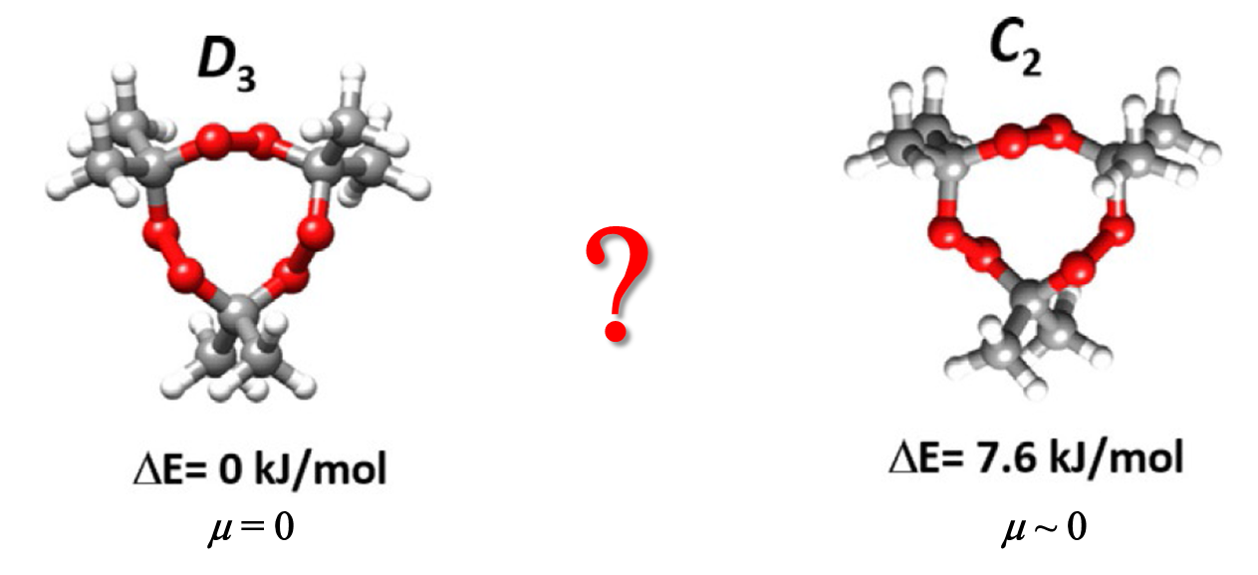
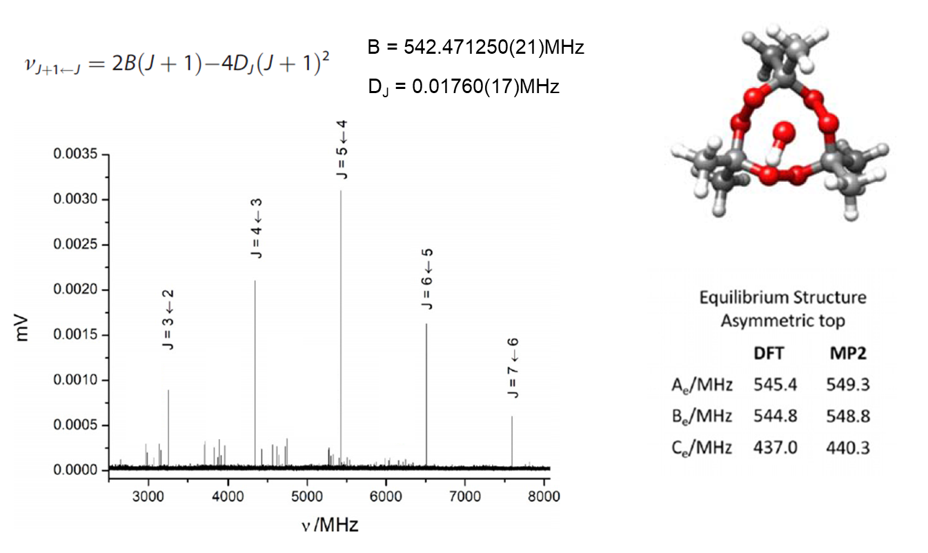
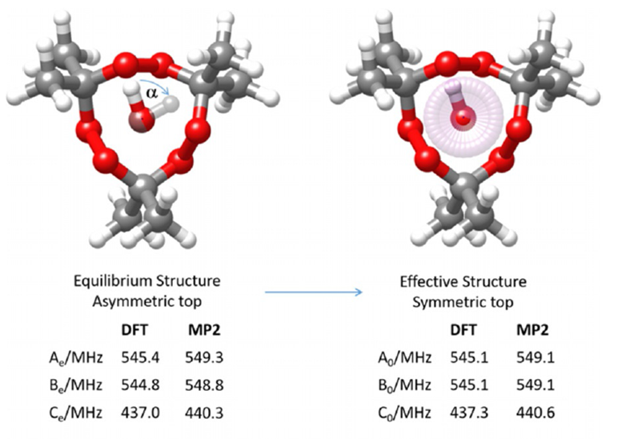
Gas-phase characterization

Rotational spectroscopy
Detection of non permanent dipole moment species
TATP is an explosive of ease synthesis and difficult to detect
Blanco, Macario et al. Chem. Eur. J. 27 (2021) 1680
Me2-1 - Alberto Macario Farto Journées de Spectroscopie Moléculaire Grenoble, 12 mars 2025

Slide 5
Gas-phase characterization

Rotational spectroscopy
Limitations
  General applicability (μ ≠ 0)
  High Selectivity
  Isomers, conformers and isotopologues, vibrationally excited states, radicals, ions
  Direct and accurate molecular structure
  Vaporization
  Isolation, lower temperature
  Characterization
  Molecular structure, Complexes, Dynamics, Conformational landscape and relative stability, intra- and inter molecular interactions
  μ = 0
      Neutral Systems
  Molecular Size
High-resolution FT Rotational spectroscopy
Me2-1 - Alberto Macario Farto Journées de Spectroscopie Moléculaire Grenoble, 12 mars 2025

Slide 6
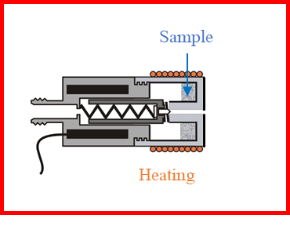
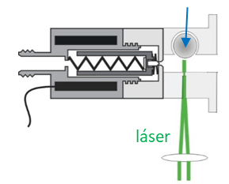
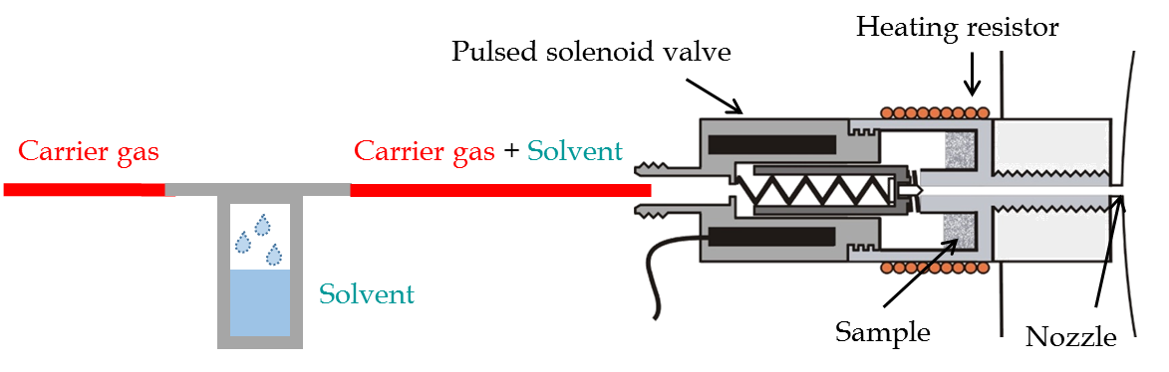
Gas-phase characterization

High-resolution FT Rotational spectroscopy
  Vaporization Formation of complexes
Non-volatile species
Electrical discharge
Laser photodissociation
Pyrolysis
Laser Ablation
Heating
Sample
Laser
High melting points
Thermally unstable
  Carrier gas = Ar, Ne, He
  Solvent = Water, Formic acid, Ethanol
Me2-1 - Alberto Macario Farto Journées de Spectroscopie Moléculaire Grenoble, 12 mars 2025

Slide 7
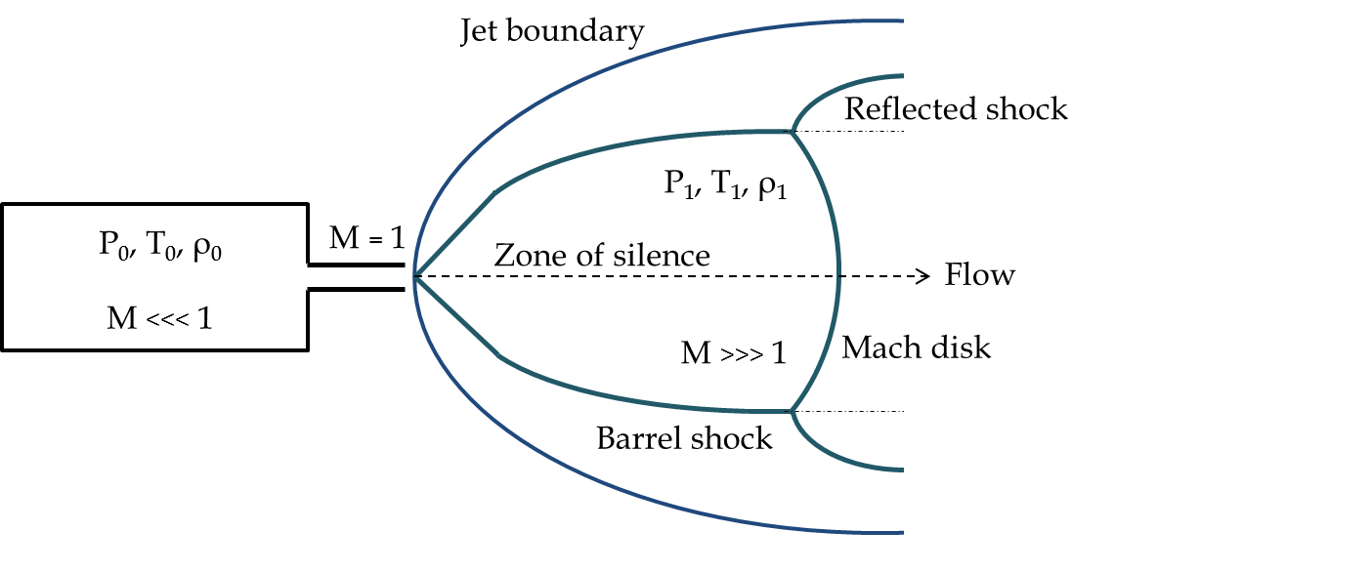
Gas-phase characterization

High-resolution FT Rotational spectroscopy
  Isolation and lower temperature Formation of complexes
Supersonic Expansion
Pulsed mode
  Carrier gas = Ar, Ne, He
  Nozzle diameter = 0.8-1.2 mm
  Solvent = Water, Formic acid, Ethanol
Me2-1 - Alberto Macario Farto Journées de Spectroscopie Moléculaire Grenoble, 12 mars 2025

Slide 8
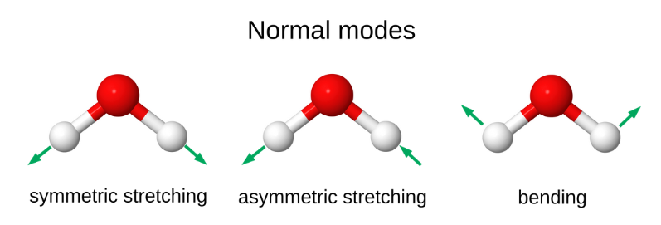
Gas-phase characterization

Vibrational spectroscopy
Limitations
  General applicability
  High Selectivity
  Isomers, conformers and isotopologues, vibrationally excited states, radicals, ions
  Information of the molecular structure
  Vaporization
  Isolation, lower temperature
  Characterization
  Molecular structure, Complexes, Dynamics
      Ionic Systems
  Molecular structure
IR MultiPhoton Dissociation (IRMPD) spectroscopy
Me2-1 - Alberto Macario Farto Journées de Spectroscopie Moléculaire Grenoble, 12 mars 2025

Slide 9
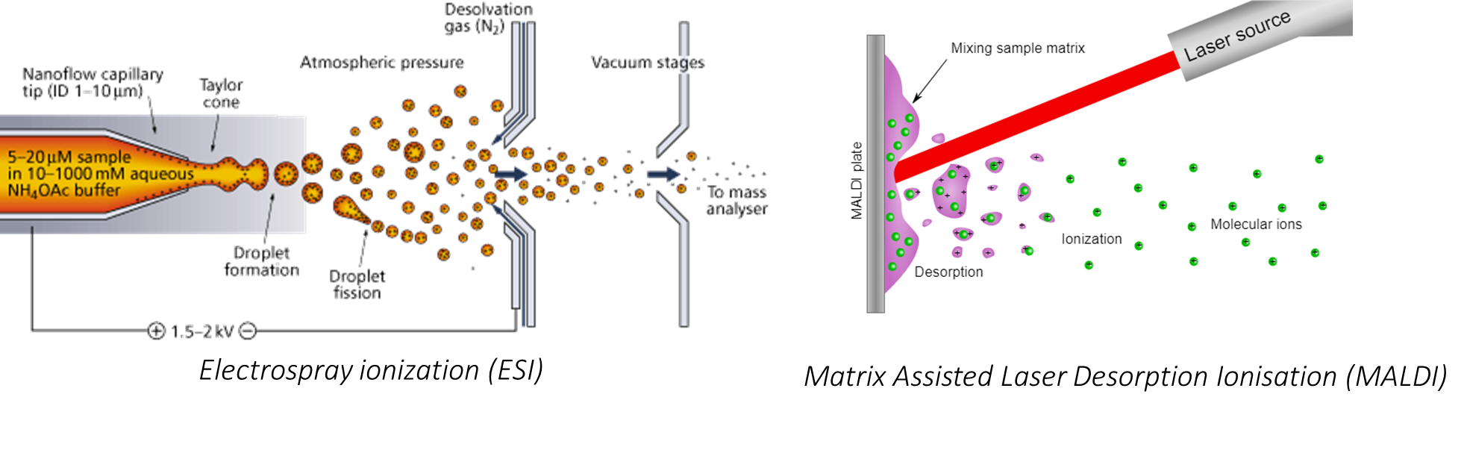
Gas-phase characterization

IRMPD spectroscopy
  Technique Isolation, lower temperature
Supersonic Expansion
Messager-tagging gas
Source
Tramp
MS Detection
IVR : Intramolecular Vibrational energy Redistribution
IR Laser
  Vaporization source
Me2-1 - Alberto Macario Farto Journées de Spectroscopie Moléculaire Grenoble, 12 mars 2025

Slide 10
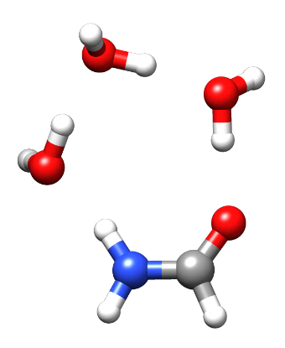
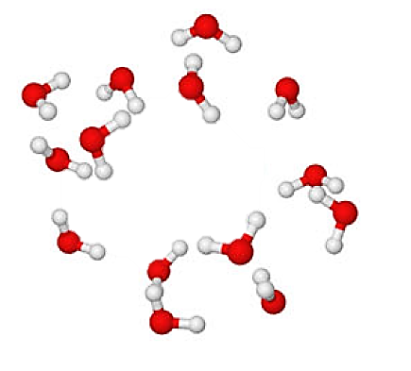
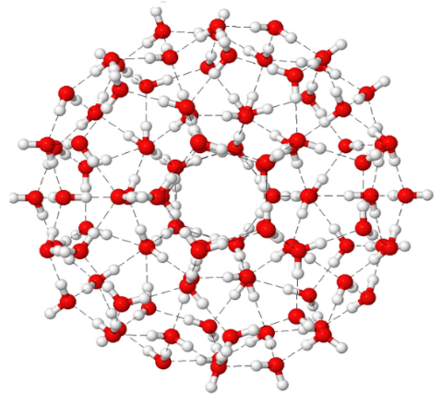
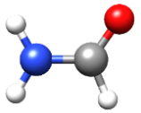

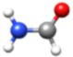
Biomolecules and its hydrates

  Correlation between the molecular structure and the biological functionality
Blanco, Macario, López Phys. Chem. Chem. Phys. 23 (2021) 13705
  Microsolvation and water complexes
  Isolated
  Water complexes
  Microsolvation
  Solvation
  Complementarity FT-MW and IRMPD Neutral – Ions 500 Da – 10 kDa
Me2-1 - Alberto Macario Farto Journées de Spectroscopie Moléculaire Grenoble, 12 mars 2025

Slide 11
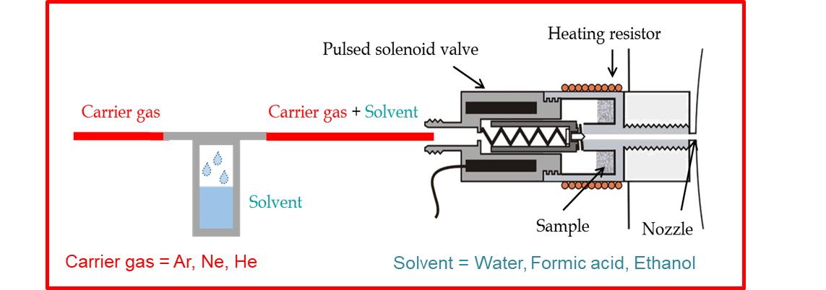
Sample
  Neutral
Laser
High melting points, thermally unstable molecules
  Complexes
What is missing ?
  Ions
Me2-1 - Alberto Macario Farto Journées de Spectroscopie Moléculaire Grenoble, 12 mars 2025

Slide 12
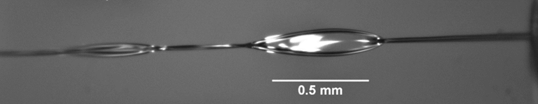
Laser desorption of water microdroplets

Pulsed droplet beam laser desorption
  Soft desorption vaporization method
  Forms directly hydrated complexes
  Comes from
  Already employed for studying biomolecular ions and its complexes
  Neutral complexes already observed in LILBID by IR
  Liquid Beam
  Laser-Induced Liquid Beam Ionization/Desorption (LILBID) method
Morgner, Barth et al. Aust. J. Chem. 59 (2006) 109
Kohno, Toyama et al. Chem. Phys. Letts. 420 (2006) 146
Kohno, Mafuné et al. J. Phys. Chem. A 108 (2004) 971
Me2-1 - Alberto Macario Farto Journées de Spectroscopie Moléculaire Grenoble, 12 mars 2025

Slide 13
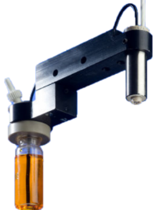
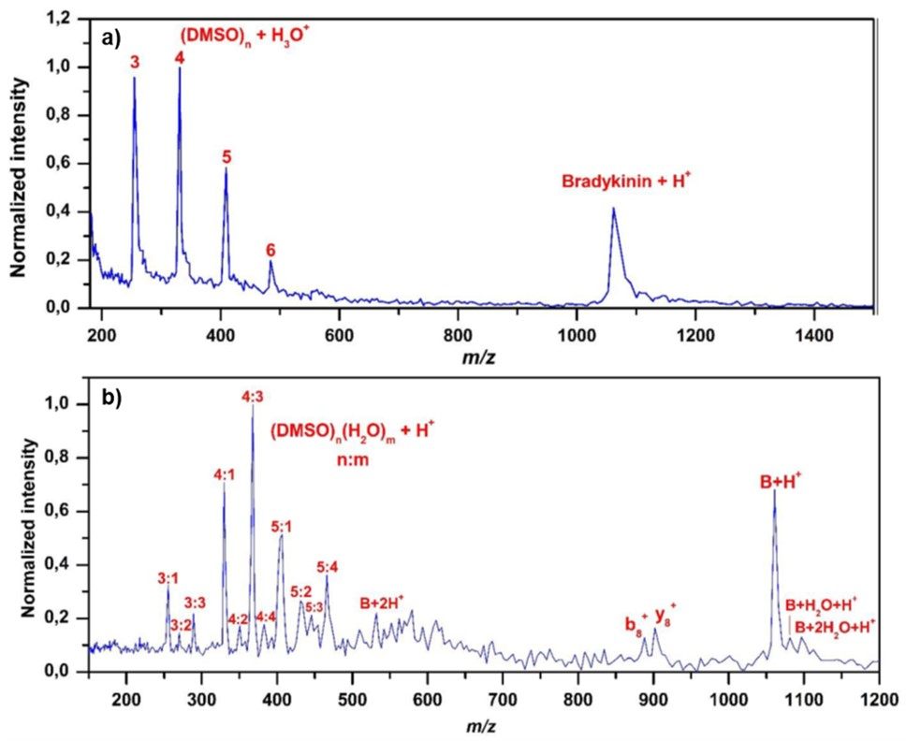
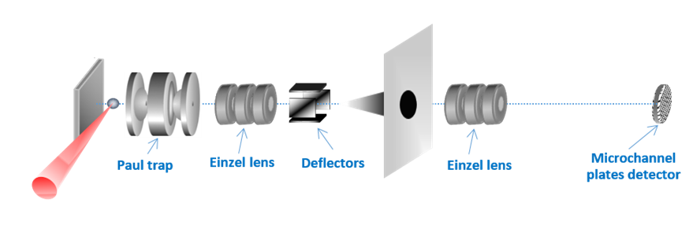
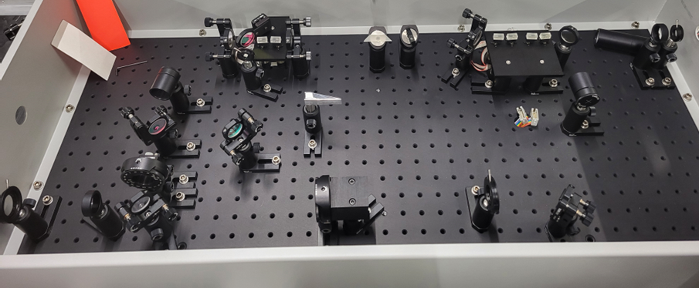
Laser desorption of water microdroplets

Pulsed droplet beam laser desorption in LPL
1. Droplet beam generation
Droplet Generator
300 mbar
4. Mass spectrum analysis
50 μm
65 ng
1º Skimmer
10⁻² mbar
2º skimmer
2. Vacuum transfer
10⁻⁶ mbar
3. IR laser desorption
Laser IR
Me2-1 - Alberto Macario Farto Journées de Spectroscopie Moléculaire Grenoble, 12 mars 2025

Slide 14
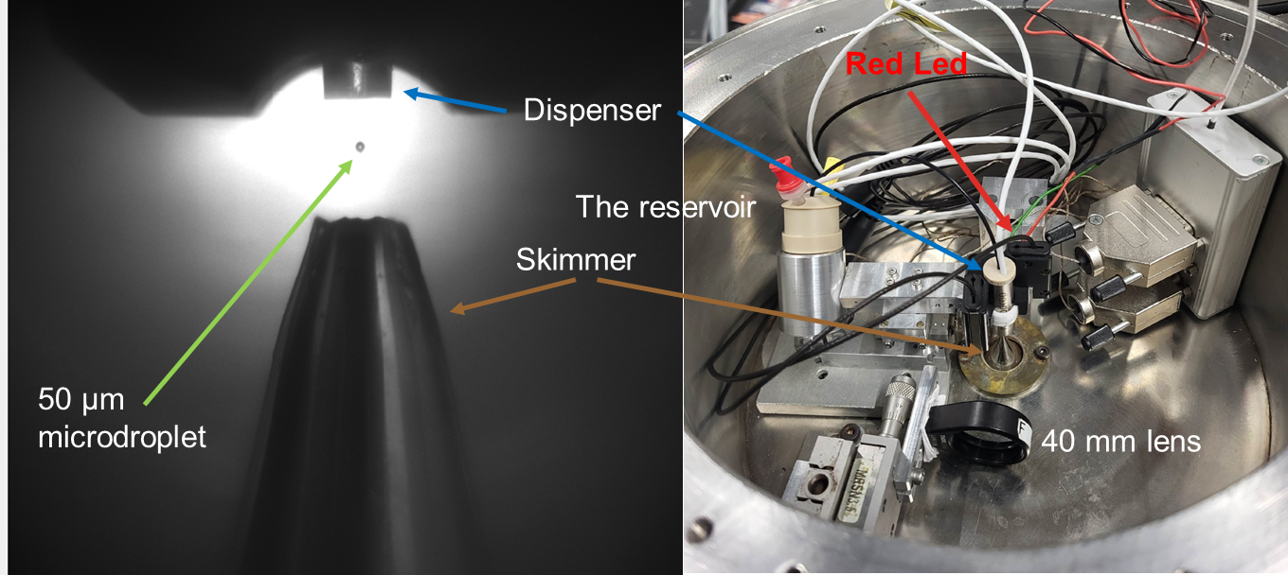
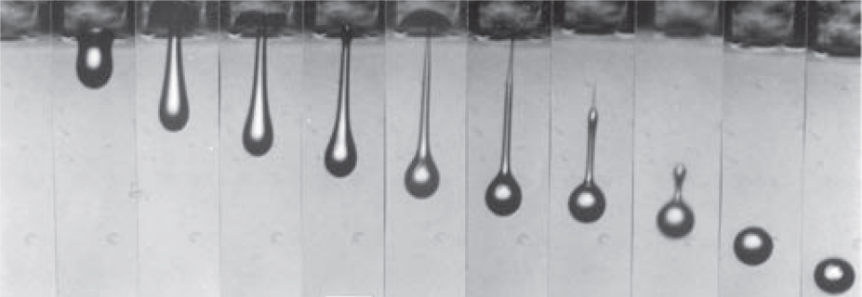
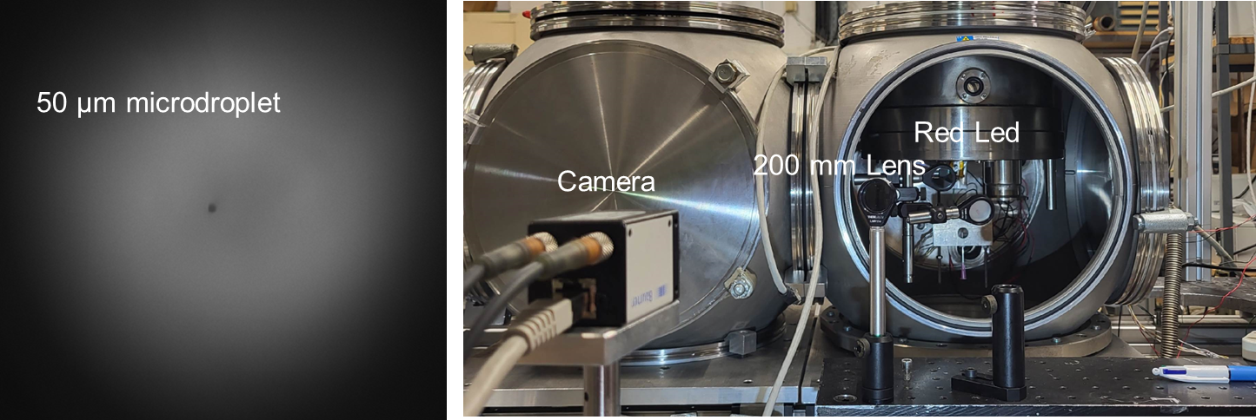
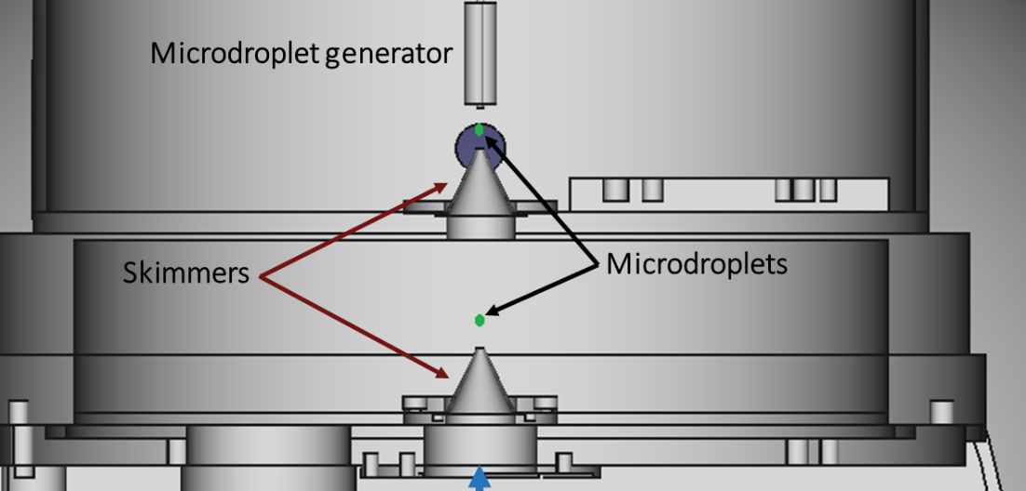
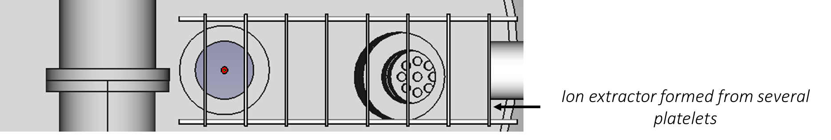
Laser desorption of water microdroplets

Pulsed droplet beam laser desorption in LPL
WATER droplets 50 to 70 µm in diameter
200 mbar
10⁻² mbar
3 cm
10⁻⁵ mbar
IR desorption laser
Me2-1 - Alberto Macario Farto Journées de Spectroscopie Moléculaire Grenoble, 12 mars 2025

Slide 15
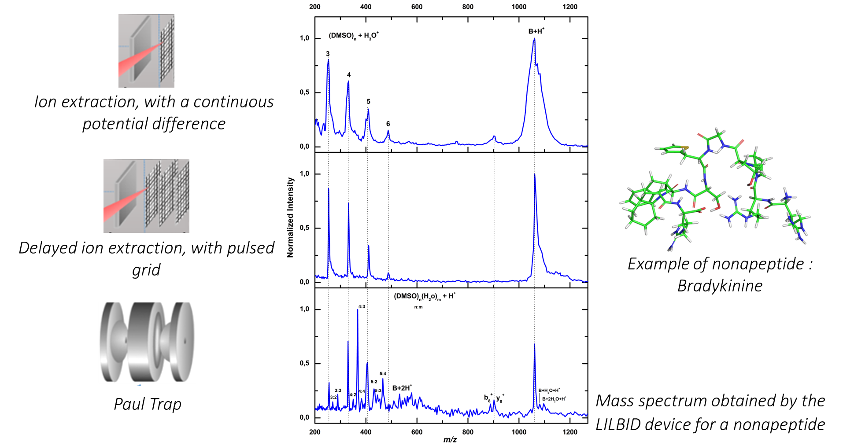
Laser desorption of water microdroplets

Pulsed droplet beam laser desorption
  Mass spectrometry detection
Me2-1 - Alberto Macario Farto Journées de Spectroscopie Moléculaire Grenoble, 12 mars 2025

Slide 16
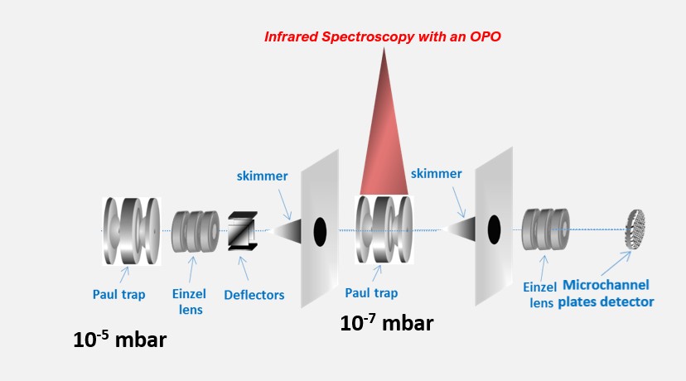
Perspectives

Pulsed droplet beam laser desorption COUPLED TO IRMPD
  Structural studies by IR spectroscopy
  Coupling a cryostat with the second Paul trap
Me2-1 - Alberto Macario Farto Journées de Spectroscopie Moléculaire Grenoble, 12 mars 2025

Slide 17
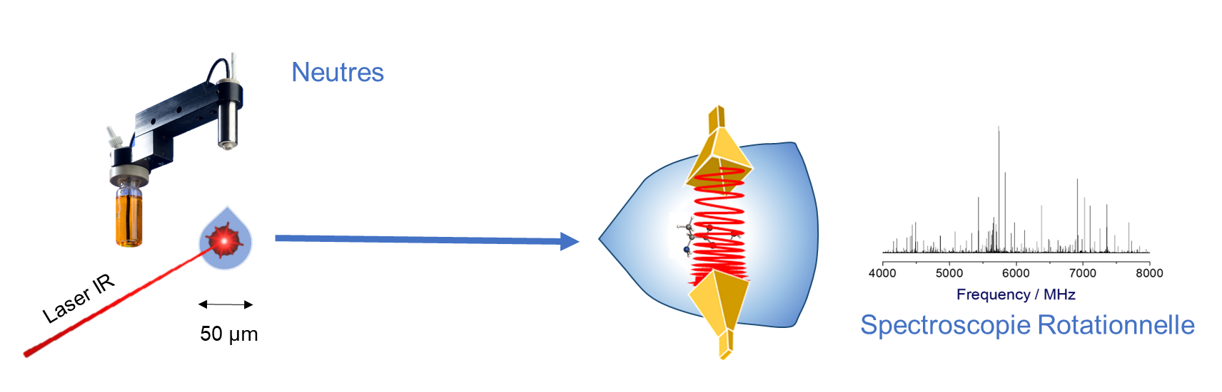
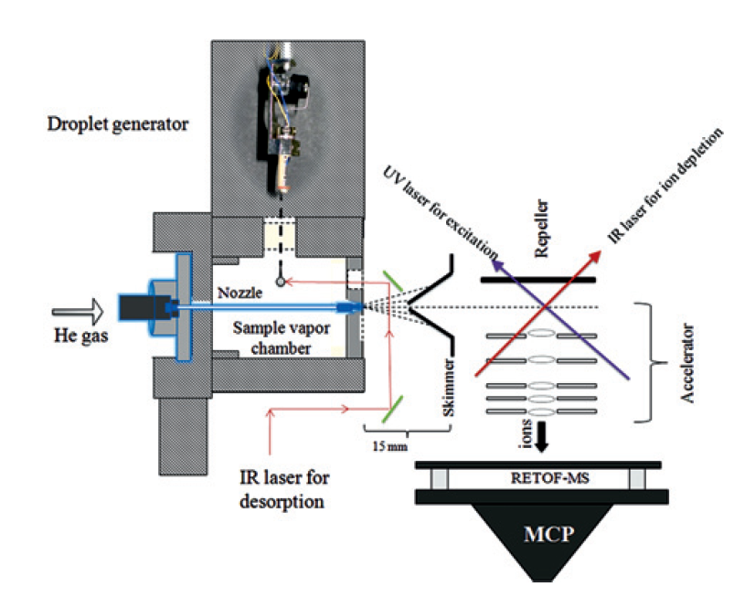
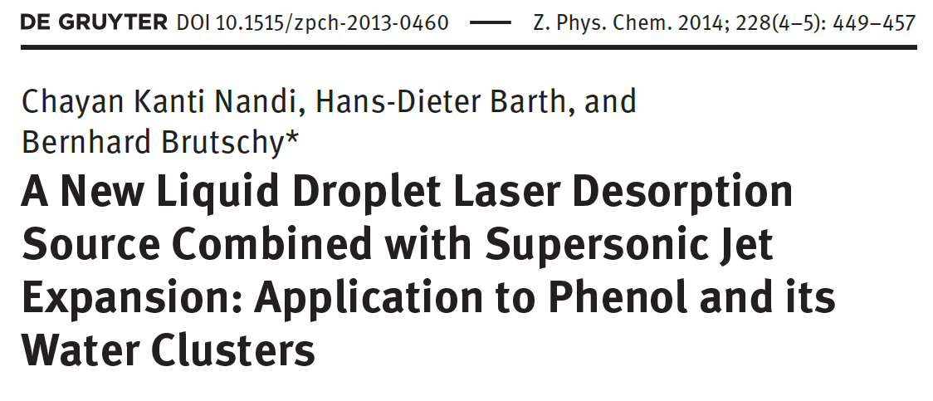
Perspectives

Pulsed droplet beam laser desorption COUPLED TO FT-MW
Coupling to Supersonic Expansion
Me2-1 - Alberto Macario Farto Journées de Spectroscopie Moléculaire Grenoble, 12 mars 2025

Slide 18
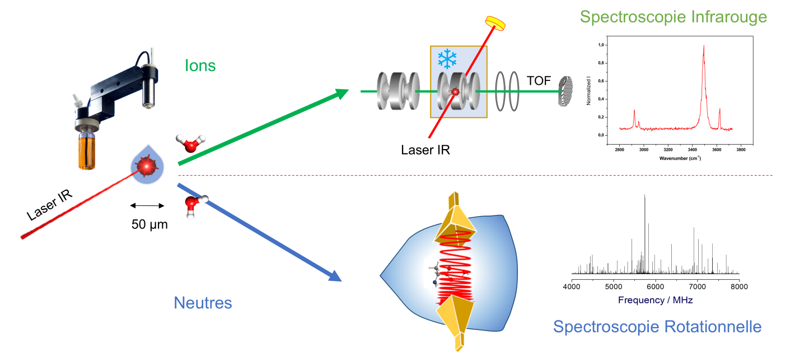
Perspectives

Pulsed droplet beam laser desorption COUPLED TO IRMPD AND FT-MW
Beyond the traditional molecular structure
Droplet as a reactor
Chemical dependence of the structure (pH)
Me2-1 - Alberto Macario Farto Journées de Spectroscopie Moléculaire Grenoble, 12 mars 2025

Slide 19
Laser desorption on water microdroplets for gas phase characterization of biomolecules and its water aggregates
Alberto Macario, Ayoub Badri, Manal Al Sahmarani, Charles Desfrançois, Frédéric Lecomte, Bruno Manil, Nicolas Nieuwjaer
Laboratoire de Physique des Lasers (LPL) – UMR 7538 du CNRS, Université Sorbonne Paris Nord, Villetaneuse, France
alberto.macariofarto@sorbonne-paris-nord.fr
Me2-1 - Alberto Macario Farto Journées de Spectroscopie Moléculaire Grenoble, 12 mars 2025

