Slide 1

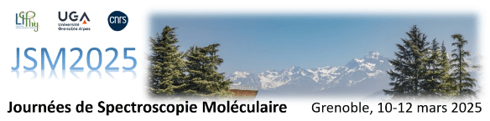
Trajectoire
Rovibrational Spectroscopy in the Gas Phase for Planetary Atmospheres, the Interstellar Medium, and Defense Applications
M. Goubet et al.

Slide 2





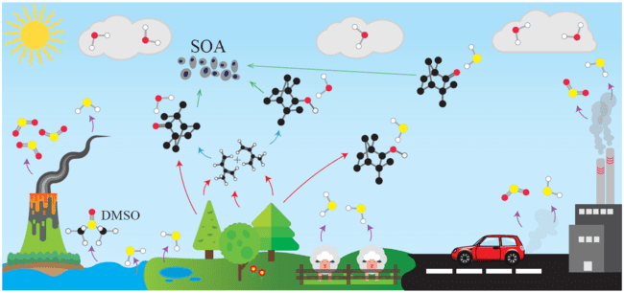

Research Objectives
Mechanisms Driving the Formation and Aging of Aerosols in the Atmosphere
Advance the understanding of our origins, from planet formation to the origin of life
Gas Phase Detection of Explosives and Their Taggants
identify and quantify explosive substances in various realistic environments (checkpoints, etc.)
Develop a high resolution spectrometer to detect species at traces level
Propose an automated spectral taxonomy method for the analysis of dense spectra
Create a database
Structure and Reactivity of Volatile Organic Compounds (VOCs)
Micro-Solvation of Secondary Organic Aerosol Precursors
Hygroscopic Properties of Secondary Organic Aerosols (SOAs)
Structure and Reactivity of Criegee Intermediates
Provide laboratory data:
to identify species in the interstellar medium
to contribute to the astrochemistry models trying to understand the physico-chemical processes occurring in space.
High resolution and high sensitivity rotational spectroscopy in the cm- and (sub)mm-wave ranges (2-1500 GHz)
High level quantum chemistry calculations

Slide 3
Laboratory Method
Electronic structure optimisation with quantum chemistry calculation
Classical molecular dynamics = fast and exhaustive exploration of the conformational landscape
Low level QCC = fast selection of (energetically) realistic structures
High level QCC = most accurate estimation of the molecular parameters
Prediction of the spectrum
Semi-rigid rotor Watson-type Hamiltonian often sufficient at first stage
Efficient academic software exist: Pickett’s suite, JB95, AABS, Pgopher, LLWP, etc.
Specific model (or collaboration) if required
Spectroscopic measurement of the spectrum
(Most intense transitions involving lowest energy levels at first)
Back to QCC if required
(LAM, ES, etc.)
Loop until instrumental accuracy is reached
Correction of the prediction from the simulation of so far observed signals
Coherent set of experimental and theoretical molecular parameters
(structural, electrical, energetic, dynamic, etc.)

Slide 4
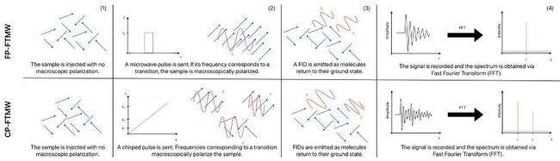
FTMW (cmW) experiments
Emission spectroscopy (dark background): high sensitivity α ≈ 10⁻⁸ cm⁻¹
Adiabatically relaxed sample (jet-cooled @ few K): intense low energy levels transitions
Very low frequency transitions (< 30 GHz) @ very low temp: high resolution (Doppler width < 10 kHz)
Low energy levels only: limited number of accessible molecular parameters

Slide 5
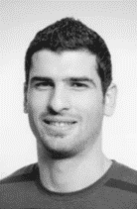


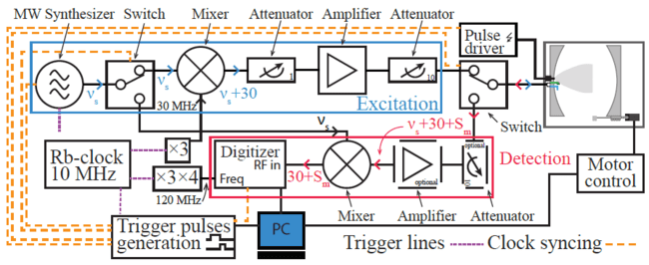
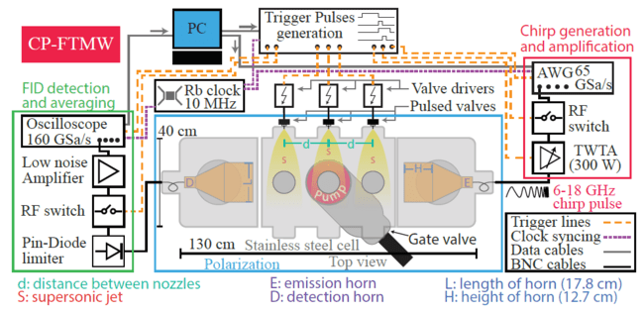
FTMW (cmW) experiments
Elias Neeman
Noureddin Osseiran
Simon Collignon
Balle & Flygare, Rev. Sci. Instrum. 52, 33 (1981)
Brown et al., Rev. Sci. Instrum. 79, 053103 (2008)
“Standard” RF components; sub-mW power; L-shape antenna
Non linear cavity response: line position only
Ultra high instrumental accuracy (kHz): hyperfin effects
Efficient polarization: low dipole moment systems observable
Very slow step-by-step scanning (several hrs / GHz)
100s W ampli; high GSa/s & High P components; large horn antenna
Reliable relative intensities over full range
Resolution limited to few tens of kHz
Power dependent polarization (μ > 0,5 D @ 300 W)
Full range in less than 1 hr
Complementary techniques to use together, independently (here) or 2-in-1 (LISA’s PARIS or McCarthy’s group)

Slide 6
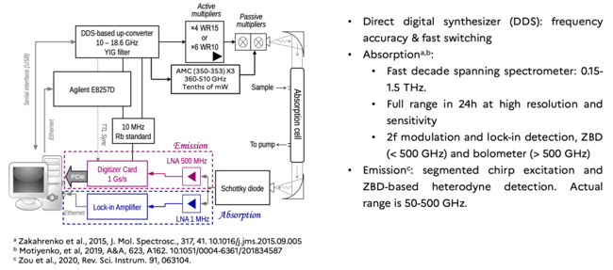

(sub)mmW experiments: the THz gap!
Luyao Zou
Broadband technique with (often) sufficient sensitivity for spectroscopy
Optical alternatives exist (molecular laser, photomixing, frequency comb, FEL / synchrotron) but (often) limited bandwidth and/or instrumentally heavy

Slide 7
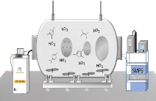
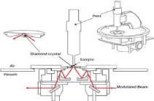
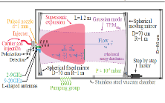
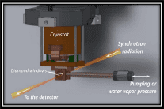



From SOAPs microsolvation to SOAs hygroscopicity
Mechanisms Driving the Formation and Aging of Aerosols in the Atmosphere
How can we relate clustering and micro-solvation (molecular level) to hygroscopicity and aging of aerosols (macroscopic scale)?
Aerosols: SOAs formation from VOCs oxydation in atmospheric simulation chamber (identification of SOAPs, collection on filters).
Gas phase: calculations and pure rotational spectroscopy of SOAPs and their hydrates.
Hygroscopicity: FTIR spectra of SOAs under different humidity conditions.
SOA formation in simulation chamber
SOA composition from ATR-FTIR
Microsolvation of precursors from FTMW
SOA hygroscopicity from FTIR

Slide 8
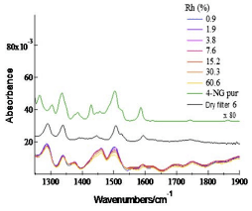
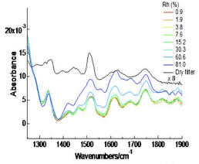
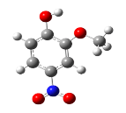
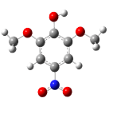
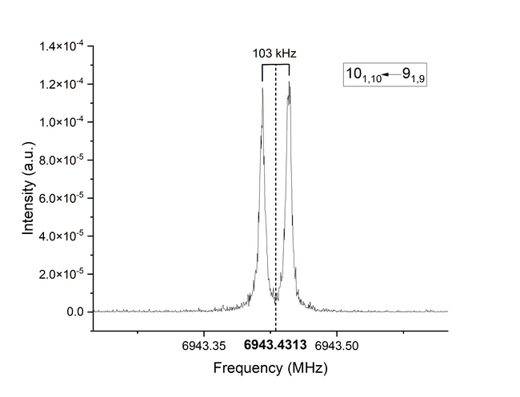
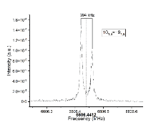
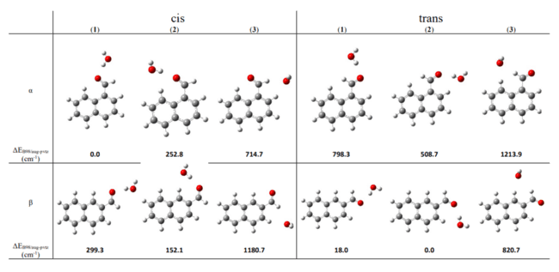
From SOAPs microsolvation to SOAs hygroscopicity
Hygroscopicity of nitromethoxyphenols SOA
4-nitroguaiacol
4-nitrosyringol
No response = Hydrophobic
Response = Hydropilic
Ahmad et al., Appl. Opt. 56, 11 (2017)
Microsolvation of naphthaldehyde isomers
α-naphthal:
only 1 site; ΔG = -24,1 kJ/mol
β-naphthal:
2 sites; ΔG = -25,7 kJ/mol
β- more hydrophilic than α-
Claus et al., PCCP, 25, 23667 (2023)

Slide 9

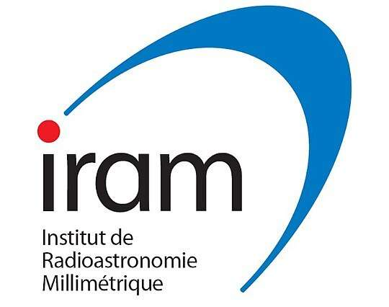


Laboratory astrophysics
Advance the understanding of our origins, from planet formation to the origin of life
Provide laboratory data:
to identify species in the interstellar medium, particularly isotopic (“weeds”) and unstable species (radicals, “exotic” isomers)
to contribute to the astrochemistry models trying to understand the physico-chemical processes occurring in space.
Frequency / GHz
cm- & (sub)mm-wave spectrometers (2 – 1500 GHz)
ALMA (31 - 950 GHz)
NOEMA (70 - 280 GHz)
GBT
(0.1 - 116 GHz)
YEBES
(5 - 90 GHz)
More than 60 new molecules detected
in the last 3 years! Most of them at
cm and mm wavelengths.

Slide 10
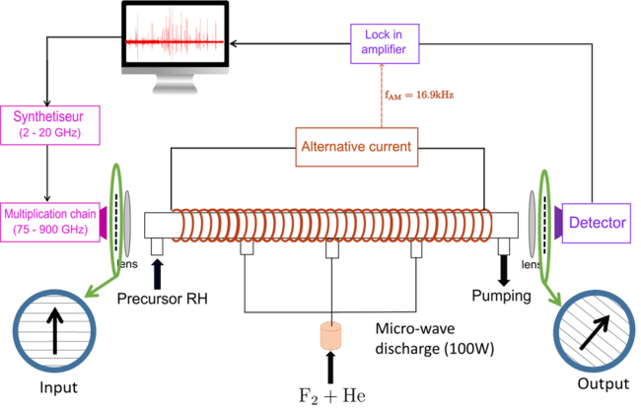


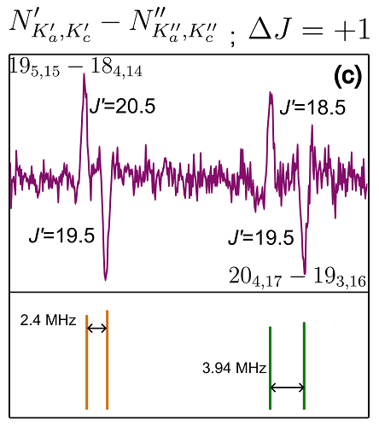

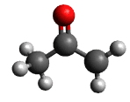

Laboratory astrophysics
Radical species from Faraday Rotation modulation spectroscopy
Specific method of:
Production: halogen ablation
Detection: Zeeman modulation & Faraday rotation
Olivia
Chitarra
Rosemonde
Chahbazian
Luan
Juppet

Slide 11
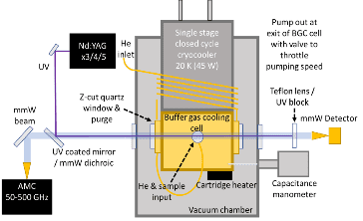
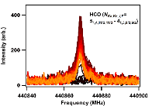
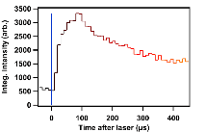
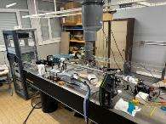


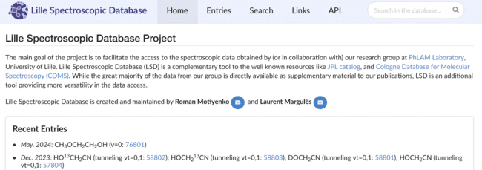
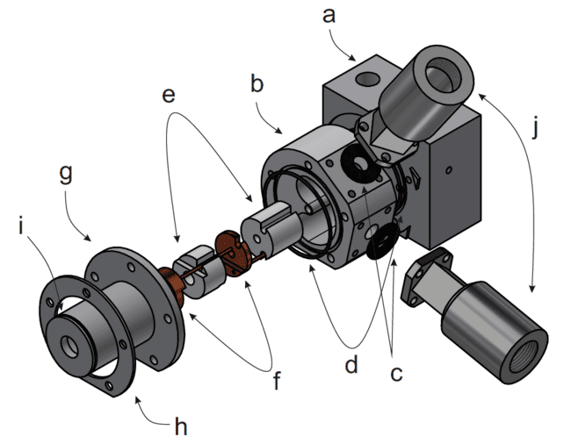
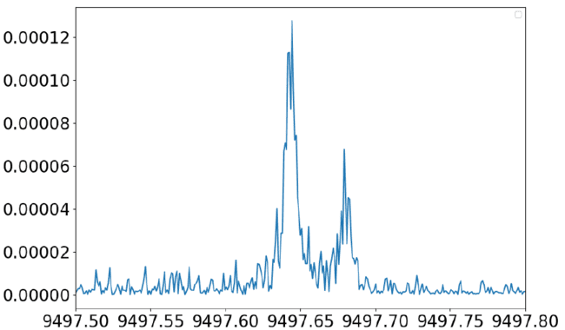

Laboratory astrophysics
Radical species + kinetics
Ning Chen
Brian Hays
HT discharge (1kV – 50 mA) on toluene
C₄H
Frequency / MHz
Jordan Claus

Slide 12
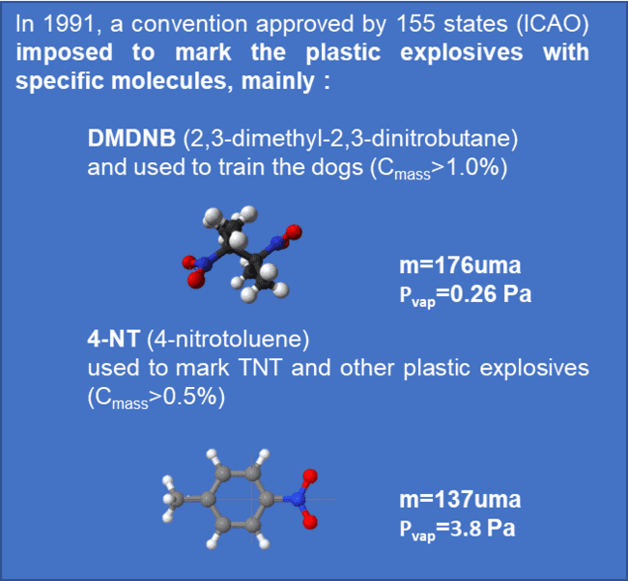
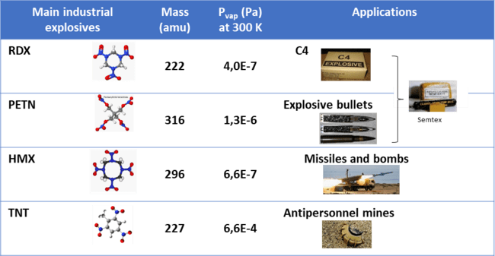
Defense applications
Gas Phase Detection of Explosives and Their Taggants
Room temperature rotational spectroscopy of such molecules at trace level requires very sensitive instruments.
identify and quantify explosive substances in various realistic environments (checkpoints, etc.)
Develop a high resolution spectrometer to detect species at traces level in the mmW range
Create a database
Detect taggants in a realistic sample
Industrial explosives are solid compounds with a very low vapor pressure at room temperature and their detection requires highly selective and non invasive methods.
For gas phase detection, the explosive taggants which are intentionally added to explosives or found as impurities due to the manufacturing process can be studied.

Slide 13
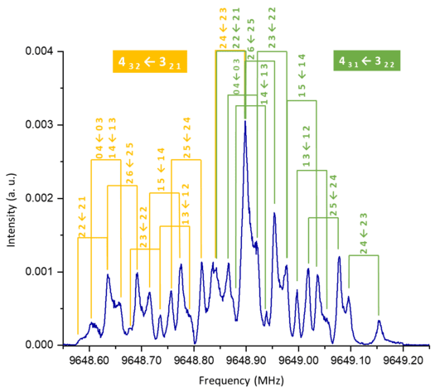

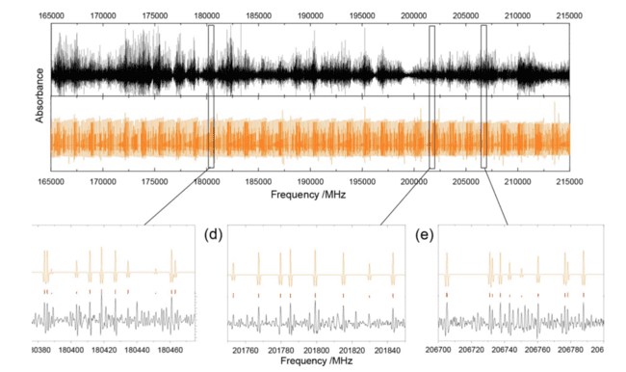
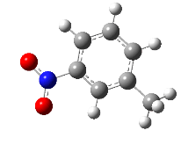
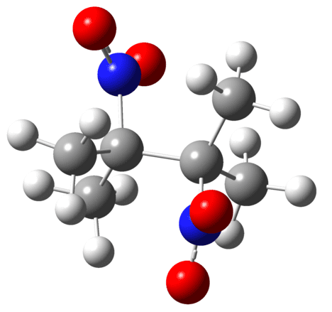
Defense applications
HR spectroscopy on very dense spectra
DNDMB
3-NT
No CH₃ internal rotation observed, but 2 ¹⁴N = many blended lines
Example: 2 transitions x 9 HFS lines x 2 Doppler components = 36 signals in less than 1 MHz!
Very low CH₃ barrier (V₃ = 6.7 cm⁻¹) + ¹⁴N HFS; 2082 lines fitted using BELGI-Cs-hyperfine

Slide 14

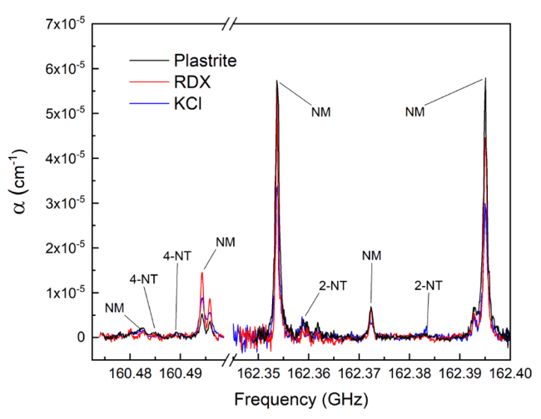
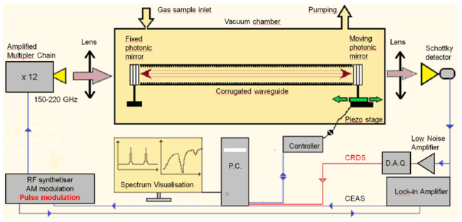
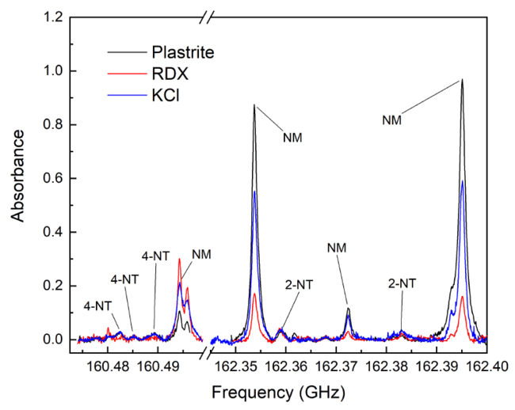
Defense applications
Cavity mmW (150-220 GHz) spectrometer
CRDS
CEAS
Source: stabilized (GPS) amplified multiplied chain, pulsed (CRDS) or modulated AM/FM (CEAS).
Cavity: photonic mirrors (stack of HR silicon wafers) + low loss corrugated waveguide.
Cavity length control: one moving mirror on a piezo linear stage (nm resolution).
Cavity tuning: calculated required displacement and periodic control of the mode position.
FSR = 317 MHz; Δν (150 GHz) = 81.8 kHz; F = 3875; Q = 1.9M; L_{eq} = 1.15 km

Slide 15
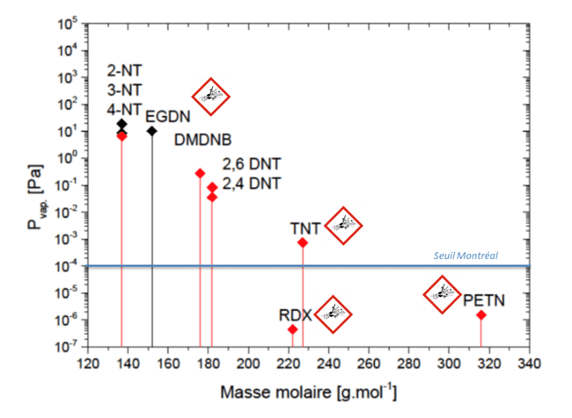




Defense applications
Observed & analysed in cmW & mmW
A. Roucou et al., ChemPhysChem, 2020, 21, 2487
A. Roucou et al., ChemPhysChem, 2018, 19, 1056
Detected in explosive matrices
M. Chrayteh et al., Sensors & Actuators B, in press
Observed in cmW only (so far)
M. Goubet et al., in prep.
Observed in cmW only
M. Chrayteh et al., PCCP, 2023, 25, 16307
Anthony Roucou
Mhamad Chrayteh
Fabien Simon
Alexandre Deguine

Slide 16
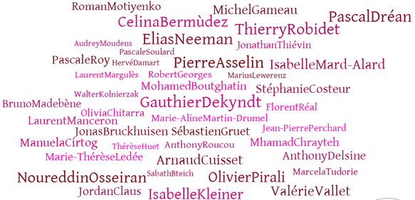






Summary / Acknowledgments
High resolution rovibrational spectroscopy is a powerful tool to unravel physico-chemical properties of systems relevant to environmental sciences, astrophysics/astrochemistry and defense applications
Even more when associated to quantum chemistry calculations, simulation chamber, mass spectrometry, MNR, FTIR techniques, observatories, etc.

Slide 17
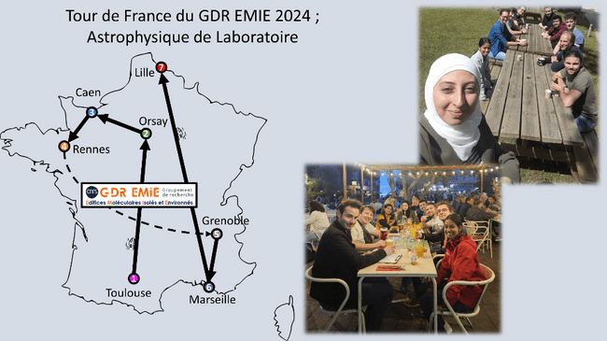
TdF 2025

Slide 18
TdF EMIE 2025
The EMIE Tour de France 2025 is a highly specialized “hands-on” training course in the various experimental and theoretical methods of molecular physics and laboratory chemistry-physics for the study of systems of atmospheric interest. The aim is to enable young researchers to meet scientists from all over France working in this field. At a national level, the EMIE GDR has a wealth of instrumental and theoretical resources, making it particularly appropriate to offer training in these tools. Around ten PhD students will be selected on application to visit specialist teams. Ten days will be devoted to laboratory visits and training over two weeks during which the PhD students will carry out experimental and theoretical practical work to improve their skills in atmospheric chemistry and physics.
 | Lundi 2 juin | Mardi 3 juin | Mercredi 4 juin | Jeudi 5 juin | Vendredi 6 juin
Etape | Lyon IRCELYON LOA |  | Reims | Lille | Dunkerque
Unités |  |  | GSMA | LOA PC2A | LPCA
 | Lundi 30 juin | Mardi 1 juillet | Mercredi 2 juillet | Jeudi 3 juillet | Vendredi 4 juillet
Etape | Créteil | Paris | Orléans ICARE LPC2E |  | Bordeaux
Unités | LISA | MONARIS LMD |  |  | ISM EPOC
To apply: Before April 04, 2025, send an application including a brief CV and a ½ page description of your thesis topic to:
Ha Tran (htran@lmd.ipsl.fr) and Sophie Sobanska (sophie.sobanska@u-bordeaux.fr)

Slide 19
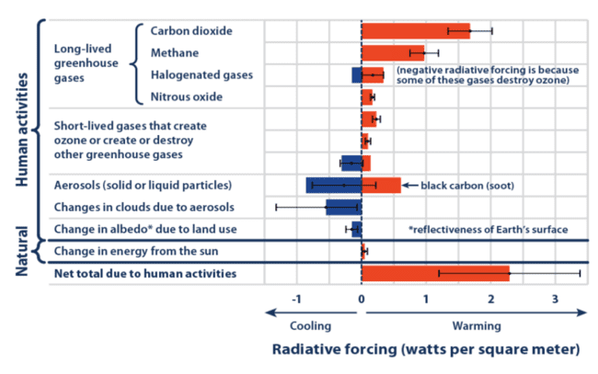

Slide 20
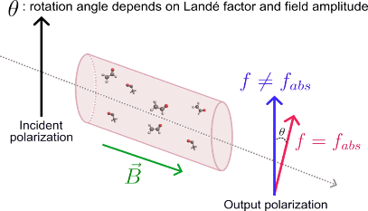
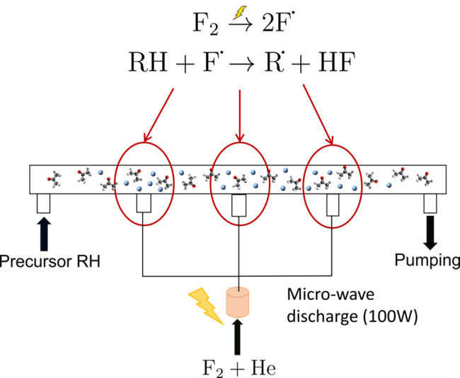
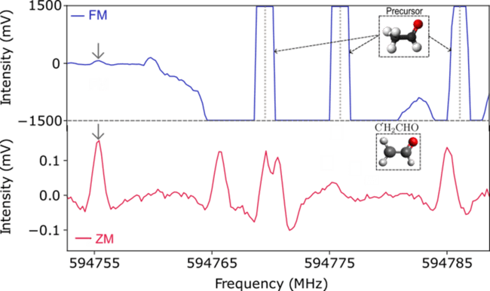

Slide 21
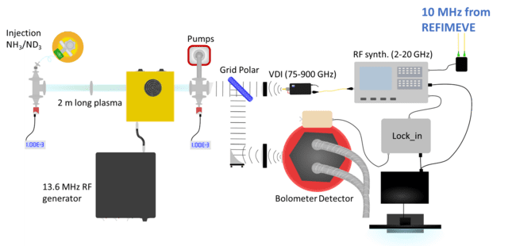
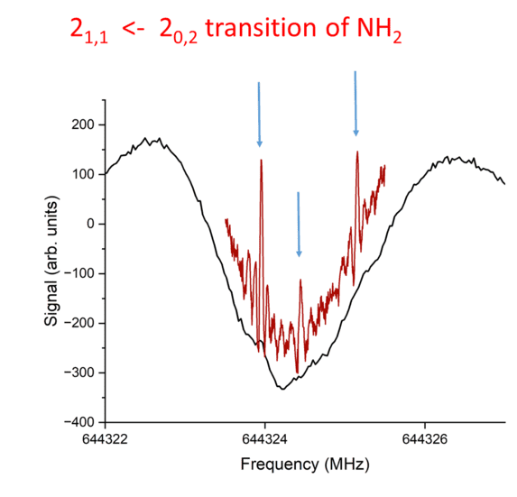
  Saturated absorption spectroscopy of NH₂ radical

