Slide 1












Molecular spectroscopy at the 10 Hz accuracy level: HCOOH as a testbed and hydrogen molecular ions for fundamental constant determination.
9.2 µm 1095 cm⁻¹
Laurent Hilico, Maxime Leuliet, Bérengère Argence
Jean-Philippe Karr, Hugo Nogueira Demattos, Maen Salman
Journées de spectroscopie moléculaire, Grenoble, 10-12 mars 2025

Slide 2
Outline
Contexte
Experimental methods for H₂⁺ or HD⁺
SI-referenced laser frequencies
HCOOH spectroscopy

Slide 3

Context
Fundamental constant adjustment
New physics beyond the standard model
CODATA
https://pml.nist.gov/cuu/Constants/
Precision measurements
Fundamental constants
YES
Least square adjustment
Limits on BSM
Agreement ?
NO
Evidence for BSM
Accurate theories
(standard model)

Slide 4
Context in AMO physics
low energy physics
Precisely calculable atomic
and molecular systems
2 body : H, D, T
3 body : H₂⁺, HD⁺, HT⁺, D₂⁺, DT⁺, T₂⁺
4 body : H₂, HD, HT, D₂, DT, T₂
Transitions frequencies
α = 1/137.035 999 177 m⁻¹ input data
Schrödinger + relativistic corrections
Dirac
+ QED corrections
Nuclear finite size correction
(proton or deuteron charge radius)
Rydberg constant R∞
Nucleus/electron mass ratio
Nucleus radii
3 mass ratios + 3 charge radius + Rydberg = 7 fundamental constants
At least 7 independant measurements

Slide 5
2022 CODATA
Penning traps
Cyclotron frequency ratios
Cyclotron to Larmor frequency ratio
HD⁺ rovibrational spectroscopy
Hydrogen spectroscopy
Muonic hydrogen

Slide 6
year
m_{p}/m_{e} inaccuracy
CODATA
inaccuracy
CODATA
Penning trap measurement
HD⁺ spectroscopy

Slide 7
Present theoretical accuracies
Theoretical accuracy
2 body
  Hydrogen H, µp, positronium, muonium, He⁺
3 body
  Hydrogen molecular ions H₂⁺, HD⁺, D₂⁺ and pHe
  Helium
4 body
  Hydrogen molecules H₂, HD, …
5 10⁻¹³
7.6 10⁻¹²
V.I. Korobov, L. Hilico, J.-Ph. Karr Phys. Rev. Lett. 118, 233001
≈ 10⁻⁹
Two electron systems
≈ 10⁻⁹
How to reach such an accuracy ?

Slide 8
Contexte
Experimental methods for H₂⁺ or HD⁺
SI-referenced laser frequencies
HCOOH spectroscopy

Slide 9
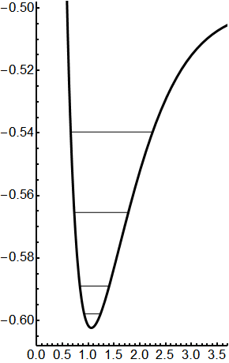
Experimental methods for H₂⁺ or HD⁺
REMPD spectroscopy
Resonance Enhanced Multiphoton Dissociation spectroscopy
3- dissociation
1sσ
on sympathetically cooled
state selected hydrogen molecular ions
2- excitation
1- preparation
SI-referenced laser frequency control
Internuclear distance [Å]
Frequency comb
1.565µm

Slide 10
Experimental methods for H₂⁺ or HD⁺
Hydrogen molecular ion spectroscopy
1sσ
Rotational structure B L(L+1), 2B ~ 1.4 THz for HD⁺
Vibrational quanta 65 THz for H₂⁺
2000 cm⁻¹
Hyperfine structure
Internuclear distance [Å]
H₂⁺
no dipole allowed transitions : month lived states
Doppler free two-photon vibrational transitions
v → v+1 (Paris)
Quadrupole transitions
Raman transitions
HD⁺
dipole allowed vibrational transitions, 10’/s decay rate ms
Rotational transitions
Overtones v → v+p
Doppler free two-photon transitions
Quadrupolar
Düsseldorf
Düsseldorf
Amsterdam + Paris (th)

Slide 11
Experimental methods for H₂⁺ or HD⁺
H₂⁺ spectroscopy
½ ½ ½
total nuclear spin
I=0 (even L) para
total spin
F=1/2
total ang. mom.
L±1/2
p p e⁻
I=1 (odd L) ortho
F=1/2, 3/2
L ±1/2 ±3/2
Odd L
Even L
GHz
v=1,L=3
v’=1,L’=2
98.9 MHz
3.25 MHz
2 x 9,17 µm
2 x 1095 cm⁻¹
v=0,L=2
105.4 MHz
Laser frequency
v=0,L=3
GHz
well resolved lines

Slide 12

Experimental methods for H₂⁺ or HD⁺
HD⁺ spectroscopy
½ 1 ½
F = S_{e} + I_{p} = 0 1
S = F + I_{d} = 1 0,1,2
J = L+S = L L±1, L±2
HD⁺
p d e⁻
v’,L’
A forest of well resolved lines
v,L
GHz

Slide 13
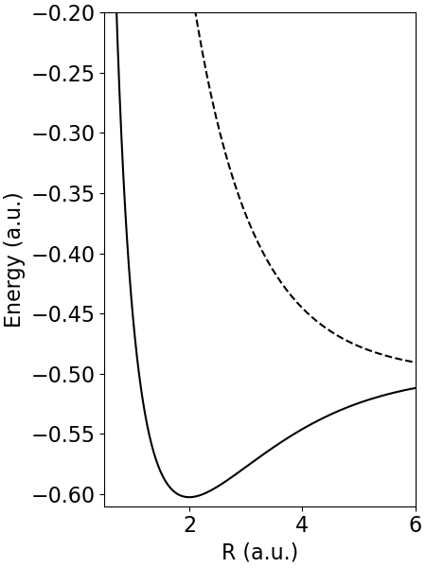
Experimental methods for H₂⁺ or HD⁺
Resonance Enhanced Multiphoton Dissociation spectroscopy
UV v-selective dissociation photon
IR or MIR spectroscopy photon (s)
v’
Spectroscopy signal = ion loss
v=0
Preparation

Slide 14
Experimental achievements in HD⁺
…..
9
CODATA 2022
Amsterdam 1 + 1’ + 1 ’’ REMPD at 1,4 µm + 532 nm
(0,3)→(4,2) →(9,3) quasi degenerate two-photon vibrational transition in HD⁺
Düsseldorf 1 + 1’ + 1’’ REMPD at 228 µm (1,3 THz) + 1,42 µm + 266 nm
(0,0) →(0,1) rotational transition in HD⁺
1 + 1’ REMPD at 5,12 µm + 266 nm
(0,0) →(1,1) vibrational transition in HD⁺
(0,0) →(5,1) vibrational transition in HD⁺
1 + 1’ REMPD at 1,15 µm + 266 nm
Paris 2 + 1’ REMPD at 9,17 µm + 213 nm
(0,2) →(1,2) two-photon vibrational transition in H₂⁺
5
2.9 10⁻¹²
vibration
4
3
Patra et al, Science 369, 1238 (2020)
2
1
?
0
0 1 2 3 …..
Alighanbari et al, Nat. Phys. 14, 555 (2018)
1.3 10⁻¹¹
rotation
Kortunov et al, Nat. Phys. 17, 569 (2021)
1.5 10⁻¹¹
Alighanbari et al, Nat. Phys. (2023)
2.3 10⁻¹²
1sσ
in progress
Internuclear distance [Å]

Slide 15
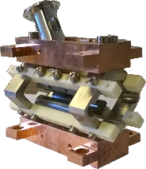
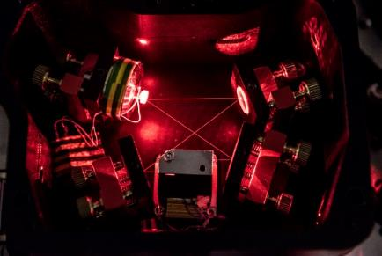
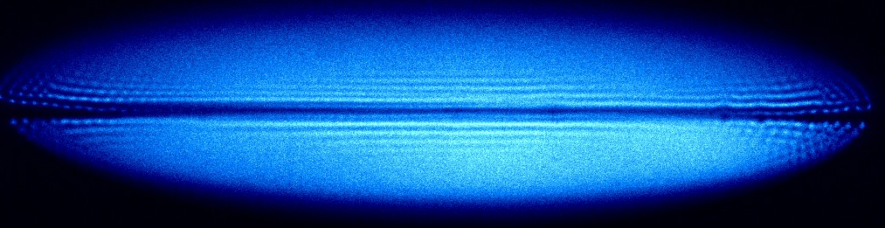
Experimental methods for H₂⁺ or HD⁺
Ion trapping and sympathetic cooling by Be⁺ ions
State selected
H₂⁺
ion source
+
+
=
Sympathetically cooled H₂⁺ ions in a Be⁺ crystal
RF Paul trap
313 nm cooling laser
r
z
R₀ = 3.5 mm
500 V at 13 MHz
Trap depth ≈1 eV
1.2 mm
≈ 100 H₂⁺ ions
T = 1 … 10 mK
Soft axial confinement : v_{z,RMS} ≈ 10 m/s λ = 1.5 µm Doppler effect = 6.6 MHz (3. 10⁻⁸)
<δz²> ≈ 0.1 mm
Strong transverse confinement : <δr²> ≈ 1 .. 2 µm

Slide 16
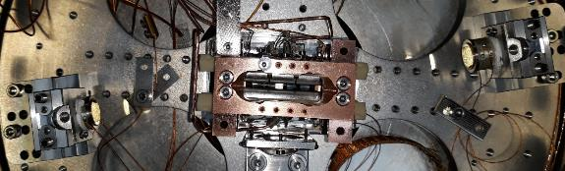

Experimental methods for H₂⁺ or HD⁺
Doppler effect cancellation
H₂⁺ in Paris
Doppler free two-photon spectroscopy
In a Fabry-Perot cavity
9.2 µm
HD⁺ in Amsterdam
Quasi-degenerate Doppler free two-photon spectroscopy (v=0,L=3) → (v=3,L=2) → (v=9,L=3)
Effective Lamb-Dicke regime
$λ_{eff}=\frac{1}{\frac{1}{λ_{1}}−\frac{1}{λ_{2}}}=700 µm≫0.1 mm$
λ₁ = 1442 nm
λ₂ = 1445 nm
2.9 10⁻¹² at 1.44 µm
HD⁺ in Düsseldorf
TICTES : trapped ion cluster transverse excitation spectroscopy
2.3 10⁻¹² at 1.15 µm

Slide 17
Experimental methods for H₂⁺ or HD⁺
Hydrogen molecular ion preparation
HD⁺ in Amsterdam and Düsseldorf
So far : Electron impact ionization + radiative relaxation to v=0, L=0, 1, 2, 3, 4 within ≈ 1 s
BBR and laser reshuffling
H₂⁺ in Paris
No radiative relaxation : electron impact ionization → 1% population over 100 (v,L) levels
State selective preparation : 3 + 1 Resonance enhanced multiphoton ionization REMPI at 303 nm
H₂ (X Σ_{g}⁺, v=0,L=2) + 3 ν_{303 nm} → H₂ (C ¹Π_{u}, v=0,L’)
H₂ (C ¹Π_{u}, v=0,L’) + ν_{303 nm} → H₂⁺ (v=0,L=2) + e⁻
90% expected selectivity

Slide 18
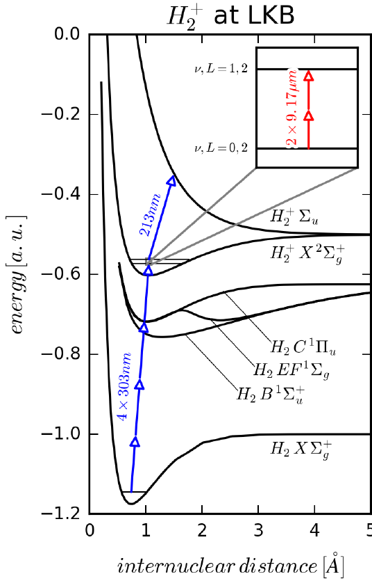
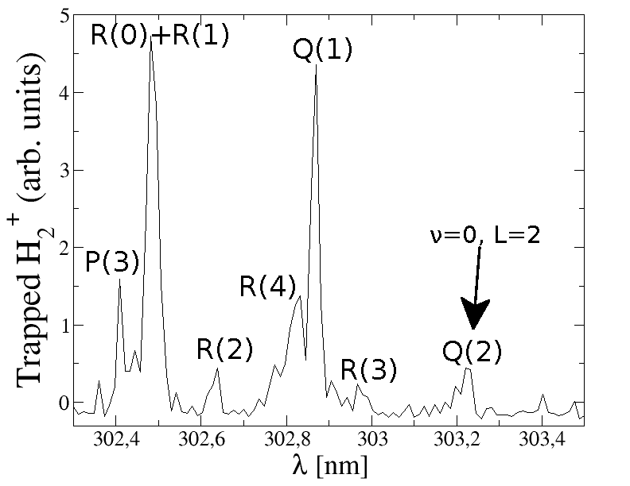
Experimental methods for H₂⁺
1
H₂⁺ preparation
303 nm :
2^{d} harmonic
pulsed dye laser
20 Hz
4 .. 5 mJ
10 ns
w₀ ≈ 10 µm
2.5 GW/mm²
2
3
3
H₂⁺ dissociation at 213 nm
1
v=0, L=0,1 ions, REMPI at 302.47 nm
213 nm :
5th harmonic
Y-NVO₄ pulsed laser
10 kHz
170 mW
v=1, L=0,1 ions
REMPI at 295.61 nm

Slide 19
Contexte
Experimental methods for H₂⁺ or HD⁺
SI-referenced laser frequencies
HCOOH spectroscopy

Slide 20

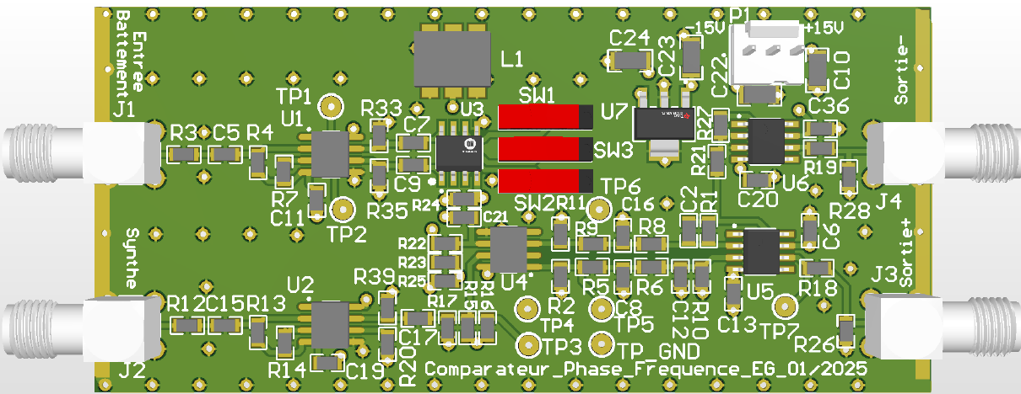
SI-referenced laser frequencies
1051 nm
1549 nm
SFG
626 nm
SHG
313 nm
Be⁺ cooling
REFIMEVE ultrastable signal at 1542 nm
1051 nm
Frequency comb 1560 nm
1900 nm
9.2 µm QCL
H₂⁺ two-photon
spectroscopy
Obs Paris
CO₂ Laser
Laser diode
1620 nm
H₂⁺
Quadrupole transition
(v=0,L=2)→(v=2,L=2)
Synthetizer
÷ 8
Phase/frequency
comparator
Phase lock loop
Laser/comb beatnote

Slide 21
SI-referenced laser frequencies
Frequency comb management strategy
H₂⁺ spectroscopy < 100 kHz
Cooling laser control > 600 MHz
Tuneability requirements
f_{ceo} free comb, comb teeth f_{p} = p _{frep}
Fixed comb repetition rate f_{rep} = 200.000 000 MHz
PLL with offset frequency
Strategy

Slide 22
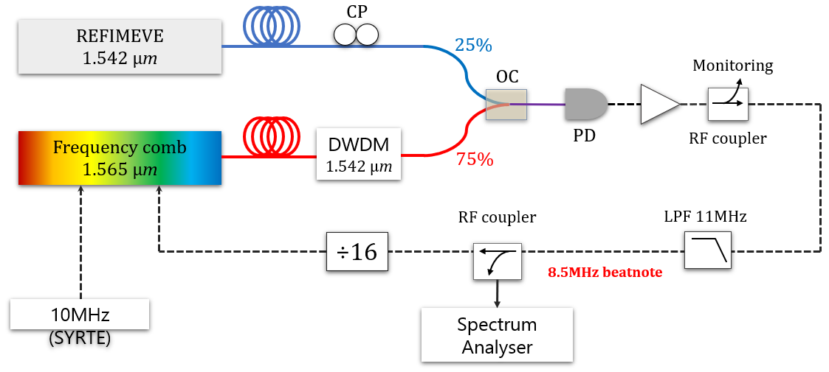
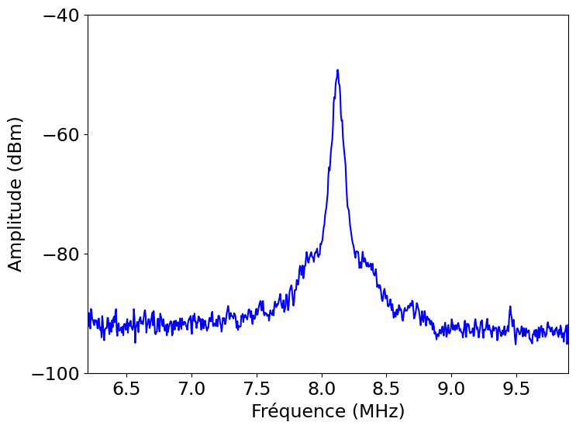
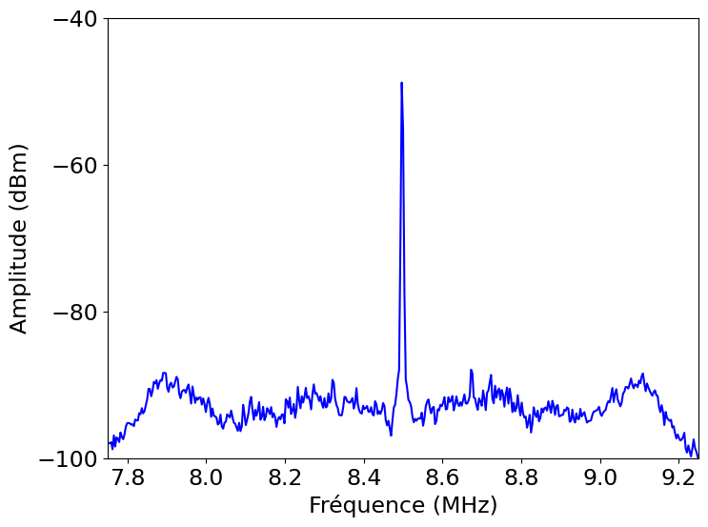
SI-referenced laser frequencies
Optical lock to REFIMEVE ultrastable signal
Optical lock
f_{Refimeve} = 972 000 f_{rep} + 8.5 MHz
f_{beat} = 8.500 000 MHz
f_{rep} = 200.000 000 MHz
Instability < 20 Hz 10⁻¹³ at 1s
2 Hz 10⁻¹⁴ at 1s
DFC 200, Toptica
60 kHz FWHM
Voigt
L 30 kHz
G 30 kHz
Lock bandwidth
580kHz
RF lock
80 x 10 MHz ⬄ 4 x f_{rep}
Local quartz instability
≈ 3.5 10⁻¹³
45 dB in 30 kHz
40 dB in 100 kHz

Slide 23
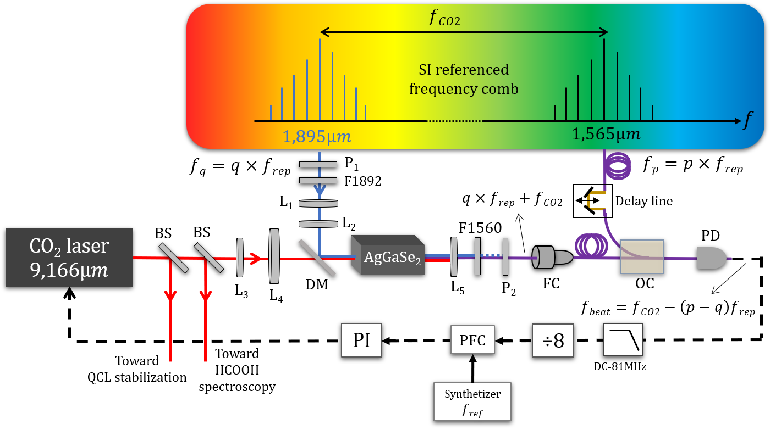







SI-referenced laser frequencies
CO₂ laser frequency lock
$$fbeat=fCO2−\left(q2−q1\right)frep$$
$$q_{2}×frep$$
q₂ - q₁ = 163 541
$$q_{1}×frep$$
Sum frequency comb
SFG in AgGaSe2 1.895 µm + 9.17 µm → 1.560 µm
18 mW 80 mW 600 nW
0.7 mW/W²
$$f$$
$$1.895µm$$
$$1.565µm$$
$${Shifted comb q}_{1}×frep+fCO2$$
LPL-like optical bench
Argence 2015

Slide 24
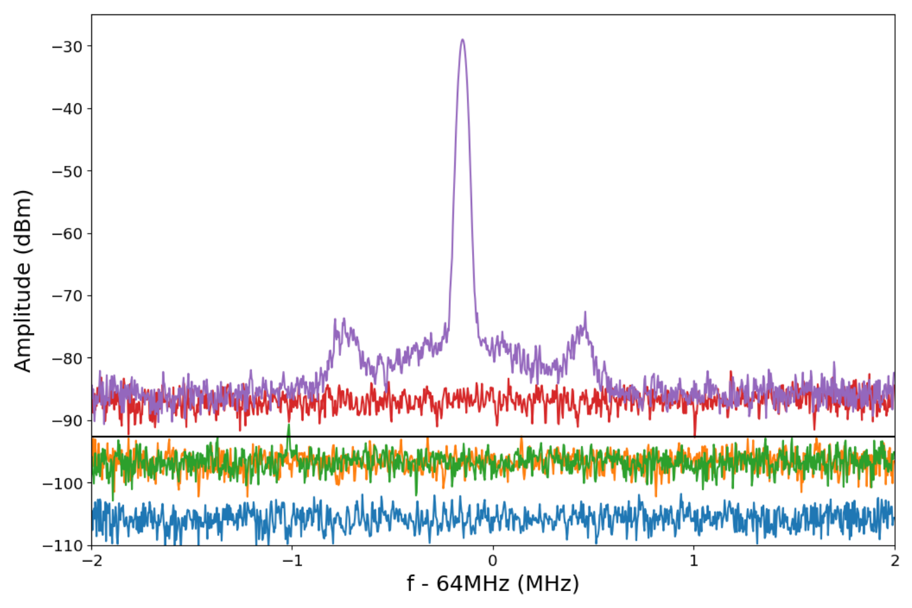
SI-referenced laser frequencies
CO₂ laser frequency lock
Shifted comb/original comb beatnote (RBW = 30 kHz)
Max beat signal 7.2 dB less than ideal theory
58 dB in 30 kHz
53 dB in 100 kHz
Noise 5-6 dB above shot noise
Comb/comb beat note
1560 nm comb noise
≈ 200 µW
≈ 200 nW
Analyzer noise floor

Slide 25
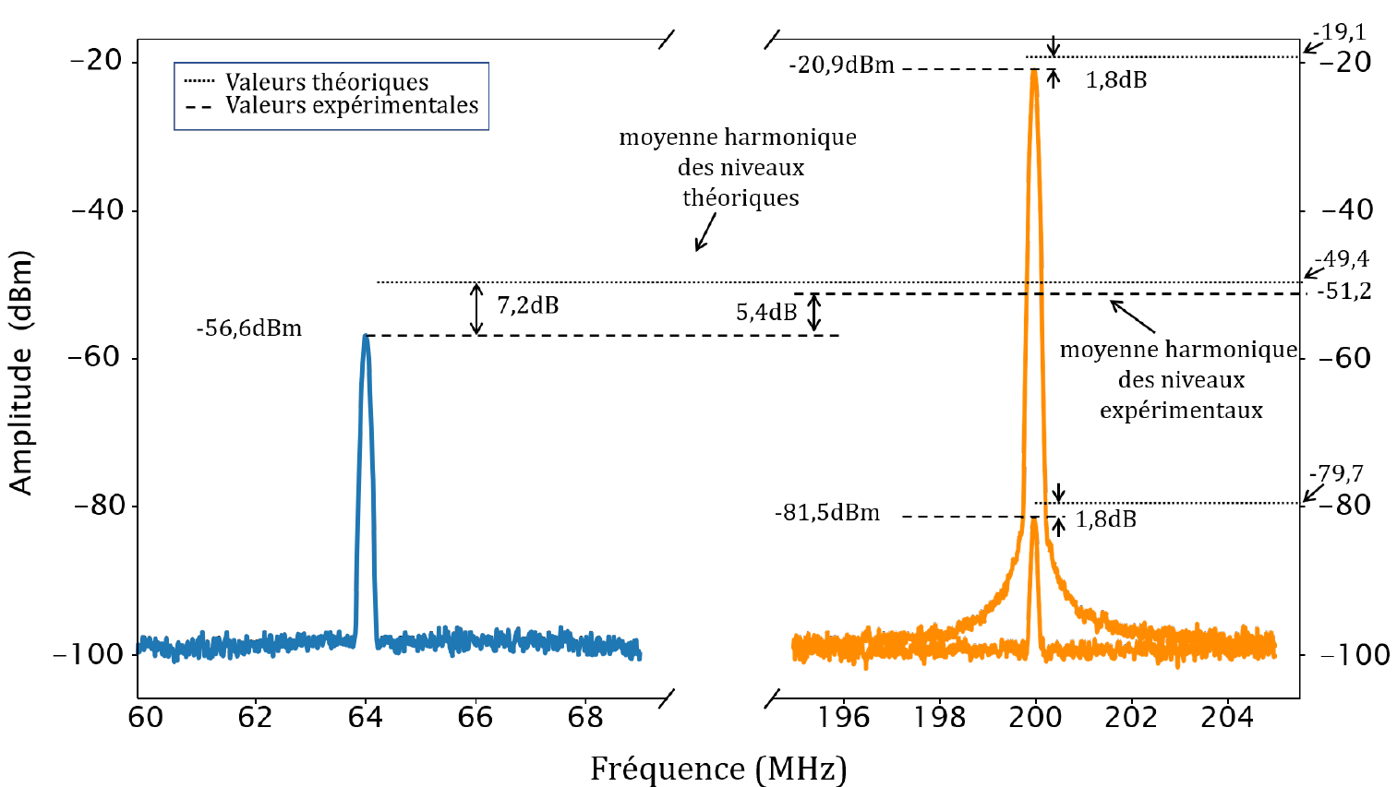
SI-referenced laser frequencies
CO₂ laser frequency lock
Shifted comb/original comb beatnote (RBW = 30 kHz)
Observed comb/comb beat note 7.2 dB only below the ideal model prediction
(5% contrast)
Ideal : 100% coherent comb with square profile, Lorentzian filters ans JJZ conversion efficiency

Slide 26
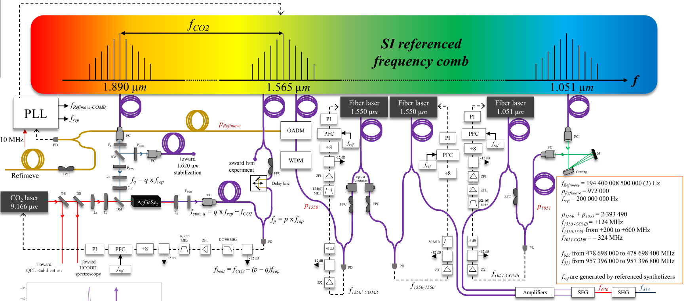
SI-referenced laser frequencies
Adding Be⁺ cooling laser frequency control ….
Maxime Leuliet 2024 exhaustive sketch

Slide 27
SI-referenced laser frequencies
Summary
Optically locked comb with fixed repetition frequency
End of 2024 : 1620 nm and 1064 nm frequency control
7 SI-referenced lasers (H₂⁺ spectroscopy and cooling)
Instability ≈ 10⁻¹³
Tuneability up to 800 MHz at 313 nm without phase jump
24/7

Slide 28
Contexte
Experimental methods for H₂⁺ or HD⁺
SI-referenced laser frequencies
HCOOH spectroscopy

Slide 29
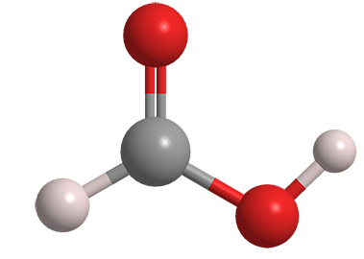
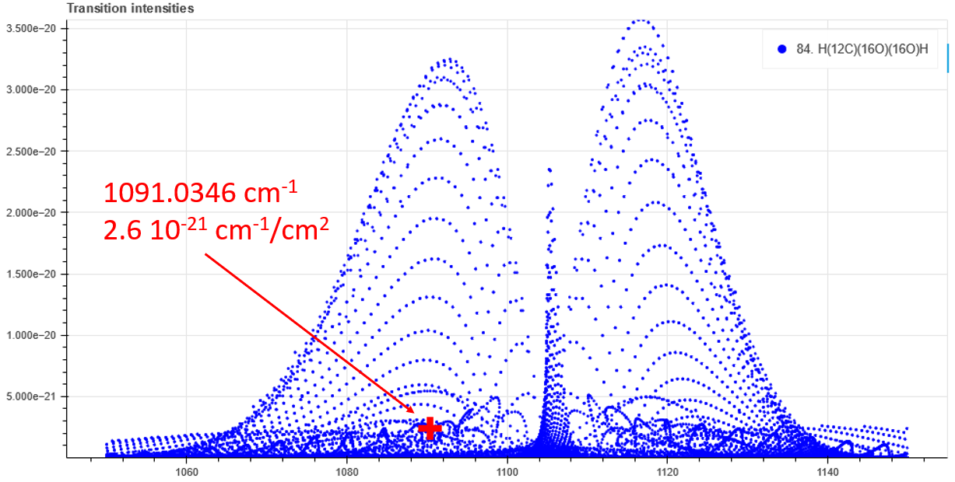
HCOOH spectroscopy
www.hitran.org
Saturated absorption spectroscopy
in Fabry-Perot cavity
ν₆ J’ = 21, K_{a}’ = 2, K_{c}’ = 20 ← J’’ = 21, K_{a}’’ = 3, K_{c}’’ = 19
quasi coincidence with CO₂ 9R(42) line
closest line to H₂⁺ (0,2) → (2,2) line
Goals
Central frequency determination
Pressure self broadening coefficient
N₂ broadening coefficient
Air broadenig coefficient

Slide 30
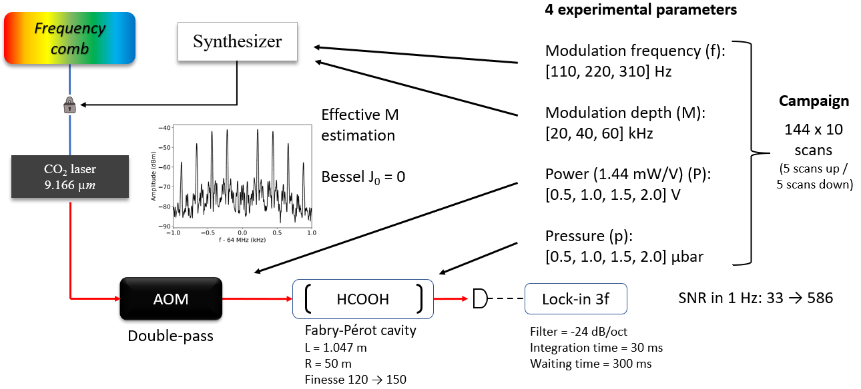
HCOOH spectroscopy
Measurement campaign
-128 MHz

Slide 31
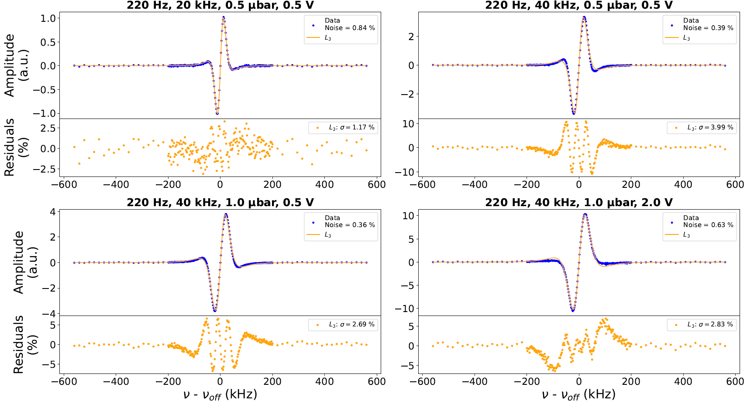


HCOOH spectroscopy
Line shape model issue ….
Central frequencies
&
widths
Lorentzian third derivative
Main problems
Line shape
pressure width
power width
dependances

Slide 32
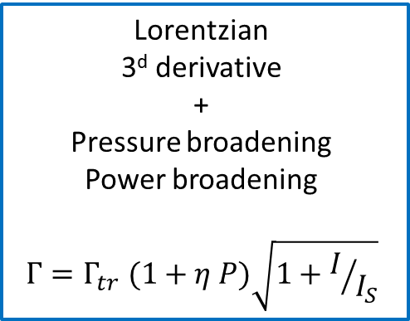

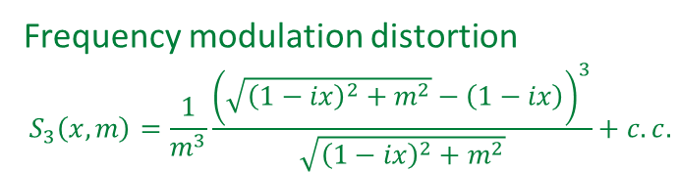
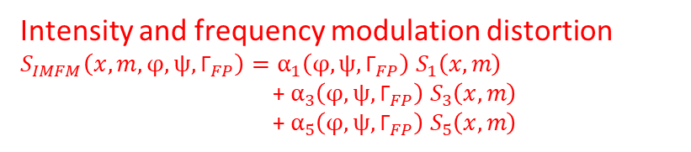
HCOOH spectroscopy
Line shape model issue ….
Frequency modulation distortion
$$S_{3}\left(x, m\right)=\frac{1}{m^{3}}\frac{{\left(\sqrt{{\left(1−ix\right)}^{2}+m^{2}}−\left(1−ix\right)\right)}^{3}}{\sqrt{{\left(1−ix\right)}^{2}+m^{2}}}+c.c.$$
Line shape
model
R. Arndt, Journal of Applied Physics, 36(8), 2522-2524 (1965)
Lorentzian
3^{d} derivative
+
Pressure broadening
Power broadening
$$Γ=Γ_{tr} (1+η P)\sqrt{1+I/{I_{S}}}$$
Intensity and frequency modulation distortion
$S_{IMFM}\left(x, m, φ, ψ,{\text{Γ}}_{FP}\right)=α_{1}\left(φ, ψ,{\text{Γ}}_{FP}\right) S_{1}\left(x, m\right)$
+ $α_{3}\left(φ, ψ,{\text{Γ}}_{FP}\right) S_{3}\left(x, m\right)$
+ $α_{5}\left(φ, ψ,{\text{Γ}}_{FP}\right){ S}_{5}\left(x, m\right)$
+
=
Adapted from S. Schilt, et al., Applied optics, 42(33), 6728-6738 (2003)
Global fitting
of the 1440 lines
$$Γ_{tr}$$
η

Slide 33
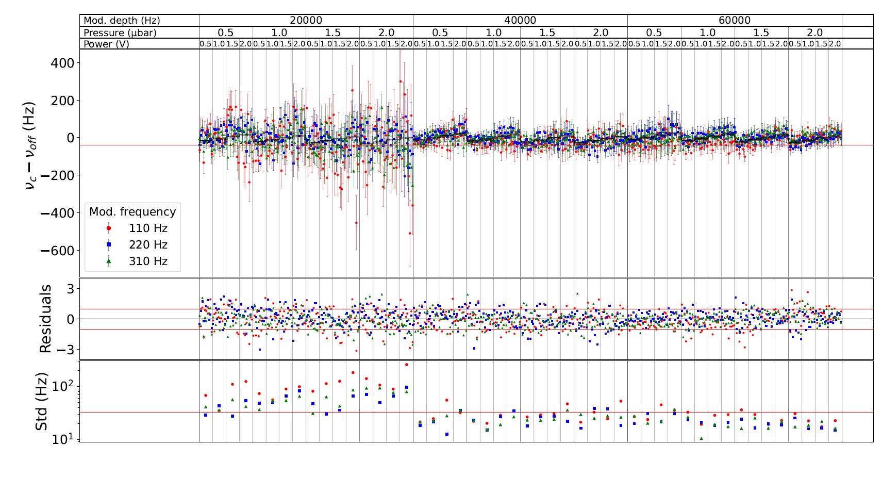


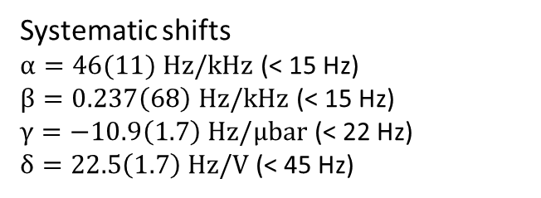
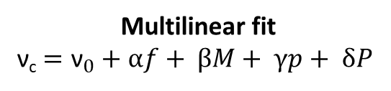
HCOOH spectroscopy
Central frequencies
Multilinear fit
ν_{c} $={\text{ν}}_{0}+αf+ βM+ γp+ δP$
$${\text{ν}}_{0}=32 708 391 980 785.1 \left(4.5\right) Hz$$
stat. rel. uncertainty = 1.4 10⁻¹³
Systematic shifts
$α=46(11) Hz/kHz$ (< 15 Hz)
$β=0.237\left(68\right) Hz/kHz$ (< 15 Hz)
$γ=−10.9\left(1.7\right) Hz/µbar$ (< 22 Hz)
$δ=22.5\left(1.7\right) Hz/V$ (< 45 Hz)
10⁻¹² x ${\text{ν}}_{0}$ = 32.7 Hz

Slide 34
HCOOH spectroscopy
Line shape model issue ….
Frequency modulation distortion
$$S_{3}\left(x, m\right)=\frac{1}{m^{3}}\frac{{\left(\sqrt{{\left(1−ix\right)}^{2}+m^{2}}−\left(1−ix\right)\right)}^{3}}{\sqrt{{\left(1−ix\right)}^{2}+m^{2}}}+c.c.$$
Line shape
model
R. Arndt, Journal of Applied Physics, 36(8), 2522-2524 (1965)
Lorentzian
3^{d} derivative
+
Pressure broadening
Power broadening
$$Γ=Γ_{tr} (1+η P)\sqrt{1+I/{I_{S}}}$$
Intensity and frequency modulation distortion
$S_{IMFM}\left(x, m, φ, ψ,{\text{Γ}}_{FP}\right)=α_{1}\left(φ, ψ,{\text{Γ}}_{FP}\right) S_{1}\left(x, m\right)$
+ $α_{3}\left(φ, ψ,{\text{Γ}}_{FP}\right) S_{3}\left(x, m\right)$
+ $α_{5}\left(φ, ψ,{\text{Γ}}_{FP}\right){ S}_{5}\left(x, m\right)$
+
=
Adapted from S. Schilt, et al., Applied optics, 42(33), 6728-6738 (2003)
Global fitting
of the 1440 lines
Hyperfine structure (unresolved), F = J ± 1
Zeeman structure m_{F} = -22 ..22
$$Γ_{tr}$$
η
|<Fm_{F}10|Fm_{F}>|² ≈ m_{F}² ≈ 1 .. 484

Slide 35
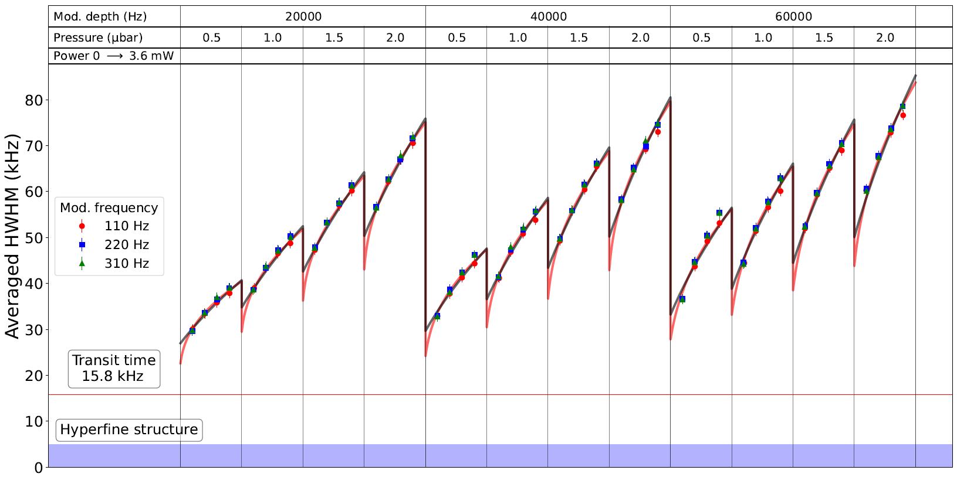
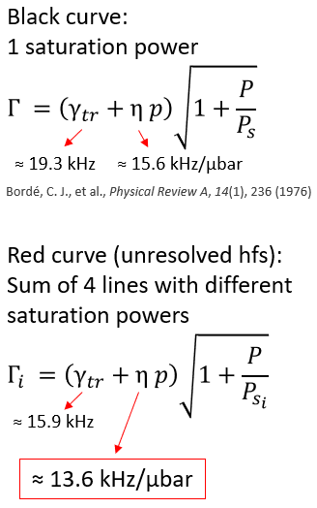
HCOOH spectroscopy
Width analysis and pressure broadening coefficient

Slide 36
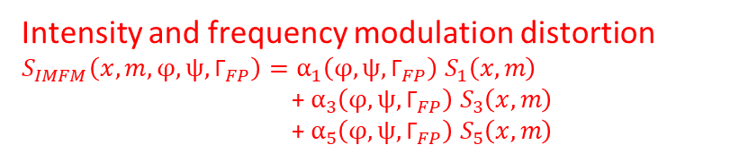

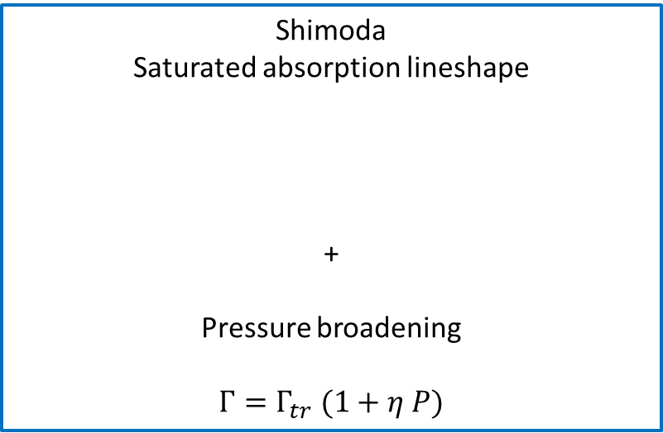
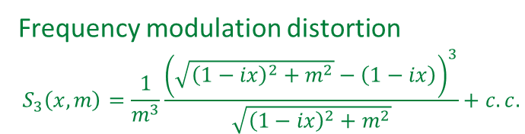
HCOOH spectroscopy
δ: normalized detuning
G: saturation parameter
Line shape model issue ….
Frequency modulation distortion
$$S_{3}\left(x, m\right)=\frac{1}{m^{3}}\frac{{\left(\sqrt{{\left(1−ix\right)}^{2}+m^{2}}−\left(1−ix\right)\right)}^{3}}{\sqrt{{\left(1−ix\right)}^{2}+m^{2}}}+c.c.$$
Shimoda
Saturated absorption lineshape
+
Pressure broadening
$$Γ=Γ_{tr} (1+η P)$$
R. Arndt, Journal of Applied Physics, 36(8), 2522-2524 (1965)
+
=
Intensity and frequency modulation distortion
$S_{IMFM}\left(x, m, φ, ψ,{\text{Γ}}_{FP}\right)=α_{1}\left(φ, ψ,{\text{Γ}}_{FP}\right) S_{1}\left(x, m\right)$
+ $α_{3}\left(φ, ψ,{\text{Γ}}_{FP}\right) S_{3}\left(x, m\right)$
+ $α_{5}\left(φ, ψ,{\text{Γ}}_{FP}\right){ S}_{5}\left(x, m\right)$
Line shape
model
Adapted from S. Schilt, et al., Applied optics, 42(33), 6728-6738 (2003)
Hyperfine structure (unresolved), F = J ± 1
Zeeman structure m_{F} = -22 ..22
Global fitting
of the 1440 lines
$$Γ_{tr}$$
η
|<Fm_{F}10|Fm_{F}>|² ≈ m_{F}² ≈ 1 ... 484
on the way
works better

Slide 37
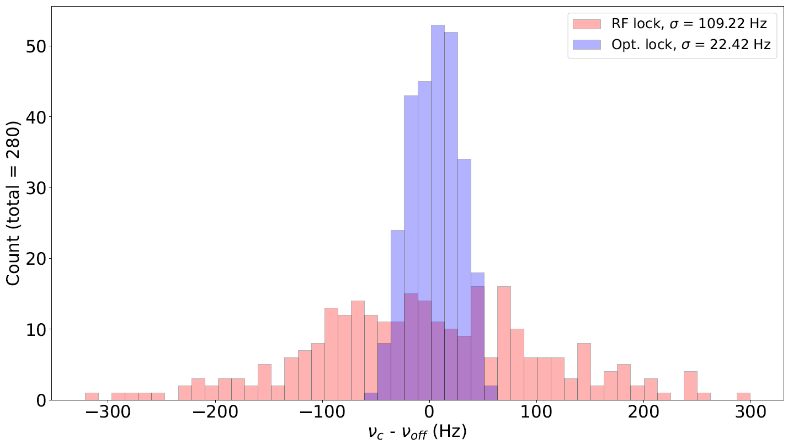
RF / optical lock of the comb
Summary
Hydrogen molecular ions and fundamental constants
SI-referenced spectrometer few 10⁻¹³ resolution
HCOOH spectroscopy
  Pressure self-broadening coefficient
  N₂ and air broadening coefficient to come soon
Experimental parameters
- Modulation freq. = 700 Hz
- Modulation depth = 42 kHz
- Pressure = 1.0 µbar
- Power = 1.0 V (1.44 mW)
140 scans/day during 4 days
Alternating RF/Optical lock
every 10 scans
Perspectives
H₂⁺ : quantum logic spectroscopy
Ultiµos project Benoît Darquié (LPL), Christophe Janssen (MONARIS), LKB
High resolution spectroscopy in NH₃ and CH₃OH
MIR transitions
ν₁
ν₂
ν_{MW} = ν₁−ν₂
to be compared with astrophysics observations

Slide 39
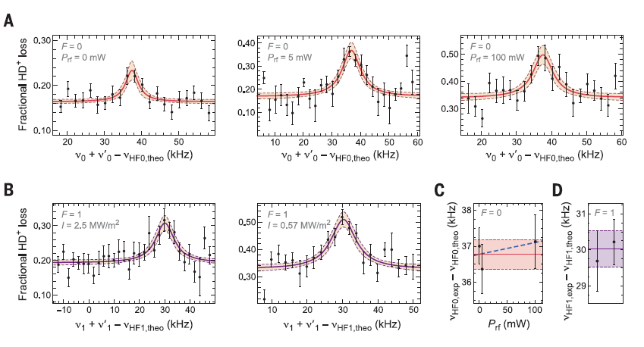
Molecular quantum logic spectroscopy
Motivations
REMPD spectroscopy is destructive
Very long aquisition time
Rather low signal to noise ratio
HD⁺ lines (Amsterdam)
Search for Fundamental constant time variation
Can one do better and reach 10^{-16…-17} inacurracies?

Slide 40
Molecular quantum logic spectroscopy
QLS quesaco?
Break-through with the Be⁺/Al⁺ ion clock at NIST, Piet Schmidt, Science 309, 749 (2005)
Ion optical clock
Highly charged ion spectroscopy Ar¹³⁺
QLS with molecular ions MgH⁺, CaH⁺ and hydrogen molecular ions

Slide 41
Molecular quantum logic spectroscopy
The quantum systems
2P
313 nm
|L↑> = |2S, F=2, m_{F}=2>
|L↓> = |2S, F=1, m_{F}=1>
2S F=2
Logic ion
Be⁺ hyperfine Qbit
Se = ½ I = 3/2
1.25 GHz
2S F=1

Slide 42
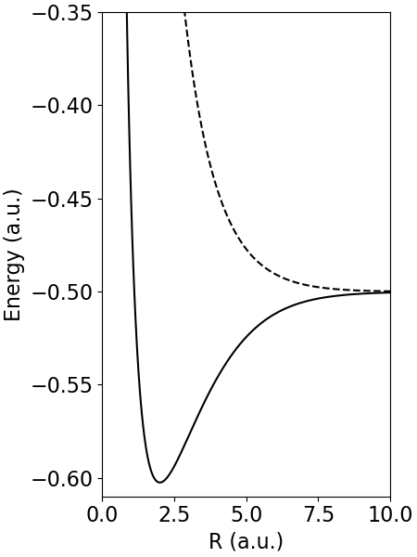
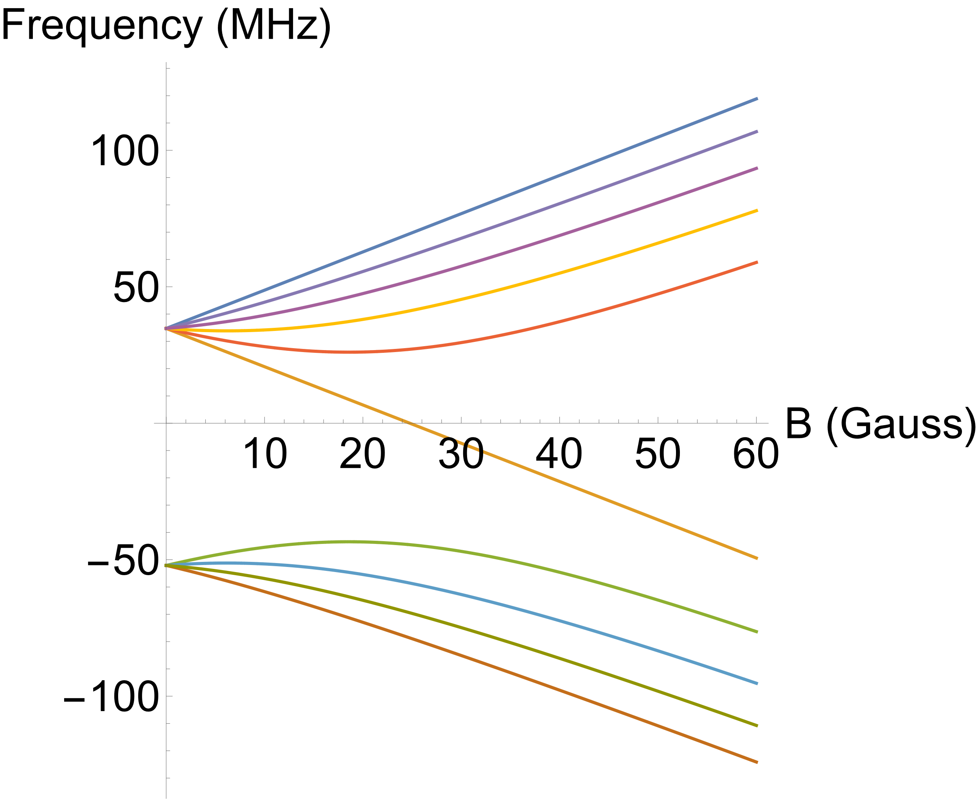
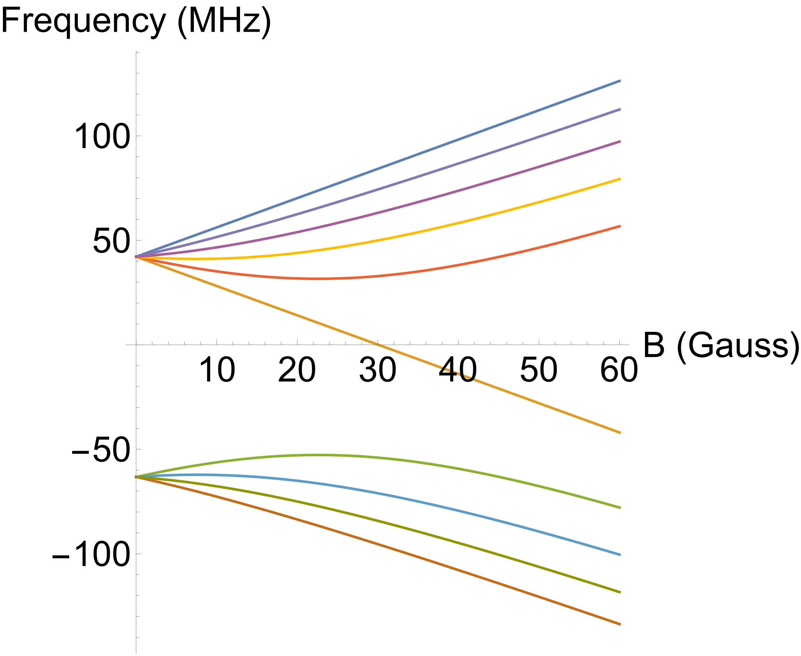
The quantum systems
Spectroscopic ion
I = 0 (L even)
I = 1 (L odd)
S = ½
F = I+S
J = F+L
Signature transition
L=3
|S↑>
J=5/2
L=2
86.8 MHz
L=1
L=0
J=3/2
1620.9 nm
6169 cm⁻¹
L=3
v=3
|S↓>
J=5/2
v=0
L=2
105.4 MHz
L=1
L=0
J=3/2
vibration
rotation
hyperfine
Zeeman

Slide 43
Molecular quantum logic spectroscopy
The quantum system Be⁺ / H₂⁺ ion pair
Motional coupling
Trapping potential
+ Coulomb interaction → coupled harmonic oscillators
→ 6 entangled eigen modes
Trap axis (z)
Logic ion
Spectroscopic ion
z axis out of phase mode
|n>
Quantum system
|L>
|S>
|n>

Slide 44
Molecular quantum logic spectroscopy
QLS tool box
Red sideband, carrier, blue sideband transitions
QLS protocol

